Slide 1
VCIC
Info Session
Fall 2017
Your School or Club Logo Here

Slide 2
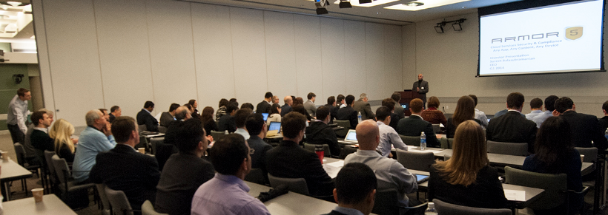
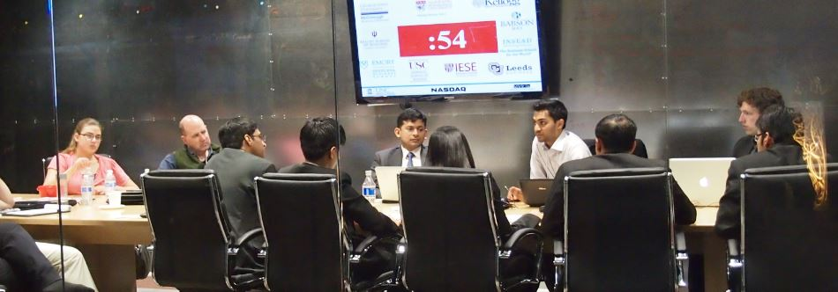
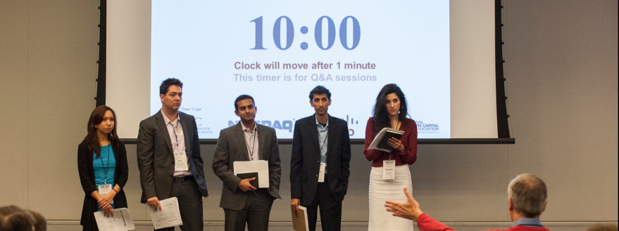
What is VCIC?
Students + Startups + VCs = VCIC
Venture Capital Investment Competition
You play the VCs
Real startups pitch to you
You invest in one startup
VCs judge your performance
Started in 1998 at UNC Kenan-Flagler

Slide 3
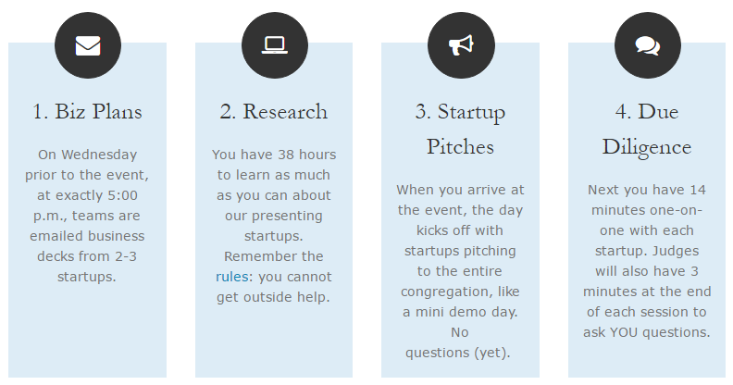
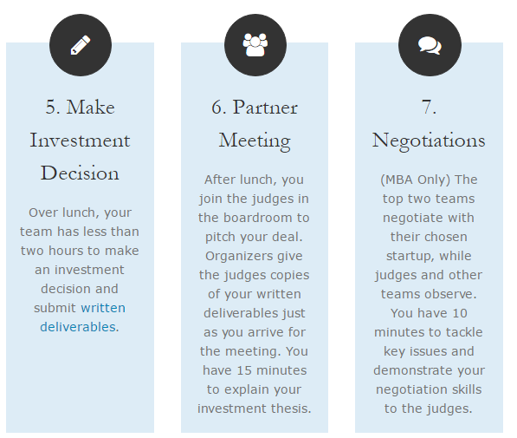
What it’s Like for Students
Wed. 5pm
Wed/Thu
Fri. 9am
10am
Noon
1:30
3:45
Click here for 2-minute video
www.vcic.org/students/

Slide 4
Schedule Walk-Through
9:00 | Startup pitches
10:00 | Due diligence (14 minutes + 3 minutes)
11:30 | Working lunch
1:00 | Written deliverables begin
1:30 | Partner meetings begin (15 minutes each)
3:30 | Judges vote
3:45 | Negotiations, top 2 teams (10 minutes each)
4:30 | Awards ceremony & round robin feedback

Slide 5
Judging Criteria
Due Diligence (20 pts)
Investment (20 pts)
Partner Meeting (20 pts)
Learned what they needed to know? Covered key questions? Dug into key issues?
Demonstrated deep understanding of the business opportunity?
Lead/controlled the meeting?
Established appropriate rapport and demonstrated value as a VC firm?
Reasons to invest
Reasons not to invest
Overall decision
Valuation, Investment Size, Fund Fit
Other terms (MBA only): Dividends, Board Structure, Liquidation Preference, Anti-dilution, Dates and Other Terms
Demonstrated deep VC knowledge, terms, exit strategy, return potential, fund fit, etc.
Adequately explained deal
Handled questions/coaching
Confident and convincing
All members contributed
Negotiations Top 6 Teams
Focused on the key issues
Tackled tough issues
Established positive rapport
Demonstrated firm's value
Note: teams are not judged on “getting to a deal”

Slide 6
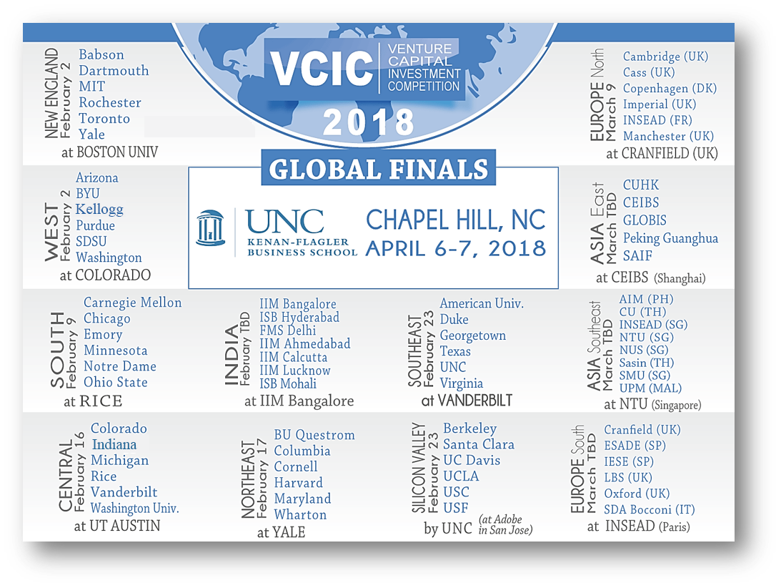
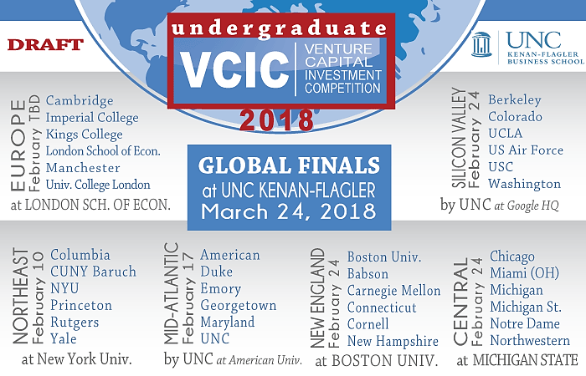
MBA Events
Undergraduate Events
DRAFT

Slide 7
MBA Events
78 schools
50 events
13 countries
3 continents
1,250 Students
175 VCs
125 Startups
Undergraduate Events
DRAFT

Slide 8
Hall of Global Champions
2017 | 2016 | 2015 | 2014 | 2013
2012 | 2011 | 2010 | 2009 | 2008
2007 | 2006 | 2005 | 2004 | 2003
2002 | 2001 | 2000 | 1999 | 1998 .

Slide 9
Why Get Involved with VCIC?
Learn about entrepreneurship and how new technologies come to market.
VC and Startups
High Tech
Tech-Driven
Notes:
Any student interested in entrepreneurship should learn how VCs think. Those going into high tech or into any corporate job highly influenced by technology should understand how venture capital works. You will be using solutions developed by venture-backed startups. You might even be acquiring venture-backed companies.

Slide 10
What makes a great team?
Interpersonal/communication skills
Tech domain expertise
Finance background?*
Diversity of…
Domain expertise (across a variety of tech industries)
Business skills
Demography
*Finance students sometimes have the hardest time adjusting to the VC mindset.

Slide 11
Recommended Resources
VCIC Training Videos
www.vcic.org/students/videos
Also…
Daily email
Dan Primack’s “Pro Rata”
VC blogs / Twitter
Marc Andreessen
Brad Feld
Fred Wilson

Slide 12
2017/18 VCIC: Round One Schedule
10/16 Introductory Meeting
10/20 Deadline for Team Applications
10/23 First Round Teams Announced
11/16 First Round Competition (12:00-7:00pm)
11/17 Finalists Announced

Slide 13
2017/18 VCIC: Round Two Schedule
11/28 Workshop (12:15-1:15pm)
1/10 Workshop (3:30-4:30pm)
1/17 Optional Workshop (9:30-10:30am)
1/18 Final Competition: CEO Presentations (5:15-7:15pm)
1/19 Final Competition: Partners Meetings (12:00-1:30pm)
1/20 Final Team Announced
2/2 VCIC Competition: Boulder, Colorado

Slide 14
Last Year’s Experience… Ryan McGovern

