Slide 1
Structural Variations
Interactions
When the effect of one explanatory variable on the dependent variable depends on the value of another explanatory variable
The “trick”: Introduce the product of the two as a new artificial explanatory variable. Example (Session 2)
Nonlinearities
When the impact of an explanatory variable on the dependent variable “bends”
The “trick”: Introduce the square of that variable as a new artificial explanatory variable. Example (Session 3)

Slide 2
Interactions: Summary
When the effect (i.e., the coefficient) of one explanatory variable on the dependent variable depends on the value of another explanatory variable
Signaled only by judgment
The “trick”: Introduce the product of the two as a new artificial explanatory variable. After the regression, interpret in the original “conceptual” model.
For example, Cost = a + (b₁+b₂⋅Age)⋅Mileage + … (rest of model)
The latter explanatory variable (in the example, Age) might or might not remain in the model
Cost: We lose a meaningful interpretation of the beta-weights

Slide 3
Nonlinearity: Summary
When the direct relationship between an explanatory variable and the dependent variable “bends”
Signaled by a “U” in a plot of the residuals against an explanatory variable
The “trick”: Introduce the square of that variable as a new artificial explanatory variable: Y = a + bX + cX² + … (rest of model)
One trick can capture 6 different nonlinear “shapes”
Always keep the original variable (the linear term, with coefficient “b”, allows the parabola to take any horizontal position)
c (positive = upward-bending parabola, negative = downward-bending)
-b/(2c) indicates where the vertex (either maximum or minimum) of the parabola occurs
Cost: We lose a meaningful interpretation of the beta-weights

Slide 4
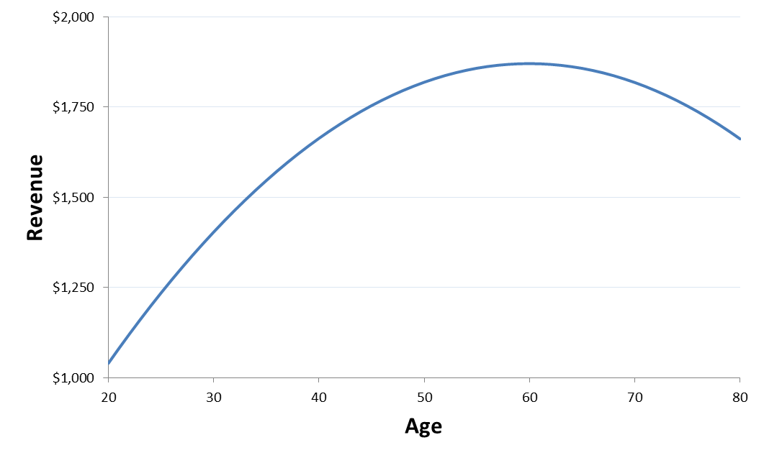
Examples from the Sample Exams
Caligula’s Castle:
Regression: Revenue
 | constant | Age | Age² | Sex | Direct | Indirect | Sex⋅Ind
coefficient | -1224.84 | 62.37502 | -0.5201 | -121.899 | 1.992615 | 0.85276 | 1.43767
Revenue_{pred} = -1224.82 + 62.37⋅Age – 0.5201⋅Age² – 121.9⋅Sex + 1.99⋅Direct + (0.8527+1.4377⋅Sex)⋅Indirect
revenue / $ incentive | direct | indirect
Men (Sex=0) | $1.99 | $0.85
Women (Sex=1) | $1.99 | $2.29
Give direct incentives (house chips, etc.) to men
Give indirect incentives (flowers, meals) to women
The Age effect on Revenue is greatest at
Age = -(62.37)/(2(-0.5201)) = 59.96 years

Slide 5
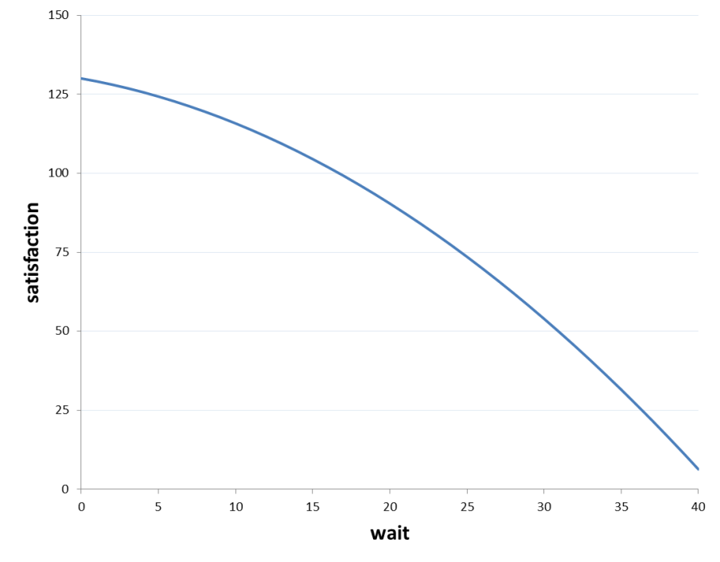
Examples from the Sample Exams
Hans and Franz:
Regression: CustSat
 | constant | Wait | Wait² | Size | Franz? | Size⋅Franz?
coefficient | 84.4016931 | -0.8666595 | -0.0556165 | -5.6022949 | -40.084506 | 8.77474654
CustSat_{pred} = 84.40 – 0.8667⋅Wait – 0.0556⋅Wait² – 5.602⋅Size + (-40.0845+8.7747⋅Size)⋅Franz?
Set Franz? = 0 (assign Hans) when the party size is < 40.0845/8.7747 = 4.568
Customers’ anger grows more quickly the longer they wait: c < 0, and
b = -(-0.8667)/(2⋅(-0.0556)) = -7.794
(i.e., in negative territory).

