Slide 1
Correlation
... beware

Slide 2
Definition
Var(X+Y) = Var(X) + Var(Y) + 2·Cov(X,Y)
The correlation between two random variables is a dimensionless number between 1 and -1.

Slide 3
Interpretation
Correlation measures the strength of the linear relationship between two variables.
Strength
  not the slope
Linear
  misses nonlinearities completely
Two
  shows only “shadows” of multidimensional relationships

Slide 4
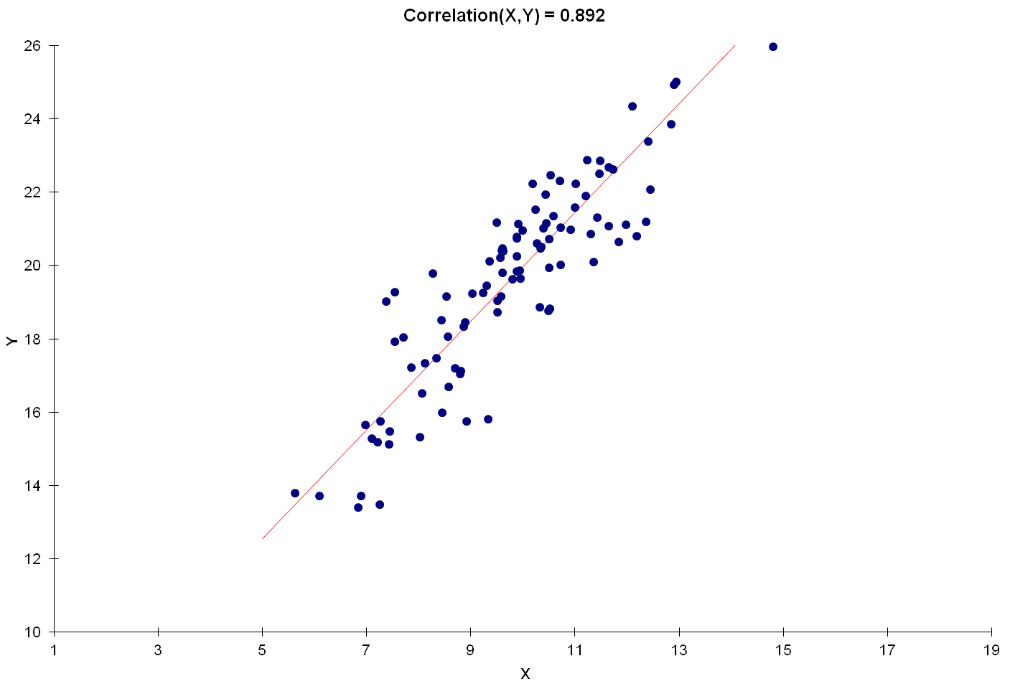
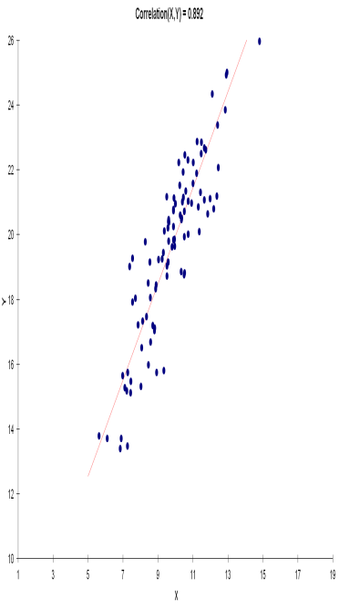

A correlation of +1 would arise only if all of the points lined up perfectly.
Stretching the diagram horizontally or vertically would change the perceived slope, but not the correlation.

Slide 5
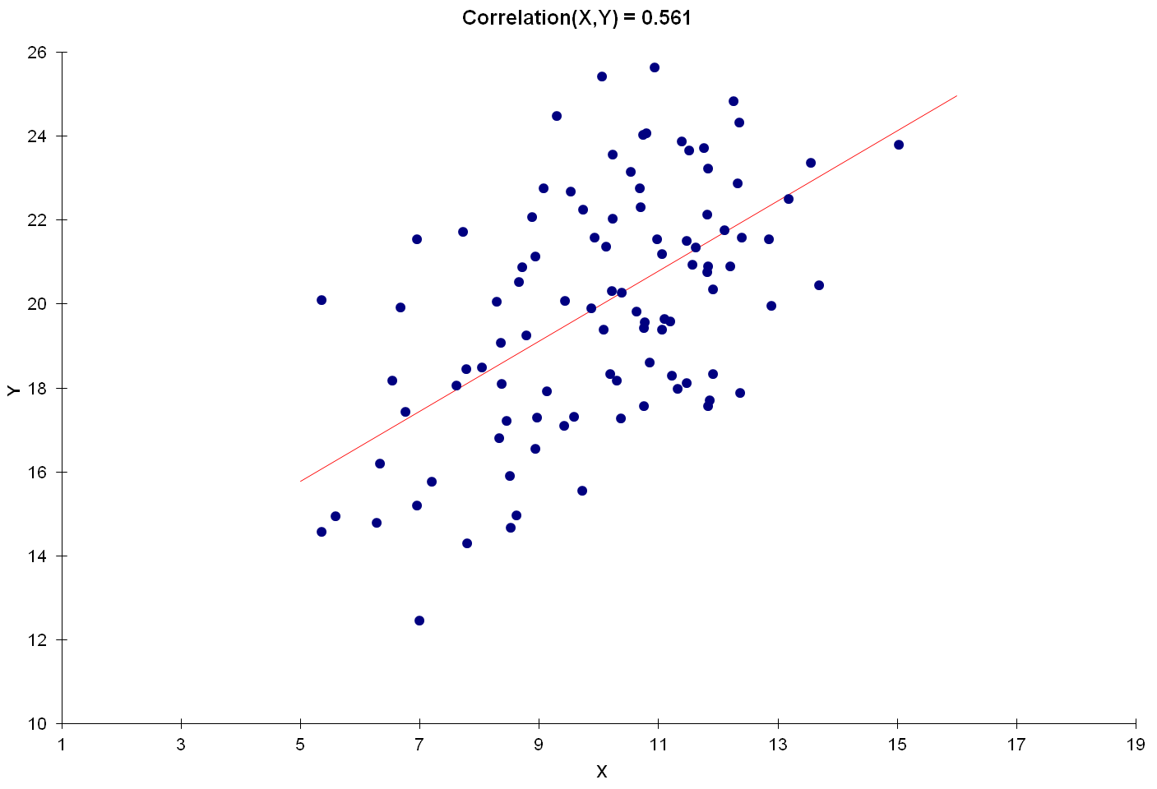
A positive correlation signals that large values of one variable are typically associated with large values of the other.
Correlation measures the “tightness” of the clustering about a single line.

Slide 6
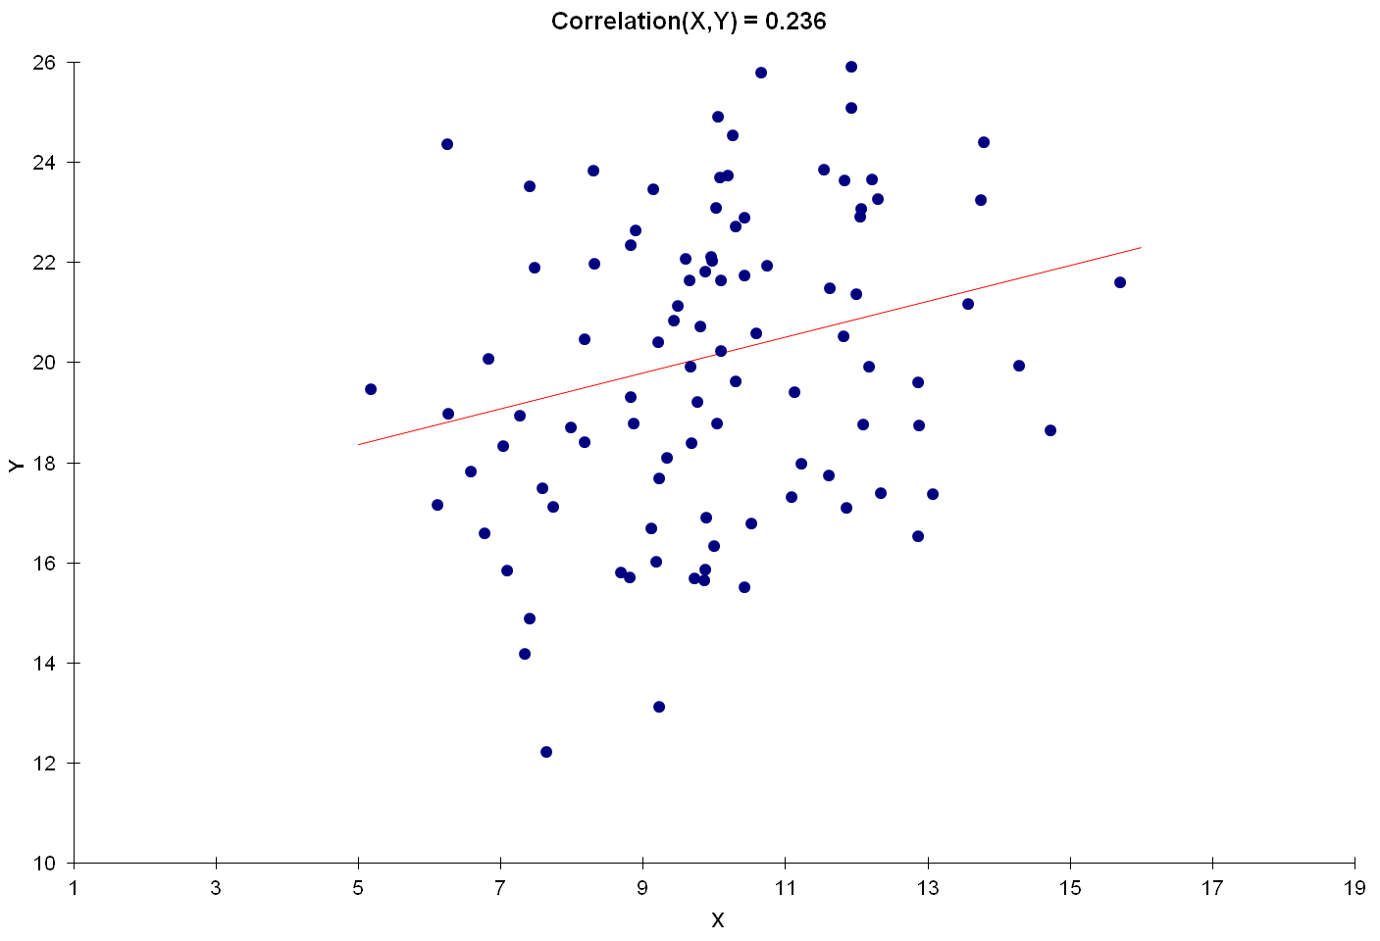

Slide 7
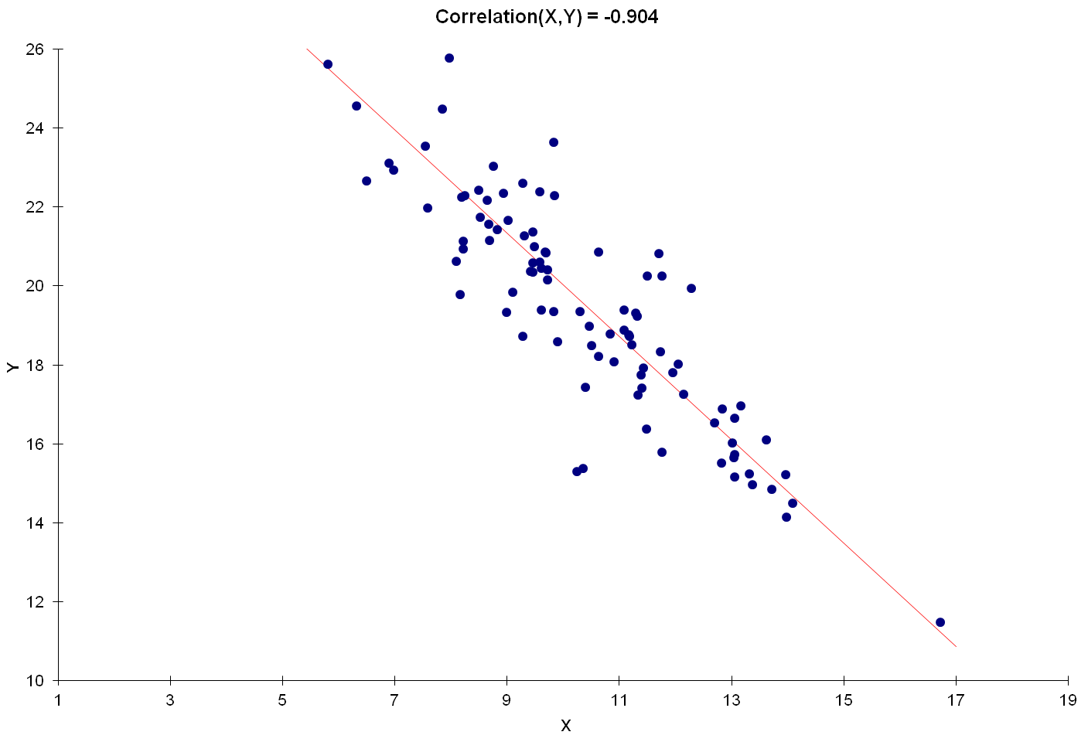
A negative correlation signals that large values of one variable are typically associated with small values of the other.

Slide 8
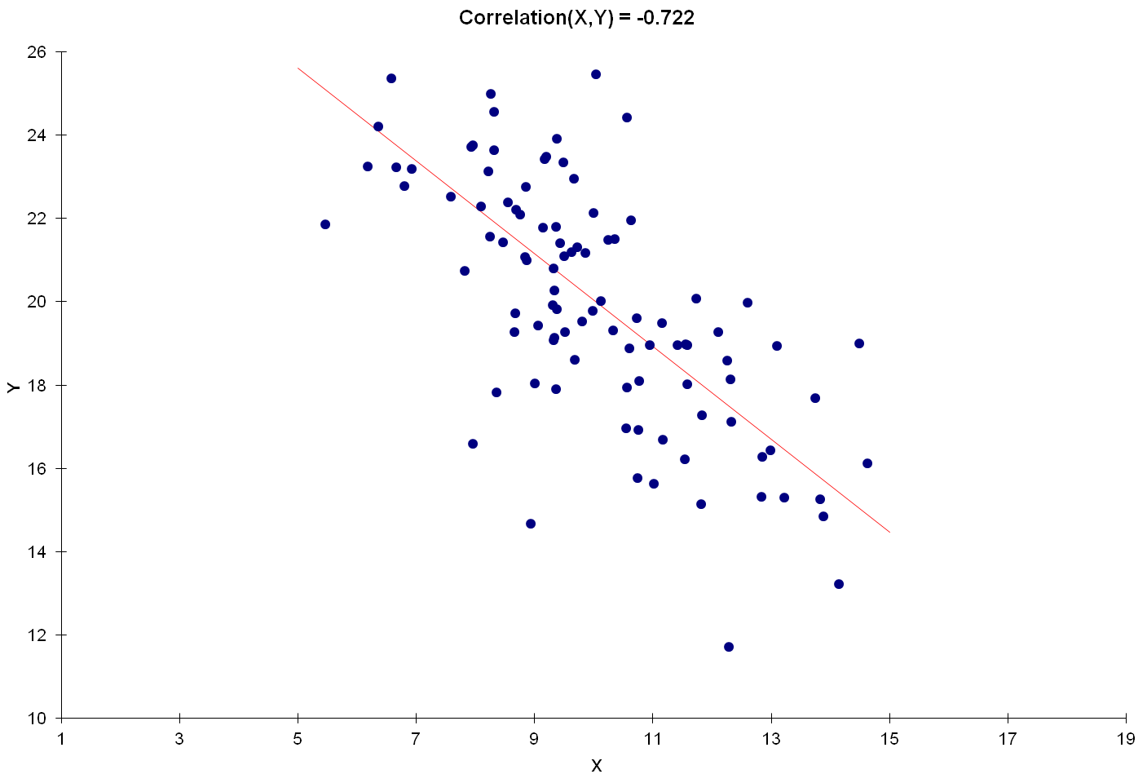

Slide 9
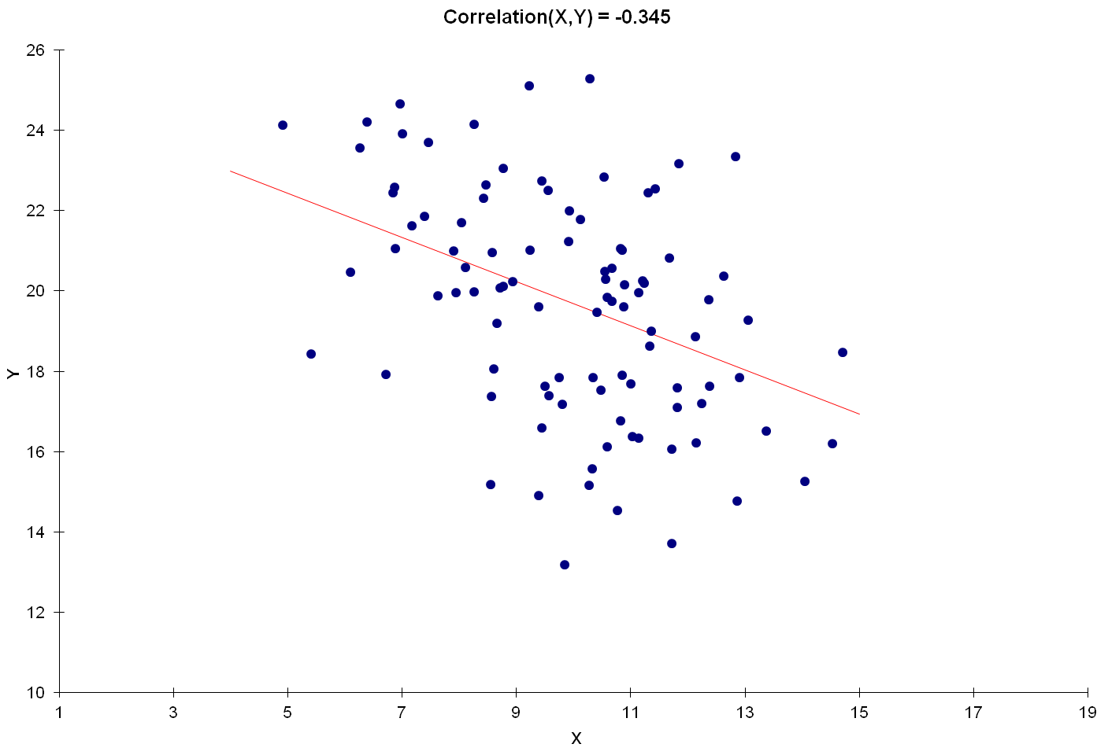

Slide 10
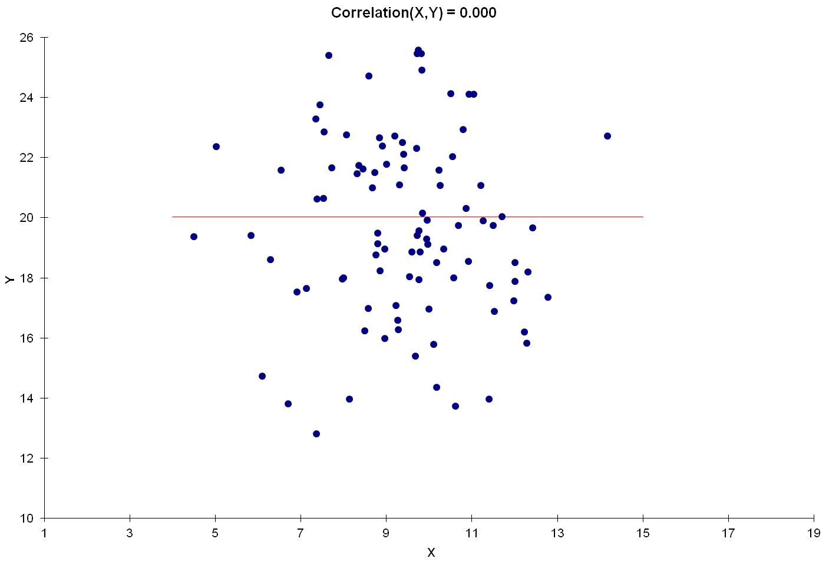
Independent random variables have a correlation of 0.

Slide 11
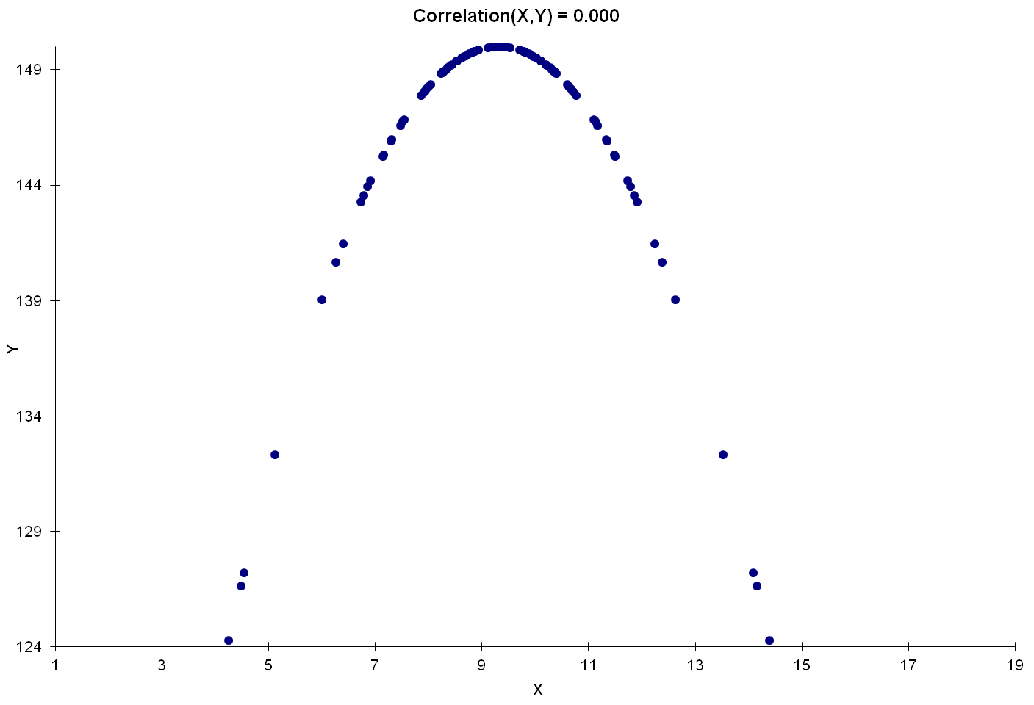
But a correlation of 0 most certainly does not imply independence.
Indeed, correlations can completely miss nonlinear relationships.

Slide 12
Correlations Show (only)
Two-Dimensional Shadows
In the motorpool case, the correlations between Age and Cost, and between Make and Cost, show precisely what the manager’s two-dimensional tables showed:
There’s little linkage directly between Age and Cost.
Fords had higher average costs than did Hondas.
But each of these facts is due to the confounding effect of Mileage!
The pure effect of each variable on its own is only revealed in the most-complete model.
 | Costs | Mileage | Age | Make
Costs | 1.000 | 0.771 | 0.023 | -0.240
Mileage | 0.771 | 1.000 | -0.496 | -0.478
Age | 0.023 | -0.496 | 1.000 | 0.164
Make | -0.240 | -0.478 | 0.164 | 1.000

Slide 13
Tilting at Shadows
(received via email from a former student, all employer references removed)
“One of the pieces of the research is to identify key attributes that drive customers to choose a vendor for buying office products.
“The market research guy that we have hired (he is an MBA/PhD from Wharton) says the following:
“‘I can determine the relative importance of various attributes that drive overall satisfaction by running a correlation of each one of them against overall satisfaction score and then ranking them based on the (correlation) coefficient scores.’
“I am not really certain if we can do that. I would tend to think we should run a regression to get relative weightage.”

Slide 14
Customer Satisfaction
Consider overall customer satisfaction (on a 100-point scale) with a Web-based provider of customized software as the order leadtime (in days), product acquisition cost, and availability of online order-tracking (0 = not available, 1 = available) vary.
Here are the correlations:
Customers forced to wait are unhappy.
Those without access to online order tracking are more satisfied.
Those who pay more are somewhat happier.
?????
Correlations with Satisfaction
leadtime | -0.766
ol-tracking | -0.242
cost | 0.097

Slide 15
The Full Regression
Regression: satisfaction | constant | leadtime | cost | ol-track
coefficient | 192.7338 | -6.8856 | -1.8025 | 8.5599
std error of coef | 16.1643 | 0.5535 | 0.3137 | 4.0729
t-ratio | 11.9234 | -12.4391 | -5.7453 | 2.1017
significance | 0.0000% | 0.0000% | 0.0000% | 4.0092%
beta-weight |  | -1.0879 | -0.4571 | 0.1586
standard error of regression |  | 13.9292
coefficient of determination |  | 75.03%
adjusted coef of determination |  | 73.70%
Customers dislike high cost, and like online order tracking.
Why does customer satisfaction vary? Primarily because leadtimes vary; secondarily, because cost varies.

Slide 16
Reconciliation
 | satisfaction | leadtime | cost | ol-tracking
satisfaction | 1.000 | -0.766 | -0.097 | -0.242
leadtime | -0.766 | 1.000 | -0.543 | 0.465
cost | -0.097 | -0.543 | 1.000 | -0.230
ol-tracking | -0.242 | 0.465 | -0.230 | 1.000
Customers can pay extra for expedited service (shorter leadtime at moderate extra cost), or for express service (shortest leadtime at highest cost)
  Those who chose to save money and wait longer ended up (slightly) regretting their choice.
Most customers who chose rapid service weren’t given access to order tracking.
  They didn’t need it, and were still happy with their fast deliveries.

Slide 17
Finally …
  The correlations between the explanatory variables can help flesh out the “story.”
  In a “simple” (i.e., one explanatory variable) regression:
  The (meaningless) beta-weight is the correlation between the two variables.
  The square of the correlation is the unadjusted coefficient of determination (r-squared).
    If you give me a correlation, I’ll interpret it by squaring it and looking at it as a coefficient of determination.

Slide 18
A Pharmaceutical Ad
Diagnostic scores from sample of patients receiving psychiatric care
So, if your patients have anxiety problems, consider prescribing our antidepressant!

Slide 19
Evaluation
At most 49% of the variability in patients’ anxiety levels can potentially be explained by variability in depression levels.
  “potentially” = might actually be explained by something else which covaries with both.
The regression provides no evidence that changing a patient’s depression level will cause a change in their anxiety level.

Slide 20
Association vs. Causality
Polio and Ice Cream
Regression (and correlation) deal only with association
  Example: Greater values for annual mileage are typically associated with higher annual maintenance costs.
  No matter how “good” the regression statistics look, they will not make the case that greater mileage causes greater costs.
  If you believe that driving more during the year causes higher costs, then it’s fine to use regression to estimate the size of the causal effect.
Evidence supporting causality comes only from controlled experimentation.
  This is why macroeconomists continue to argue about which aspects of public policy are the key drivers of economic growth.
  It’s also why the cigarette companies won all the lawsuits filed against them for several decades.

