Slide 1
DECS-431
… is focused on a single statistical tool for studying relationships:
  Regression Analysis
That said, we won’t use that tool in this course.
First, we need to be comfortable with the two “languages” of statistics
  The language of estimation (“trust”)
  The language of hypothesis testing (“evidence”)

Slide 2
First Part of Class
An overview of statistics
  What is statistics?
  Why is it done?
  How is it done?
  What is the fundamental idea behind all of it?
The language of estimation
Who cares?
Two technical issues, one of which can’t be avoided

Slide 3
What is “Statistics”?
Statistics is focused on making inferences about a group of individuals (the population of interest) using only data collected from a subgroup (the sample).
Why might we do this?
Perhaps …
the population is large, and looking at all individuals would be too costly or too time-consuming
taking individual measurements is destructive
some members of the population aren’t available for direct observation

Slide 4
Managers aren’t Paid to be Historians
Their concern is how their decisions will play out in the future.
Still, if the near-term future can be expected to be similar to the recent past, then the past can be viewed as a sample from a larger population consisting of both the recent past and the soon-to-come future.
The sample gives us insight into the population as a whole, and therefore into whatever the future holds in store.
Indeed, even if you stand in the middle of turbulent times, data from past similarly turbulent times may help you find the best path forward.

Slide 5
How is Statistics Done?
Any statistical study consists of three specifications:
How will the data be collected?
How much data will be collected in this way?
What will be computed from the data?
Running example: Estimating the average age across a population, in preparation for a sales pitch.

Slide 6
1. How Will the Data be Collected?
Primary Goals: No bias High precision Low cost
Simple random sampling with replacement
  Typically implemented via systematic sampling
Simple random sampling without replacement
  Typically done if a population list is available
  Covered in next class
Stratified sampling
  Done if the population consists of subgroups with substantial within-group homogeneity
Cluster sampling
  Done if the population consists of (typically geographic) subgroups with substantial within-group heterogeneity
Specialized approaches

Slide 7
2. How is the Sample Size Chosen?
In order to yield the desired (target) precision (to be made clearer in next class)
simple random sampling with replacement
sample size of 5

Slide 8
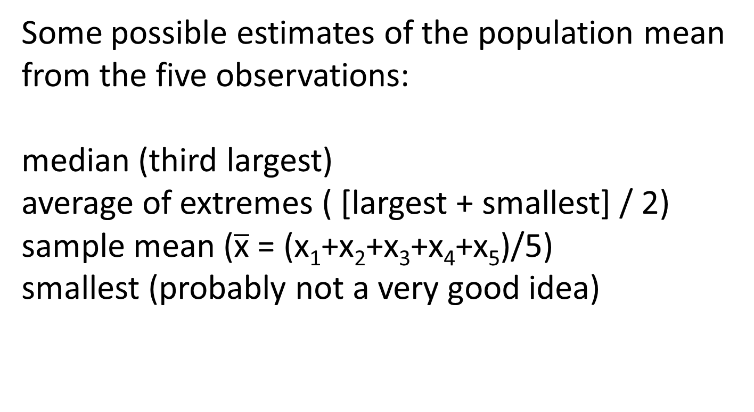
3. What Will be Done with the Data?
Some possible estimates of the population mean from the five observations:
median (third largest)
average of extremes ( [largest + smallest] / 2)
sample mean ($\overline{\text{x}}$ = (x₁+x₂+x₃+x₄+x₅)/5)
smallest (probably not a very good idea)

Slide 9
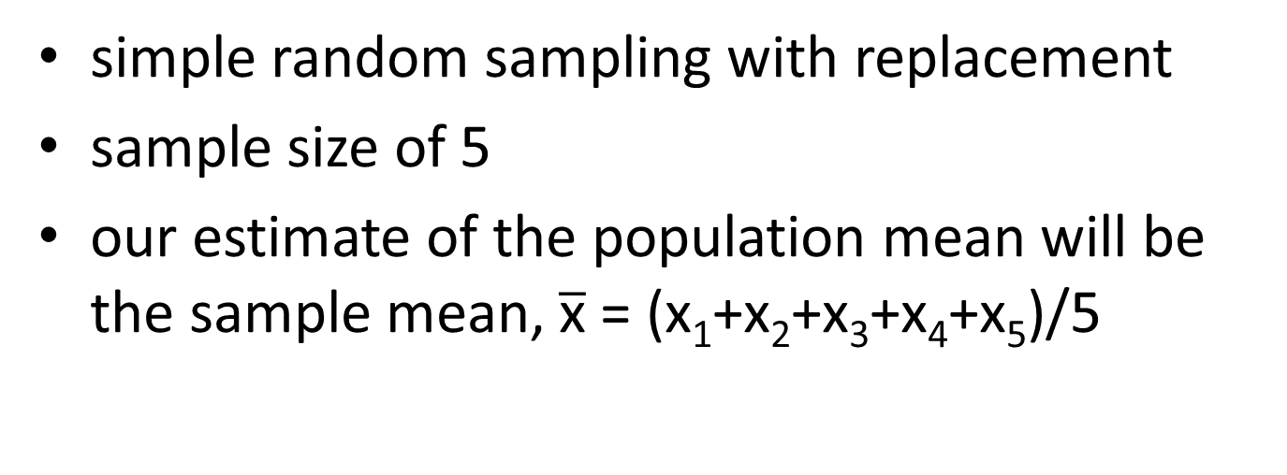
We’ve Finally Chosen an Estimation Procedure!
simple random sampling with replacement
sample size of 5
our estimate of the population mean will be the sample mean, $\overline{\text{x}}$ = (x₁+x₂+x₃+x₄+x₅)/5
This will certainly give us an estimate.
But how much can we trust that estimate???

Slide 10
The Fundamental Idea underlying All of Statistics
At the moment I decide how I’m going to make an estimate, if I look into the future, the (not yet determined) end result of my chosen estimation procedure looks like a random variable.
Using the tools of probability, I can analyze this random variable to see how precise my ultimate (after the procedure is carried out) estimate is likely to be.

Slide 11
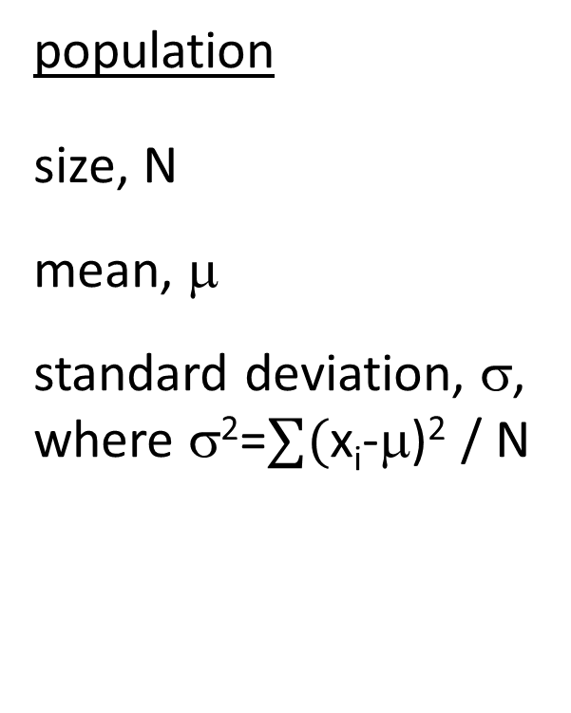
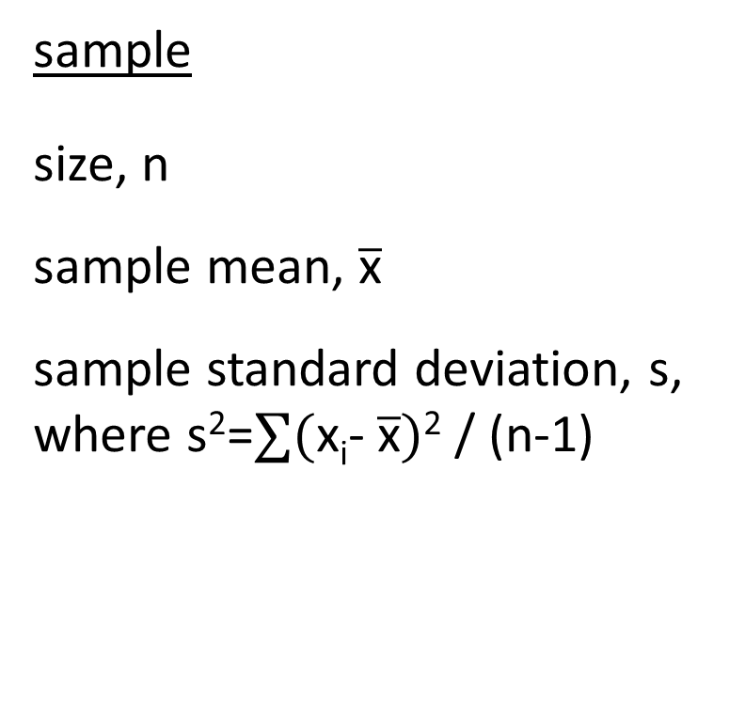
Some Notation
population
size, N
mean, μ
standard deviation, σ,
where σ²=$∑($x_{i}-μ)² / N
sample
size, n
sample mean, $\overline{\text{x}}$
sample standard deviation, s, where s²=$∑($x_{i}- $\overline{\text{x}})$² / (n-1)

Slide 12
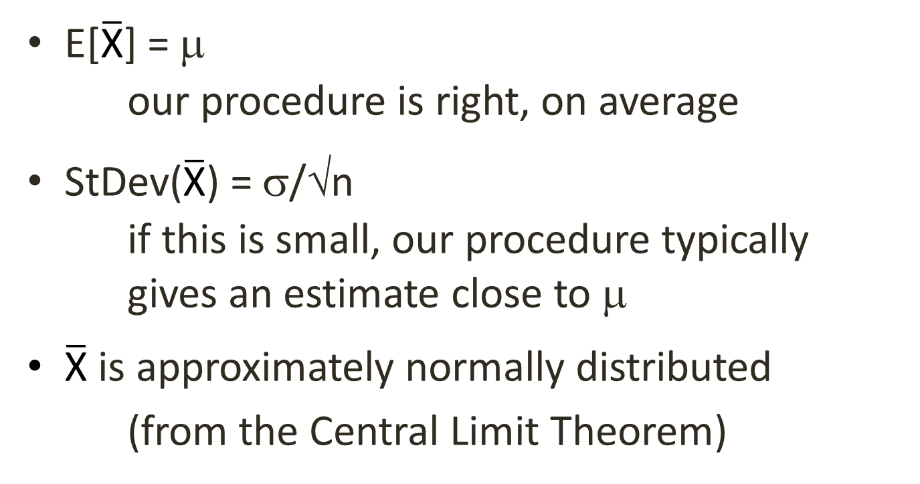
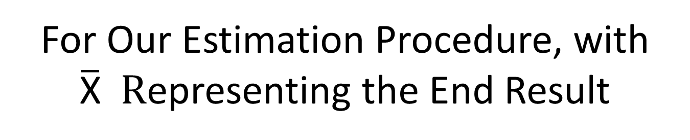
For Our Estimation Procedure, with $\overline{\text{X}} R$epresenting the End Result
E[$\overline{\text{X}}$] = μ
our procedure is right, on average
StDev($\overline{\text{X}}$) = σ/√n
if this is small, our procedure typically gives an estimate close to μ
$\overline{\text{X}}$ is approximately normally distributed
  (from the Central Limit Theorem)

Slide 13
Pulling This All Together, Here’s the “Language” of Estimation
“I conducted a study to estimate {something} about {some population}. My estimate is {some value}. The way I went about making this estimate, I had {a large chance} of ending up with an estimate within {some small amount} of the truth.”
For example, “I conducted a study to estimate the mean amount spent on furniture over the past year by current subscribers to our magazine. My estimate is $530. The way I went about making this estimate, I had a 95% chance of ending up with an estimate within $36 of the truth.”

Slide 14
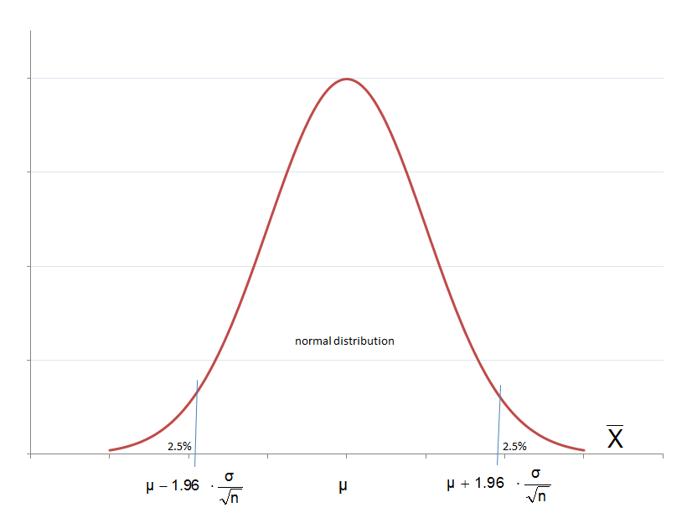
Pictorially

Slide 15
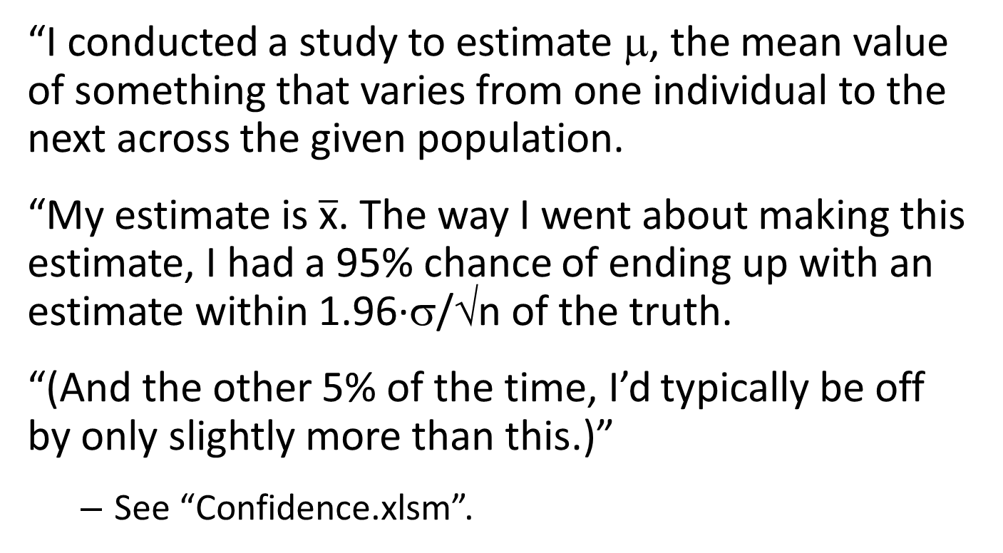
For Simple Random Sampling with Replacement
“I conducted a study to estimate $$, the mean value of something that varies from one individual to the next across the given population.
“My estimate is $\overline{\text{x}}$. The way I went about making this estimate, I had a 95% chance of ending up with an estimate within 1.96·σ/√n of the truth.
“(And the other 5% of the time, I’d typically be off by only slightly more than this.)”
  See “Confidence.xlsm”.

Slide 16
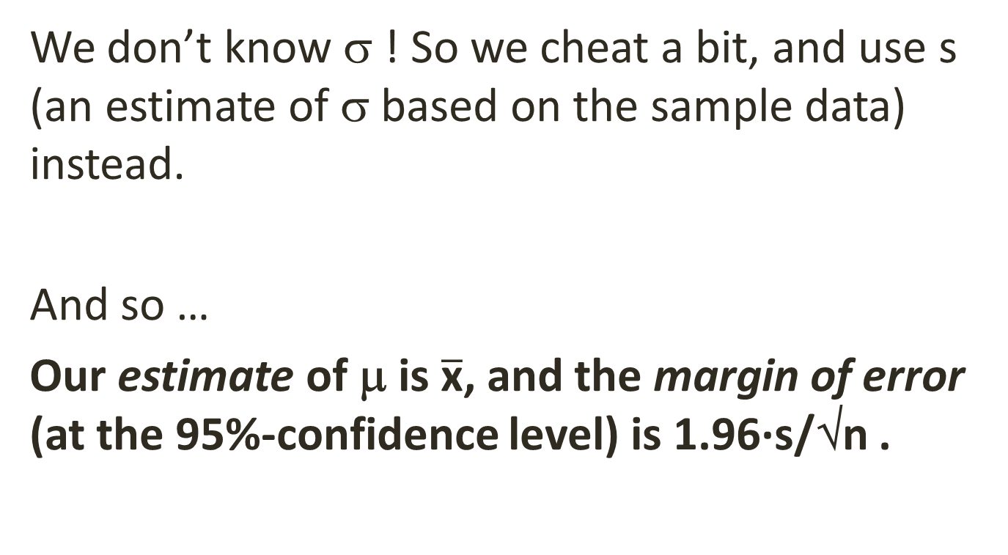
There’s Only One Problem …
We don’t know σ ! So we cheat a bit, and use s (an estimate of σ based on the sample data) instead.
And so …
Our estimate of μ is $\overline{\text{x}}$, and the margin of error (at the 95%-confidence level) is 1.96·s/√n .

Slide 17
And That’s It!
We can afford to standardize our language of "trust" around the notion of 95% confidence, because translations to other levels of confidence are simple. The following statements are totally synonymous:
I'm 90%-confident that my estimate is wrong by no more than $29.61. (~1.64)·s/√n
I'm 95%-confident that my estimate is wrong by no more than $35.28. (~1.96)·s/√n
I'm 99%-confident that my estimate is wrong by no more than $46.36. (~2.58)·s/√n

Slide 18
Next
Why should a manager want to know the margin of error in an estimate?
Some necessary technical details
(after break) The language of hypothesis testing (evaluating evidence: to what extent does data support or contradict a statement?)
(next week) Polling (estimating the fraction of the population with some qualitative property)

Slide 19
The Language of Estimation (for Simple Random Sampling with Replacement)
the standard error of the mean (one standard-deviation’s-worth of exposure to error when estimating the population mean)
the margin of error (implied, unless otherwise explicitly stated: at the 95%-confidence level) when the sample mean is used as an estimate of the population mean
a 95%-confidence interval for the population mean μ

Slide 20
Advertising Sales
A magazine publishing house wishes to estimate (for purposes of advertising sales) the average annual expenditure on furniture among its subscribers.
A sample of 100 subscribers is chosen at random from the 100,000-person subscription list, and each sampled subscriber is questioned about their furniture purchases over the last year. The sample mean response is $530, with a sample standard deviation of $180.
To whom, and where, is the $36 margin of error of relevance?

Slide 21
Put Yourself in the Shoes of the Marketing Manager at a Furniture Company
Part of your job is to track the performance of current ad placements. Each month …
You apportion sales across all the placements.
You divide sales by placement costs.
You rank the placements by “bang per buck.”
The lowest ranked placement is at the top of your replacement list, and its ratio determines the hurdle a new opportunity must clear to replace it.

Slide 22
Keep Yourself in the Shoes of the Marketing Manager at the Furniture Company
Another part of your job is to learn the relationship between properties of specific ad placements, and the performance of those placements.
You do this using regression analysis, with the characteristics of, and return on, previous placements as your sample data.
Given the characteristics of a new opportunity (e.g., number of subscribers to a magazine, and how much the average subscriber spends on furniture in a year), you can predict the likely return on your advertising dollar if you take advantage of this opportunity.

Slide 23
One Day, the Advertising Sales Representative for a Magazine Drops By
S/he wants you to buy space in this magazine.
You ask (among other things), “What’s the average amount your subscribers spend on furniture per year?”
S/he says, “ $530 ± $36 ”
You put $530 (and other relevant information) into your regression model … and it predicts a return greater than your current hurdle rate!
Do you jump onboard?

Slide 24
What If the $530 is an Over-Estimate or an Under-Estimate?
The predicted bang-per-buck could actually be worse than your hurdle rate!
There are many ways to do a risk analysis, and you’ll discuss them throughout the program. They all require that you know something about the uncertainty in numbers you’re using.
At the very least, you can put $494 and $566 into your prediction model, and see what you would predict in those cases.
[More generally, (margin-of-error/1.96) is one standard-deviation’s-worth of “noise” in the estimate. This can be used in more sophisticated analyses.]

Slide 25
Sometimes It’s Right to Say “Maybe”
If the prediction looks good at both extremes, you can be relatively confident that this is a good opportunity.
If it looks meaningfully bad at either extreme, you delay your decision:
“Gee! This sounds interesting, but your numbers are a bit too fuzzy for me to make a decision. Please go back and collect some more data. If the estimate stands up, and the margin of error can be brought down, I might be able to say “Yes.””

Slide 26
Practical Issues
If it looks good, either now or on a second visit, be sure to get details on the estimation study in writing as part of your deal. (Then you can sue for fraud if you learn the rep was lying.)
The risk analysis I’ve described is quite simplistic. You can (and will learn to) do better. But you’ll need the margin of error for any approach.

Slide 27
General Discussion
How would our answer ($530 ± $36) change, if there were 400,000 subscribers (instead of 100,000)?
It wouldn’t change at all! “N” doesn’t appear in our formulas.
The precision of our estimate depends on the sample size, but NOT on the size of the population being studied.
This is WONDERFUL!!!

Slide 28
(Continued)
What if there had been only 4,000 subscribers?
Still no change.
What if there had been only 100 subscribers?
Still no change.
But wait!
Ahhh!! … Everything we’ve said so far, and the formulas we’ve derived, are for an estimation procedure involving simple random sampling with replacement.

Slide 29
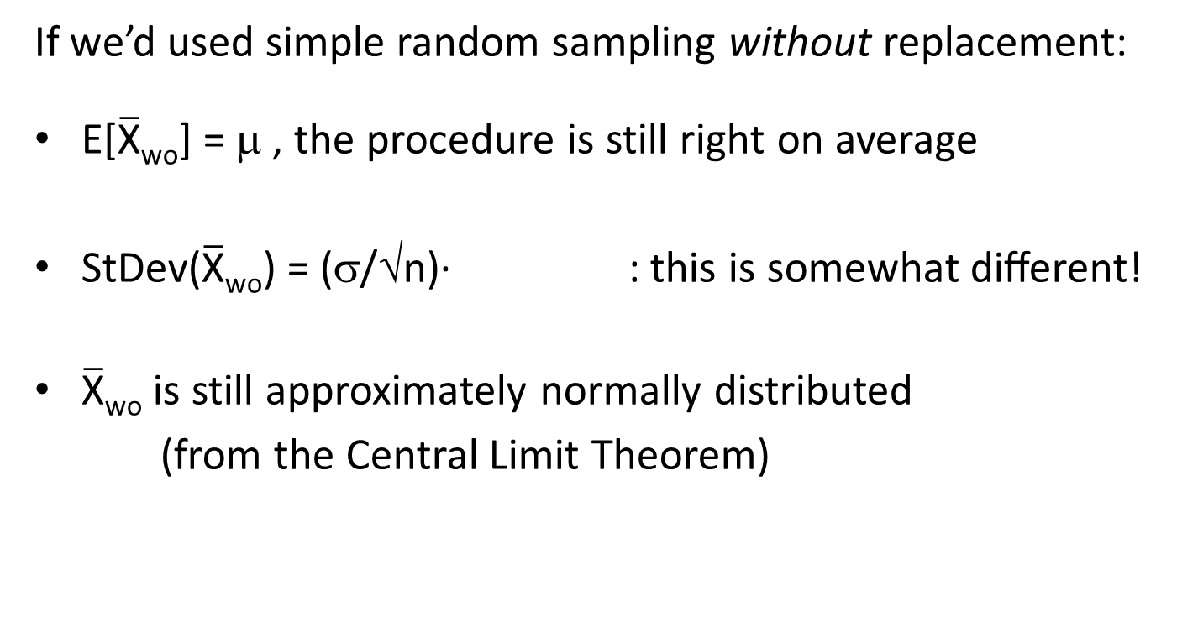
Technical Detail #1
If we’d used simple random sampling without replacement:
E[$\overline{\text{X}}$_{wo}] = μ , the procedure is still right on average
StDev($\overline{\text{X}}$_{wo}) = (σ/√n)· : this is somewhat different!
$\overline{\text{X}}$_{wo} is still approximately normally distributed
  (from the Central Limit Theorem)

Slide 30
For Simple Random Sampling without Replacement
But for typical managerial settings, this extra factor is just a hair less than 1. For example, if N = 100,000 and n = 100, the factor is 0.9995.
So in managerial settings the factor is usually ignored, and we’ll use
for both types of simple random sampling.

Slide 31
Technical Detail #2
twice!
In coming up with , we cheated …
We invoked the Central Limit Theorem to get the 1.96, even though the CLT only says, “The bigger the bunch of things being aggregated, the closer the aggregate will come to having a normal distribution.”
  As long as the sample size is a couple of dozen or more, OR even smaller when drawn from an approximately normal population distribution, this cheat turns out to be relatively innocuous.
We used s instead of σ.
  This cheat is a bit more severe when the sample size is small. So we cover for it by raising the 1.96 factor a bit.

Slide 32
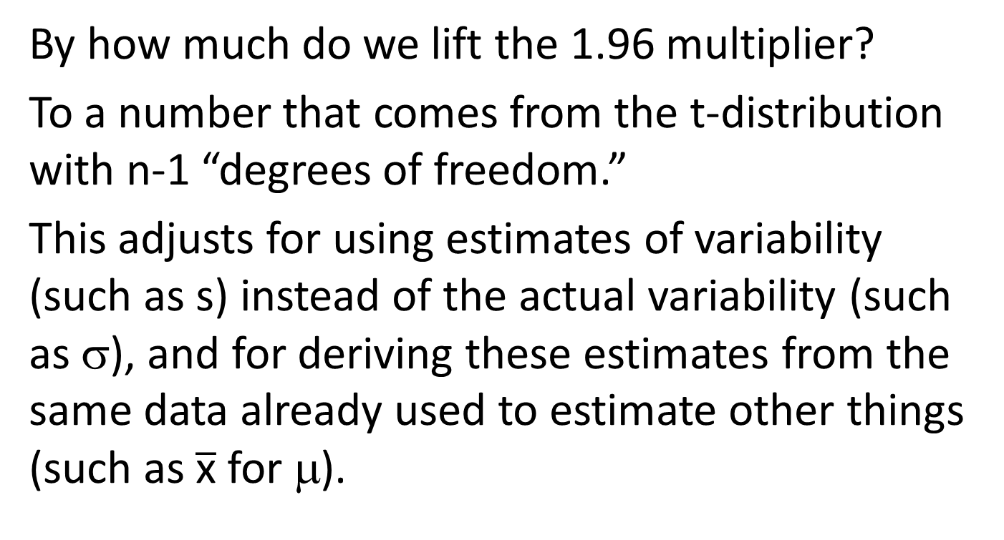
Very Technical Detail #2
By how much do we lift the 1.96 multiplier?
To a number that comes from the t-distribution with n-1 “degrees of freedom.”
This adjusts for using estimates of variability (such as s) instead of the actual variability (such as σ), and for deriving these estimates from the same data already used to estimate other things (such as $\overline{\text{x}}$ for μ).

Slide 33
Correcting for Using s Instead of σ
t-distribution
degrees of freedom | 95% central probability | degrees of freedom | 95% central probability | degrees of freedom | 95% central probability
1 | 12.706 | 11 | 2.201 | 21 | 2.080
2 | 4.303 | 12 | 2.179 | 22 | 2.074
3 | 3.182 | 13 | 2.160 | 23 | 2.069
4 | 2.776 | 14 | 2.145 | 24 | 2.064
5 | 2.571 | 15 | 2.131 | 25 | 2.060
6 | 2.447 | 16 | 2.120 | 30 | 2.042
7 | 2.365 | 17 | 2.110 | 40 | 2.021
8 | 2.306 | 18 | 2.101 | 60 | 2.000
9 | 2.262 | 19 | 2.093 | 120 | 1.980
10 | 2.228 | 20 | 2.086 | ∞ | 1.960
Note that, as the sample size grows, the correct “approximately 2” multiplier becomes closer and closer to 1.96.

Slide 34
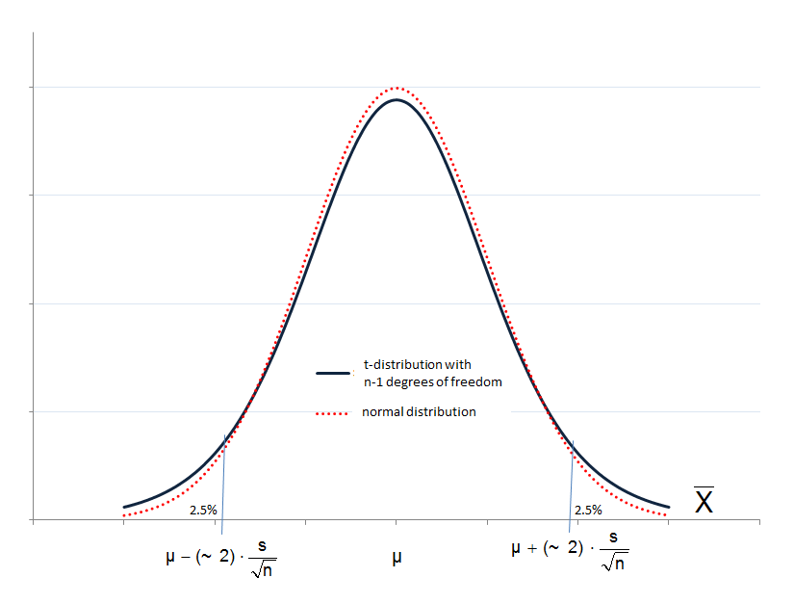
Pictorially

Slide 35
A Plethora of Excel Functions!
Excel 2010 offers 10(!) different commands for working with the t distribution.
T.DIST and T.INV are comparable to NORMDIST and NORMINV (they all focus on left tails). The T. functions both assume a standardized distribution (expected value 0, standard deviation 1). Learn them and you’ll be fine.
T.DIST | T.INV | T.TEST
T.DIST.RT | T.INV.2T | TTEST
T.DIST.2T | TINV | CONFIDENCE.T
TDIST
The older TDIST and TINV commands were inconsistently defined.
T.DIST(where, df, TRUE) tells you the probability to the left (below) where you’re standing
T.INV(cut off, df) tells you where to stand, in order to cut off this much probability to your left (below).

Slide 36
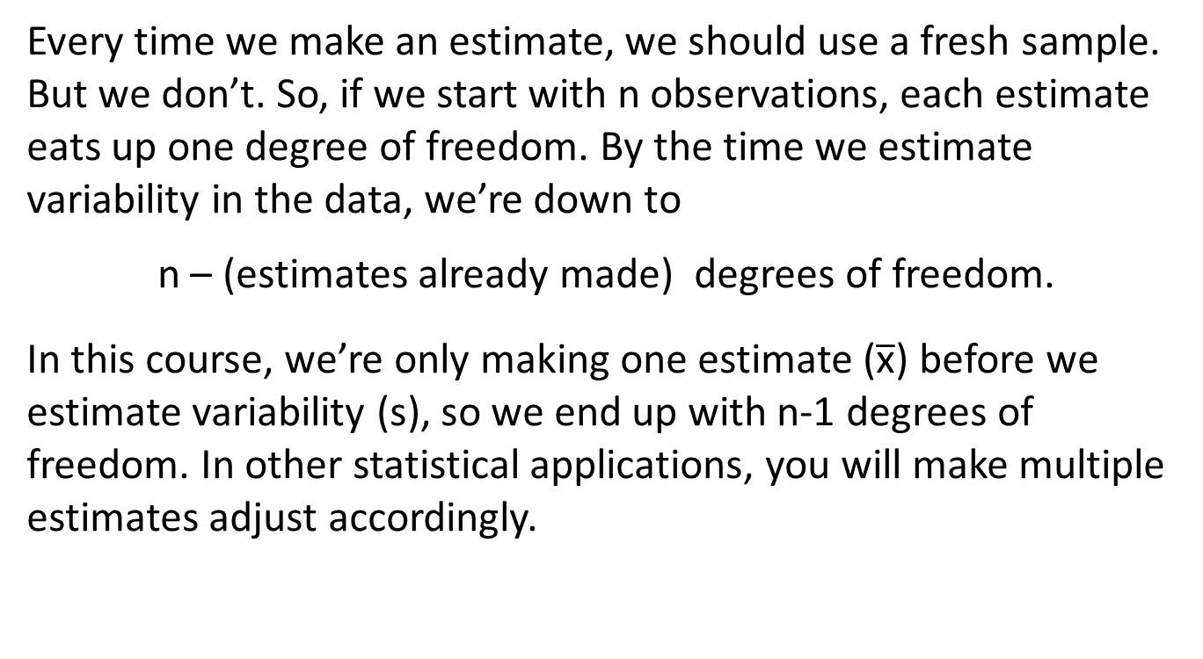
And What’s This “Degrees of Freedom” Stuff?
Every time we make an estimate, we should use a fresh sample. But we don’t. So, if we start with n observations, each estimate eats up one degree of freedom. By the time we estimate variability in the data, we’re down to
n – (estimates already made) degrees of freedom.
In this course, we’re only making one estimate ($\overline{\text{x}}$) before we estimate variability (s), so we end up with n-1 degrees of freedom. In other statistical applications, you will make multiple estimates adjust accordingly.

Slide 37
And How Do We Do This?
Fortunately, any decent statistical software these days will count degrees of freedom, look in the appropriate t-distribution tables, and give us the slightly-larger-than-1.96 number we should use.
In general, just think
(one standard deviation’s worth of uncertainty in the way the estimate was made)
(your estimate) ± (~2) ·
as in
where the (~2) is determined by the computer

Slide 38
Summary
Whenever you give an estimate or prediction to someone, or accept an estimate or prediction from someone, in order to facilitate risk analysis be sure the estimate is accompanied by its margin of error: A 95%-confidence interval for the estimated quantity is
If you’re estimating a mean using simple random sampling:
In Excel =AVERAGE(range) ± (-T.INV(0.025,n-1))*STDEV(range)/SQRT(n)
(one standard-deviation’s-worth of uncertainty inherent in the way the estimate was made)
(your estimate) ± (~2) ·

Slide 39
A Regression Example

Slide 40
Estimate mean cost across the entire fleet:
688.87 ± 2.1448 ∙ 28.84

Slide 41
Estimate the mean increase in cost per year of age:
73.96 ± 2.2010 ∙ 17.91

Slide 42
Predict the annual cost for a 1-year-old Ford driven 15,000 miles:
626.01 ± 2.2010 ∙ 53.25

Slide 43
And That’s It!
For the moment …
After break, we’ll go over the “other” language of statistics: The language of hypothesis testing (used to evaluate evidence).
And next week we’ll talk about estimates of proportions (such as in polling).

