Slide 1
DECS 430-A
Business Analytics I: Class 5
    Sampling
      Polling, and estimating proportions
      Choosing a sample size
      Sampling methods
        Stratified sampling, cluster sampling
      Sampling problems
        Non-response bias, measurement bias
  Optimization (Excel’s “Solver”)
  Adverse selection

Slide 2
Polling
If the individuals in the population differ in some qualitative way, we often wish to estimate the proportion / fraction / percentage of the population with some given property.
For example: We track the sex of purchasers of our product, and find that, across 400 recent purchasers, 240 were female. What do we estimate to be the proportion of all purchasers who are female, and how much do we trust our estimate?

Slide 3
First, the Estimate
Let
Obviously, this will be our estimate for the population proportion.
But how much can this estimate be trusted?

Slide 4
And Now, the Trick
Imagine that each woman is represented by a “1”, and each man by a “0”.
Then the proportion (of the sample or population) which is female is just the mean of these numeric values, and so estimating a proportion is just a special case of what we’ve already done!

Slide 5
The Result
Estimating a mean:
Estimating a proportion:
[When all of the numeric values are either 0 or 1, s takes the special form shown above.]
The example:

Slide 6
Multiple-Choice Questions
If the Republican Party’s candidate were to be chosen today, which one would you most prefer?
Romney, Cain, Bachman, Perry, Gingrich, Santorum, Paul, Huntsman, none
The results are reported as if 9 separate “yes/no” questions had been asked.
If the Republican Party’s candidate were to be chosen today, which of these would have your approval?
The same reporting method is used.

Slide 7
Choice of Sample Size
Set a “target” margin of error for your estimate, based on your judgment as to how small will be small enough for those who will be using the estimate to make decisions.
There’s no magic formula here, even though this is a very important choice: Too large, and your study is useless; too small, and you’re wasting money.

Slide 8
Estimating a Proportion: Polling
Pick the target margin of error.
Why do news organizations always use 3% or 4% during the election season?
  Because that’s the largest they can get away with.
So, for example, n=400 (resp., 625, or 1112) assures a margin of error of no more than 5% (resp., 4%, or 3%).

Slide 9
Estimating a Mean: Choice of Sample Size
Set the target margin of error.
Solve
From whence comes s?
From historical data (previous studies) or from a pilot study (small initial survey).
target = $25.
s ≈ $180.
Set n = 207.

Slide 10
The “Square-Root” Effect : Choice of Sample Size after an Initial Study
Given the results of a study, to cut the margin of error in half requires roughly 4 times the original sample size.
And generally, the sample size required to achieve a desired margin of error =

Slide 11
How to Read Presidential-Race Polls
When reading political polls, remember that the margin of error in an estimate of the “gap” between the two leading candidates is roughly twice as large as the poll's reported margin of error.
The margin of error in the estimated “change in the gap” from one poll to the next is nearly three times as large as the poll's reported margin of error.

Slide 12
Summary
Whenever you give an estimate or prediction to someone, or accept an estimate or prediction from someone, in order to facilitate risk analysis be sure the estimate is accompanied by its margin of error: A 95%-confidence interval is
If you’re estimating a mean using simple random sampling:
If you’re estimating a proportion using simple random sampling:
(one standard-deviation’s-worth of uncertainty inherent in the way the estimate was made)
(your estimate) ± (~2) ·

Slide 13
How Will the Data be Collected?
Primary Goals: No bias High precision Low cost
Simple random sampling with replacement
  Typically implemented via systematic sampling
Simple random sampling without replacement
  Typically done if a population list is available
Stratified sampling
  Done if the population consists of subgroups with relative within-group homogeneity
Cluster sampling
  Done if the population consists of (typically geographic) subgroups with substantial within-group heterogeneity
Specialized approaches (e.g., tagging the U-Haul fleet)

Slide 14
Non-Response Bias
One of the difficulties in surveying people (whether by mail, telephone, or direct approach) is that some choose not to respond. Assume that you have decided to conduct a study which requires a sample size of 100. If you only expect 10% of those surveyed to respond to your questionnaire, what should you do?
A naïve answer is, "Simply send out 1000 questionnaires!"
Unfortunately, the demographics of respondents and nonrespondents may differ substantially. To base estimates for the entire population merely on the data collected from respondents therefore might leave you exposed to substantial sampling bias.

Slide 15
Non-Response Bias
A form of stratified sampling is typically used to overcome non-response bias. An initial mass mailing of questionnaires takes place, with identifying codes placed on each questionnaire (or its return envelope). When the submission deadline for responses is reached, estimates can be made for the stratum of "people who respond to the initial mailing." Crossing these people off the mailing list (by cross-referencing the codes on their responses) leaves a list of people all of whom are now known to be in the other "people who don't respond" stratum. The initial response rate is used to estimate the relative sizes of the two strata.
A sample of those who didn't respond is now recontacted, using a more expensive approach designed to obtain responses from everyone. (The expense is typically related to an incentive of some kind.) Their data provides estimates for the second stratum, and the study can then be completed.
See “Nonresponse_Bias.xls” for an example.

Slide 16
Measurement Bias
Asking sensitive questions
  Software piracy
  Sexual activities
  Tax fraud
People will lie
Allow them to hide behind a mask of randomness

Slide 17
Randomized Response Surveys
  Larger samples are required for the same precision …
  But the bias can be completely eliminated.
  See Sampling.xls for details.

Slide 18
Optimization
Using Excel’s “Solver” add-in

Slide 19
Take My Car. Please!
Have I got a deal for you! I've got this great used car, and I might be willing to sell.
The actual value of the car depends on how well it has been maintained, and this is of course only known to me: Expressed in terms of the car's value to me, you believe it to be equally likely to be worth any amount between $0 and $5000.
You, who would utilize the car to a greater extent than I, would derive 50% more value from ownership (e.g., if it's worth $3000 to me, then it's worth $4500 to you).
How much are you willing to offer me? (I'll interpret your offer as "take-it-or-leave-it.")

Slide 20
Adverse Selection
You are subject to adverse selection whenever
You offer to engage in a transaction with another party, and that party can either accept or refuse your offer.
The other party holds information not yet available to you concerning the value to you of the transaction.
The other party is most likely to accept the offer (i.e., to select to do the deal) when the information is "bad news" (i.e., adverse) to you.

Slide 21
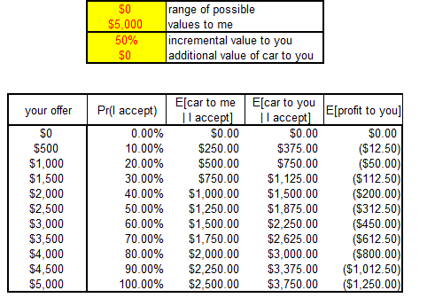
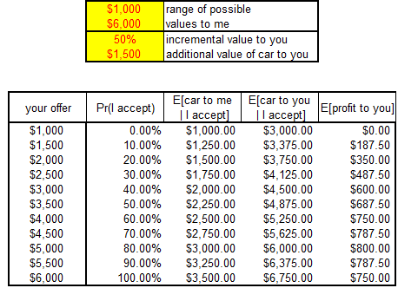
Adverse Selection: Dealing with It
We need to be able to compute E[ V | V ≤ v] . For normally-distributed uncertainty, this can be done analytically. (See Adverse_Selection_plus.xls)

Slide 22
Adverse Selection: Examples
Making a buyout offer
Setting an insurance premium
  getting (forcing) healthy young people to carry insurance is critical to the ACA
Giving bid/ask quotes
Auctions with objective value uncertainty
  contracting (unknown costs)
  natural resource sales (unknown supply)
    the “Winner’s Curse”
  debt auctions (unknown post-auction market price)
Here’s another Saturday night …
  mothers teach daughters to avoid giving bad signals

Slide 23
Course Finale
We’ve covered …
Enough probability to get you started in FINC-430, OPNS-430, and other courses dealing with risk.
Enough statistics to begin DECS-431, on regression analysis.
Enough warning to provide a bit of protection against common errors.
Good luck, and bon voyage!

