Slide 1
Business Analytics I
Session 3
  Independence (reprise)
  Careless assumptions of independence
  Covariance and correlation
  Spreadsheet tools for optimization (Solver)
  The Central Limit Theorem and
  the normal distribution

Slide 2
Predicting the Results of the
2012 U.S. Presidential Election
See InTrade-2012.xls.

Slide 3

Meadow’s Law: Are crib deaths independent events?

Slide 4
Beware Unwarranted Assumptions of Independence
Sir Samuel Roy Meadow (born 1933) is a British pediatrician and professor, who rose to initial fame for his 1977 academic paper on the now controversial Munchausen Syndrome by Proxy (MSbP). He was knighted for this work. He endorsed the dictum that “one sudden infant death is a tragedy, two is suspicious and three is murder, until proved otherwise“ in his book ABC of Child Abuse^{[1]} and this became known as Meadow's Law and at one time was widely adopted by social workers and child protection agencies (such as the NSPCC) in Britain.
He appeared as an expert witness for the prosecution in several trials, in at least one of which his testimony played a crucial part in a wrongful conviction for murder. The British General Medical Council (GMC) struck off Meadow from the British Medical Register after he was found to have offered “erroneous” and “misleading” evidence in the Sally Clark case. Clark was a lawyer wrongly convicted in 1999 of the murder of her two baby sons, largely on the basis of Meadow's evidence; her conviction was quashed in 2003 after she had spent three years in jail.
By the time he gave evidence at Sally Clark's trial, Roy Meadow claimed to have found 81 cot deaths which were in fact murder, but he had destroyed the data. Amongst the prosecution team was Meadow, whose evidence included a soundbite which was to provoke much argument: he testified that the odds against two cot deaths occurring in the same family was 73,000,000:1, a figure which he obtained by squaring the observed ratio of live-births to cot deaths in affluent non-smoking families (approximately 8,500:1). The jury returned a 10/2 majority verdict of "guilty".

Slide 5
“Bad Debt” patterns
Did you notice any patterns in the Bad Debt data?
  The 200 transactions that became bad debts averaged $7,443 per invoice.
  The 9800 that were eventually paid averaged only $4,332 per invoice.
What was the effect of separating the data for small/large transactions?
  The 4,533 “small” (sub-$4000) invoices that were eventually paid were paid off, on average, in about 94 days. The “large” invoices took, on average, about 10 days longer.
  More strikingly, the 9,679 paid-off invoices below $9000 were paid, on average, in a bit less than 97 days … and the 121 above $9000 averaged more than 298 days to payment.
Generally, how might we measure the probabilistic linkage between random variables? For example, how might we assess whether they tend to be “large” together, and “small” together?

Slide 6
Dependence and Covariance
If two random variables are not independent, do they tend to be large together (and small together)? Or when one is large, is the other typically small (and vice versa)?
Definition: The covariance of random variables X and Y is
Cov(X,Y) = E[ (X–E[X]) · (Y–E[Y]) ]
= E[XY] – E[X]·E[Y] .
(The two expressions are algebraically the same.)
A positive covariance corresponds to “typically big together, and small together.”
A negative covariance corresponds to “typically, when one is big, the other is small.”
Independent random variables have a covariance of 0.
Emphatically: A covariance of 0 does NOT imply independence.

Slide 7
Correlation
It is easier to interpret covariance after a rescaling:
The correlation of two random variables is
Corr(X,Y) = Cov(X,Y) / (StDev(X)·StDev(Y)) .
Just as we use both variance (for calculations) and standard deviation (for interpretation), we use covariance (for calculations) and correlation (for interpretation).
Specifically, the correlation between two random variables is a dimensionless measure of the strength of the linear relationship between those two variables. It takes values between -1 and 1.

Slide 8
Correlation
... beware

Slide 9
Definition
The correlation between two random variables is a dimensionless number between 1 and -1.

Slide 10
Interpretation
Correlation measures the strength of the linear relationship between two variables.
Strength
  not the slope
Linear
  misses nonlinearities completely
Two
  shows only “shadows” of multidimensional relationships

Slide 11
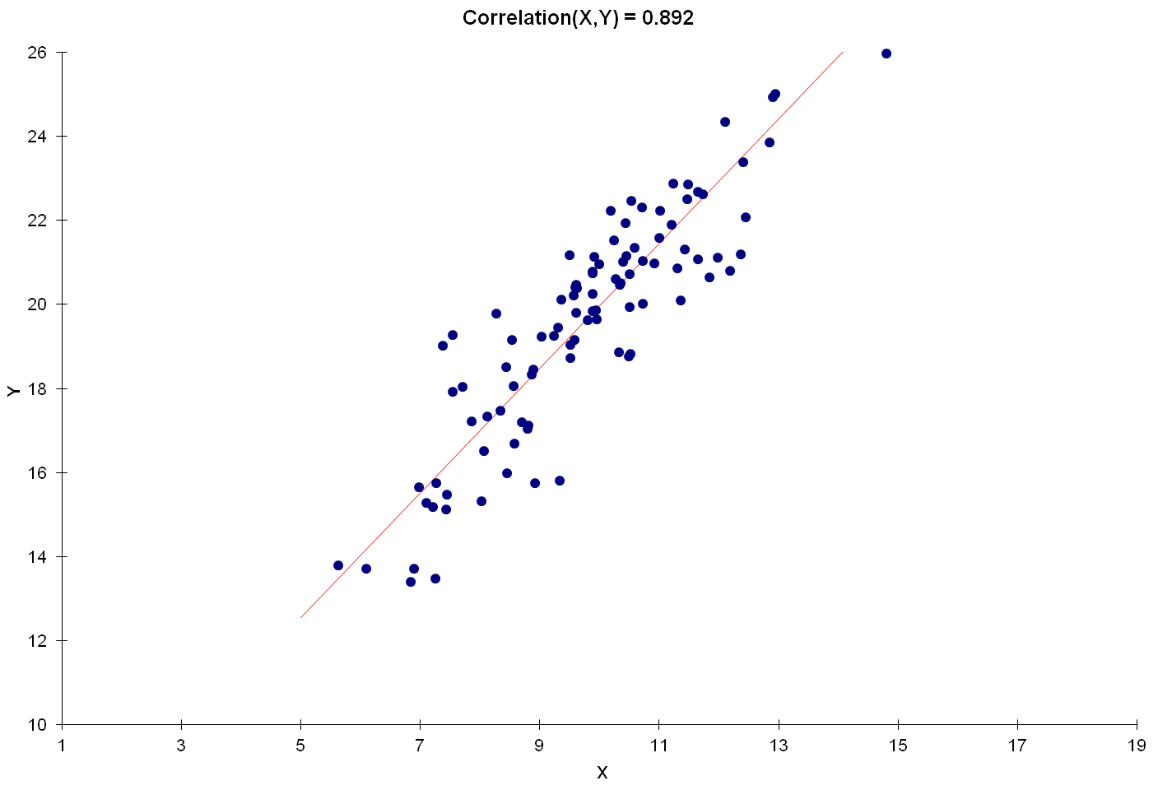
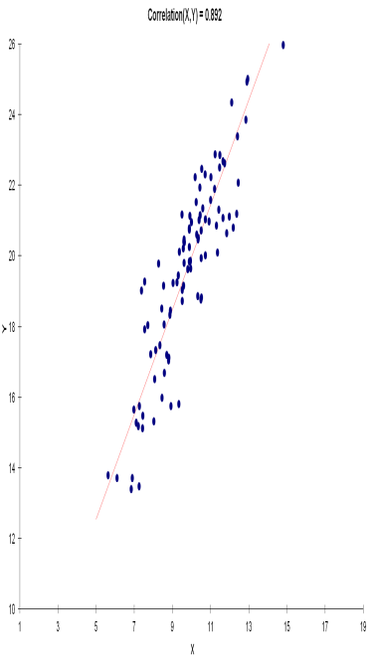

A correlation of +1 would arise only if all of the points lined up perfectly.
Stretching the diagram horizontally or vertically would change the perceived slope, but not the correlation.

Slide 12
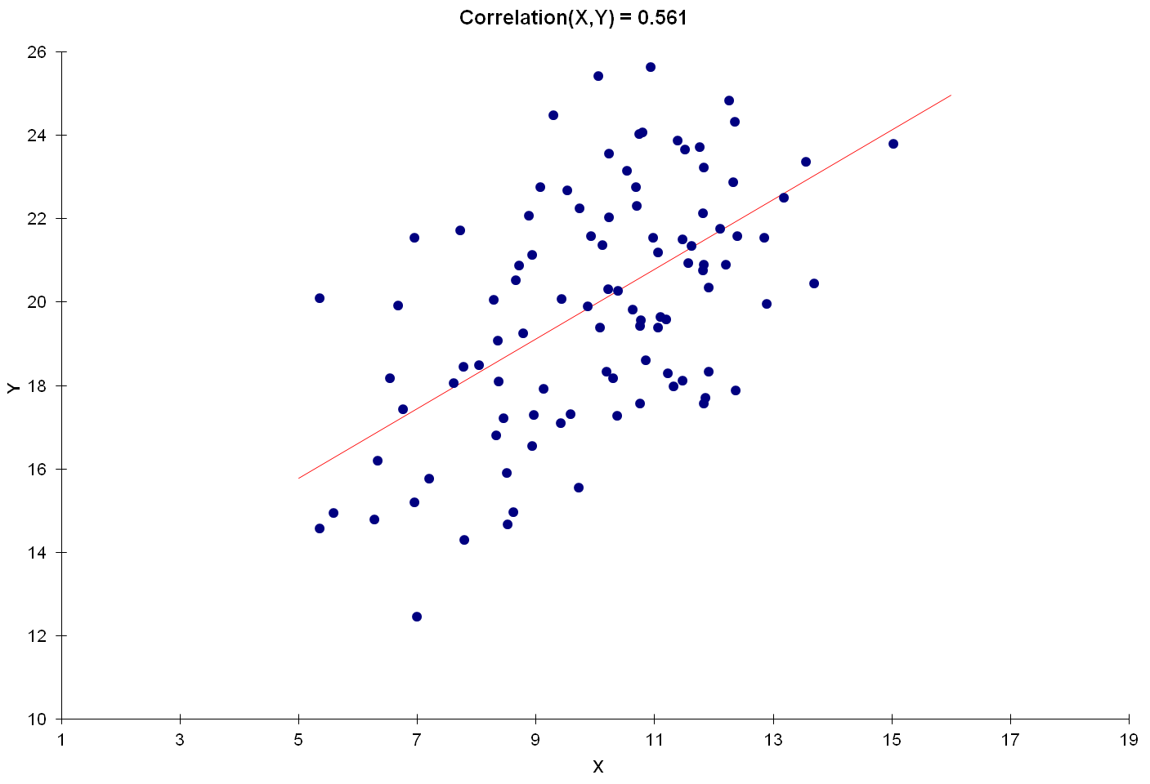
A positive correlation signals that large values of one variable are typically associated with large values of the other.
Correlation measures the “tightness” of the clustering about a single line.

Slide 13
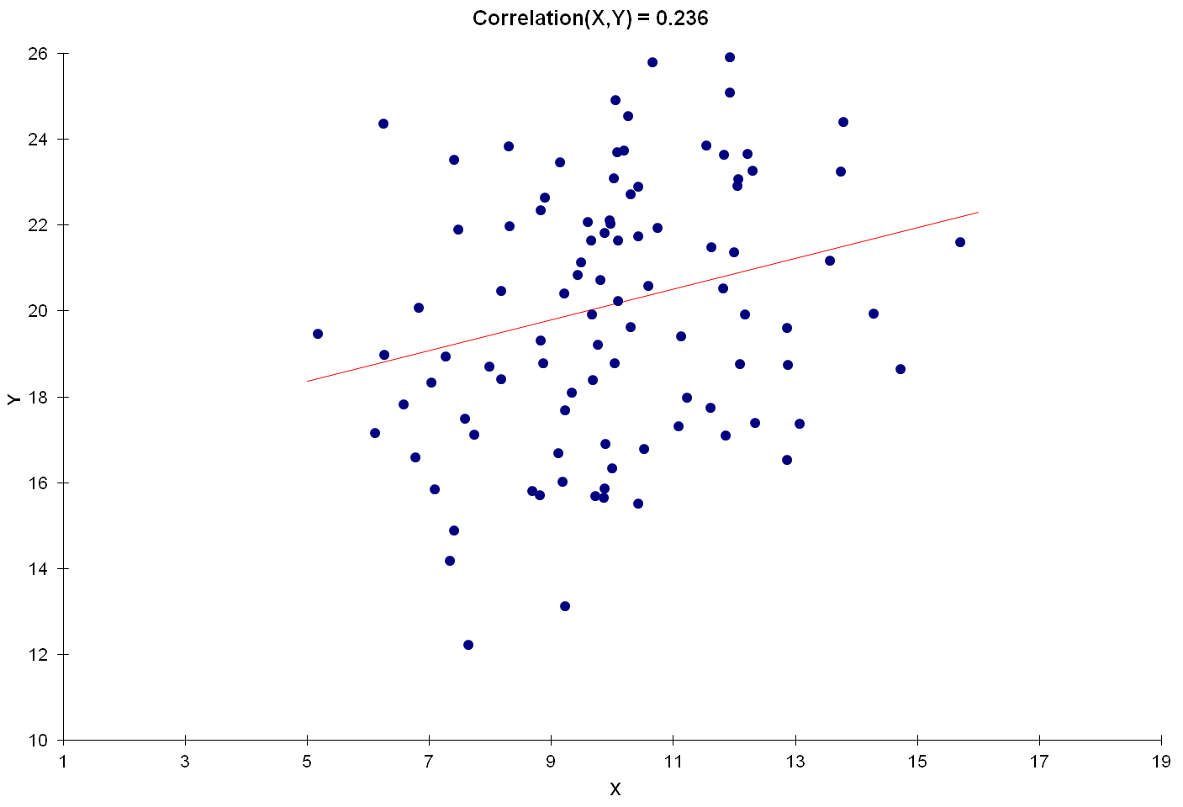

Slide 14
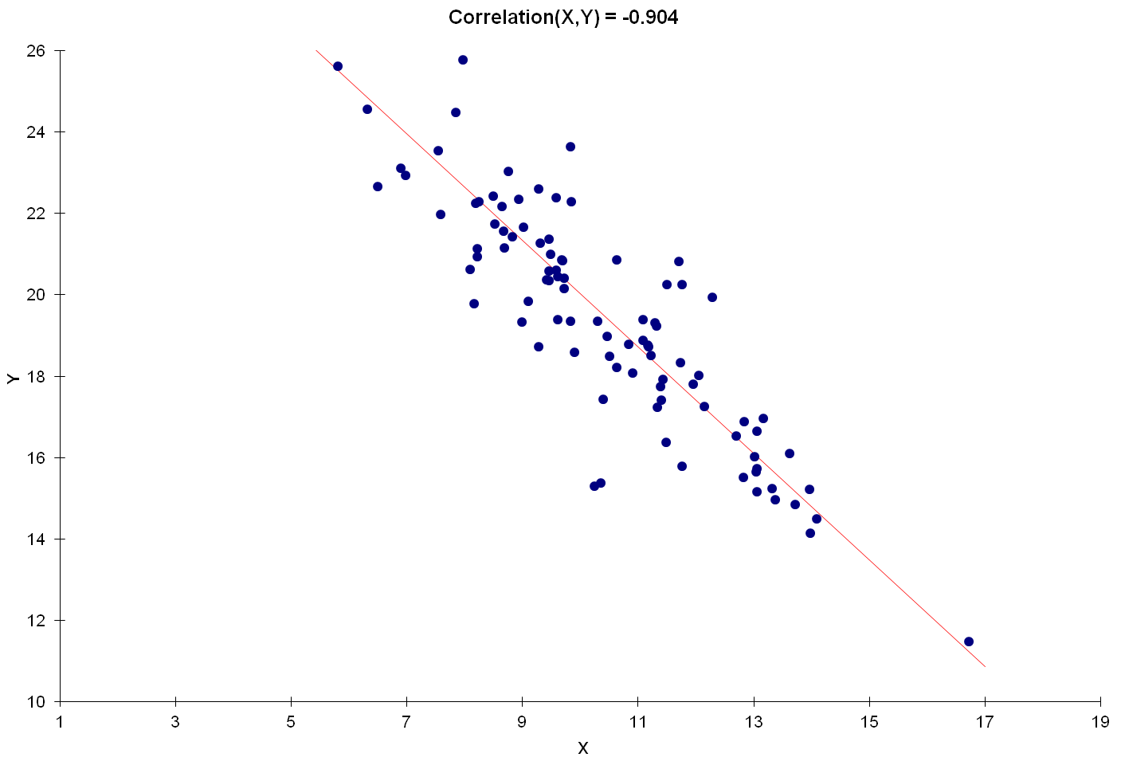
A negative correlation signals that large values of one variable are typically associated with small values of the other.

Slide 15
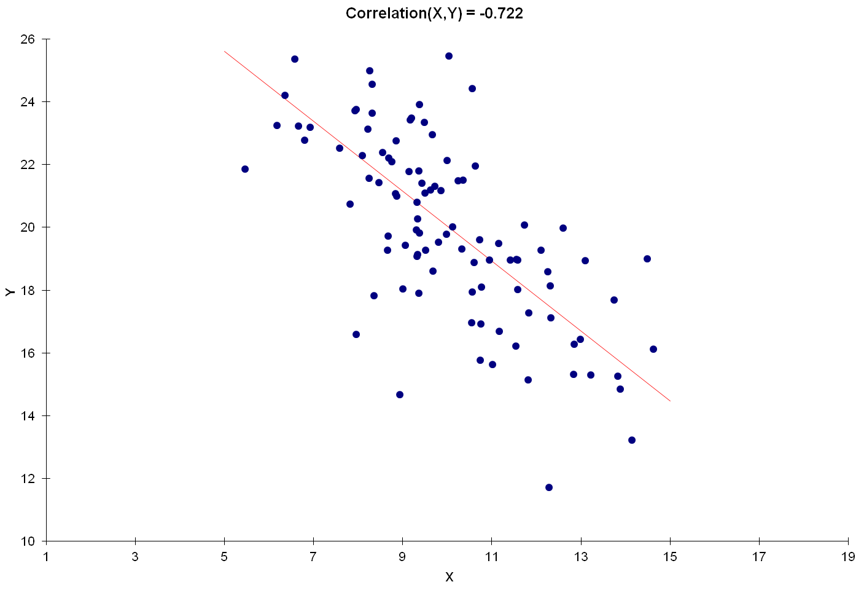

Slide 16
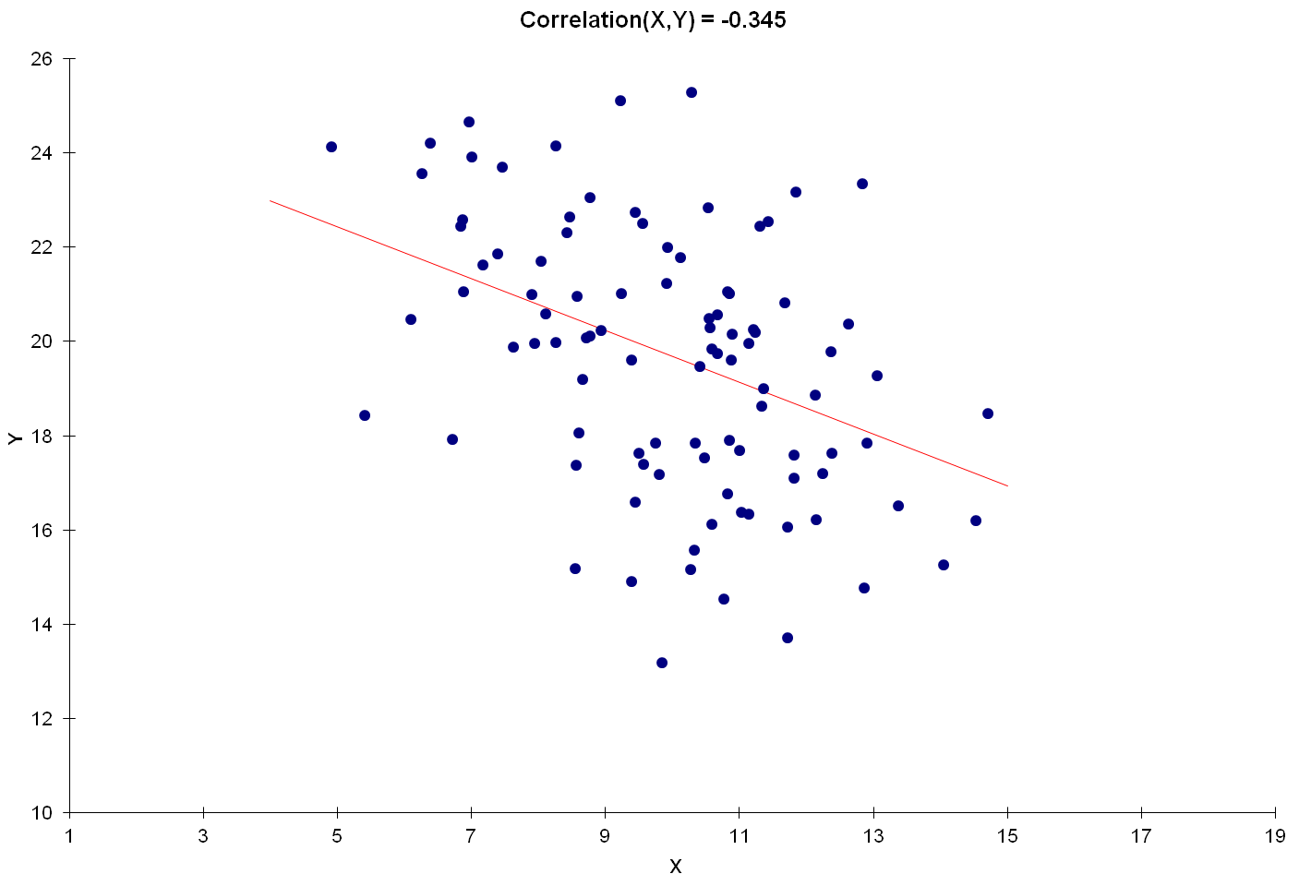

Slide 17
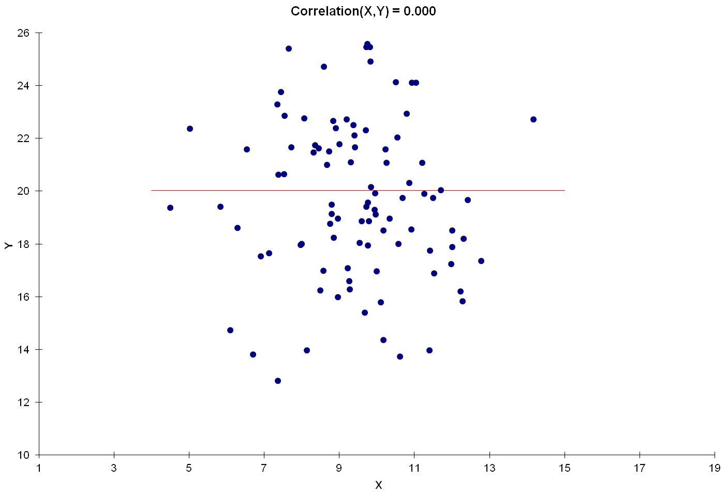
Independent random variables have a correlation of 0.

Slide 18
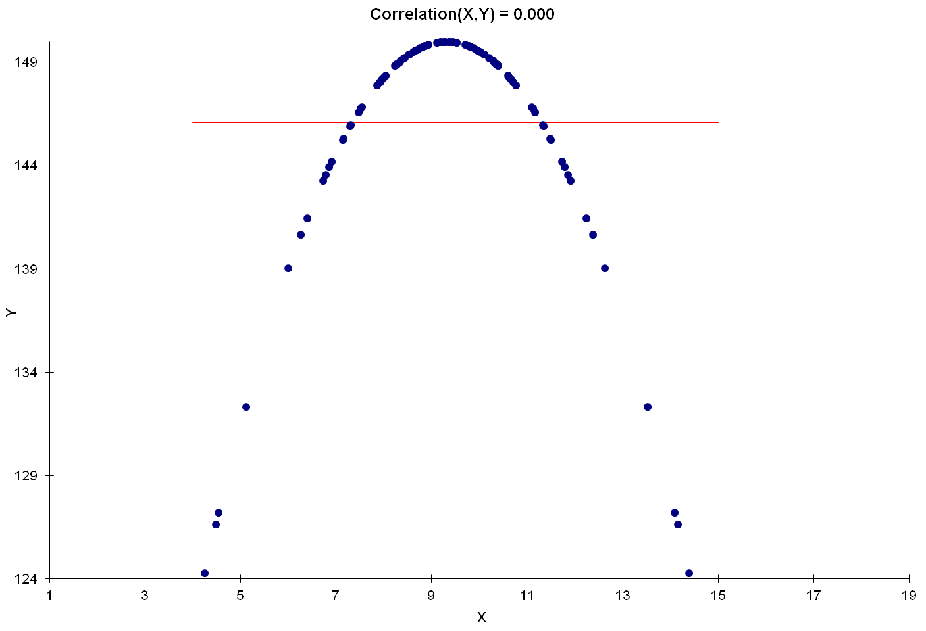
But a correlation of 0 most certainly does not imply independence.
Indeed, correlations can completely miss nonlinear relationships.

Slide 19
Back to Bad Debt
Consider the data provided in the Bad Debt homework exercise.
  Restrict attention to the invoices that were paid (98% of data).
Let I = Invoice amount and D = days to pay.
Among paid invoices, is the tendency for I and D to vary in the same or opposite direction?
We can calculate E(I) and E(D) (using Excel’s =AVERAGE(range) function twice) and E(ID) (using =SUMPRODUCT(range)/COUNT(range) ).
  Cov(I,D) = E(ID) – E(I)·E(D) = 25636 (dollar-days)
Is this a strong relationship? (Excel’s =STDEV(range) function is useful here.)
Corr(I,D) = Cov(I,D) / (2463.9·93.6) = 0.111

Slide 20
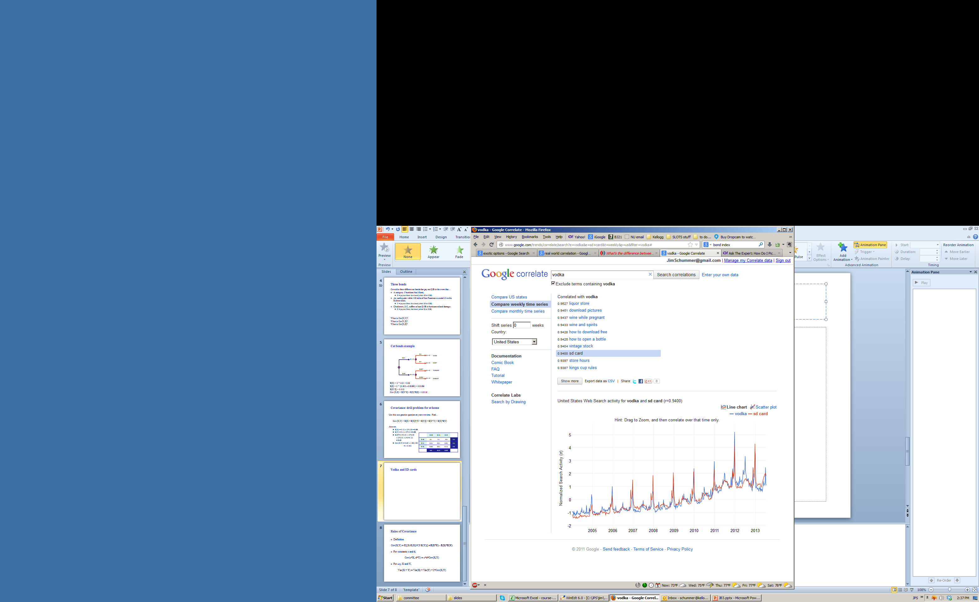
Corr(Google searches for “Vodka”,
Google searches for “SD cards”) = 0.9400
The correlation comes from common calendar peaks: a small one in June and a large one in December.
Consider
advertising and sales (for a seasonal product)!

Slide 21
Correlation doesn’t imply Causality!

Slide 22
The Variance of a Sum
Tattoo this somewhere on your body:
Var(X+Y) = Var(X) + Var(Y) + 2·Cov(X,Y) .
More generally,
Var(X+Y+Z) = Var(X)+Var(Y)+Var(Z) + 2·Cov(X,Y)+2·Cov(X,Z)+2·Cov(Y,Z) .
and most generally, the variance of a sum is the sum of the individual variances, plus twice all of the pairwise covariances.

Slide 23
Portfolio Balancing
See portfolios.xls

Slide 24
Next
You are about to learn one of the handful of fundamental facts that make the universe what it is.
It’s right up there with the inverse square law of gravity, Maxwell’s equations, the Theory of Relativity, the Law of Large Numbers, and the existence of the Higgs boson.
It is used in every branch of science, and every functional area of management.
“I know of scarcely anything so apt to impress the imagination as the wonderful form of cosmic order expressed by [what you are about to learn]. [It] would have been personified by the Greeks if they had known of it. It reigns with serenity and complete self-effacement amidst the wildest confusion. The larger the mob, the greater the apparent anarchy, the more perfect is its sway. It is the supreme law of unreason.”
- Sir Francis Galton

Slide 25
What do these problems have in common?
A firm needs to set aside funds to satisfy potential warranty claims for one product. The firm wants to minimize these funds, but also have a reasonable chance that the funds will be sufficient to cover all claims.
A firm wants to keep its inventory levels down, but also limit the odds it runs out of stock in the next month.
Quality control: A pharmaceutical company finds a pallet of drug vials to be 0.31kg underweight. How likely is this under normal conditions? Or when their vial injector is partly clogged? (You will see this example in OM-430)
A casino offers a loss-triggered rebate to a high stakes player. They want to find the probability that they will have to pay the rebate to that customer.

Slide 26
What the problems had in common
Each problem had these elements…
Large number of independent individual trials;
  Customer purchases, warranty claims, vial weights, or gambles.
Repetition: Comparable uncertainty about each of the individual trials;
  Customers indistinguishable from each other, drug vials coming from same machine, etc.
Summing: We only really care about the aggregate total outcome of these individual trials.
  Total of demand, warranty claims, pallet weight, total winnings.

Slide 27

The Central Limit Theorem
Whenever you sum a bunch of independent random variables (with comparable variances), no matter what their individual distributions may be, the result will be approximately normally distributed.
We illustrate the probability distribution of a normally-distributed random variable through a diagram, where the total area beneath the curve is 1, and the probability of the normal variate lying in any range is the area above that range.
How big is “a bunch”?
Empirical studies have shown that interpreting “a bunch” as a couple of dozen or more works quite well.

Slide 28

The normal distribution
What you needn’t concern yourself with:
The height of the curve at any point x (a.k.a. the density function) is:
What you do need to know:
Normal distributions are completely described by their expected value and standard deviation.

Slide 29
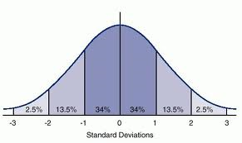
Normal distribution “rules of thumb”
P(within one standard deviation of EV) = 2/3.
P(within two standard deviations of EV) = 95%.
P(within three standard deviations of EV) = 99.7%.
P(within four standard deviations of EV) = 99.994%.

Slide 30
The normal distribution in Excel
X
Excel commands
=NORMDIST(X, expected value, standard deviation, TRUE)
  gives the probability that you get a value no higher than X
=NORMINV(probability, expected value, standard deviation)
  gives the value X corresponding to the stated probability
See also: NORMSDIST, NORMSINV (when EV=0, SD=1)
Newer Excel versions: NORM.DIST, NORM.INV, etc., are identical to these commands.

