Slide 1
DECS 430-A
Business Analytics I
  Probability Basics

Slide 2
The basic rules of probability:
Pr(A) + Pr(not-A) = 1;
Pr(A and B) + Pr(A and not-B) = Pr(A), and so on
Pr(A or B) = 1 – Pr(not-A and not-B)
Pr(A or B) = Pr(A) + Pr(B) – Pr(A and B)
The basic rules of conditional probability:
Definition: Pr(A|B) = Pr(A and B) / Pr(B)
Pr(A and B) = Pr(A)∙Pr(B|A) = Pr(B)∙Pr(A|B) ;
Pr(A and B and C) = Pr(A)∙Pr(B|A)∙Pr(C|A and B), and so on
when A and B are independent, Pr(A and B) = Pr(A)∙Pr(B)
when B1, …, Bk are disjoint and exhaustive,
Pr(A) = Pr(A|B1)∙Pr(B1) + … + Pr(A|Bk)∙Pr(Bk),
Bayes’ Rule, and how it works using probability trees

Slide 3
Solving Problems involving Uncertainty
There is no “mechanical” approach that always works.
Indeed, many important problems have no analytical (algebraic) solution at all!
If there’s no obvious answer, use the “rules” to decompose or transform the problem. Perhaps the new problem(s) will be easier to analyze.
If this fails (either because we weren’t sufficiently creative, or because there was no simple answer) …
  Use simulation to approximate the solution.

Slide 4
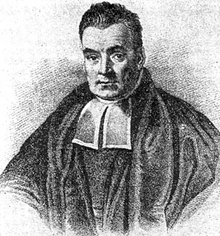
Bayes’ Rule (for Updating Beliefs, Given New Information)
Beliefs can be updated using Bayes’ Rule:
  Pr( A|B ) = Pr( A∩B ) / Pr( B )
  = Pr( A∩B ) / [Pr( A )∙Pr( B|A ) + Pr( not A )∙Pr( B|not A )]
Equivalently, the calculations can be organized by using a probability tree.
You may use whichever is more convenient.

Slide 5
Updating Beliefs, Given New Information
A witness to a hit-and-run accident identifies the fleeing vehicle as a Ford. 20% of the vehicles in town are Fords. However, when shown a sample of photographs, the witness correctly identifies Fords only 90% of the time, and calls non-Fords Fords 30% of the time. How likely is it that the fleeing vehicle was actually a Ford?
20% cars which are Fords
80% cars which aren't Fords
90% Pr( witness calls car a “Ford” | car is Ford )
30% Pr( witness calls car a “Ford” | car isn't Ford )
  So, for example,
  18% Pr( car is Ford, and witness says “Ford” )
  20%∙90% Pr( car is Ford ) ∙ Pr( witness says “Ford” | car is Ford )

Slide 6
A Probability Tree
20% cars which are Fords
80% cars which aren't Fords
90% Pr( witness calls car a “Ford” | car is Ford )
30% Pr( witness calls car a “Ford” | car isn't Ford )

Slide 7
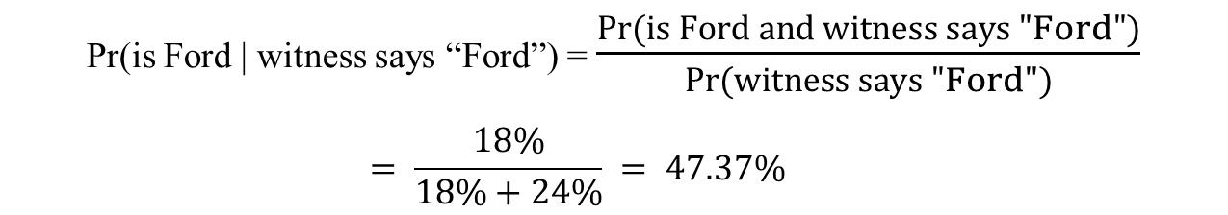
Bayes’ Rule, using the Probability Tree
√
  Pr(is Ford | witness says “Ford”) = $\frac{Pr(is Ford and witness says "Ford")}{Pr(witness says "Ford")}$
  $$= \frac{18\%}{18\%+24\%} = 47.37\%$$

Slide 8
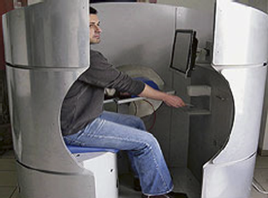
THE WALL STREET JOURNAL AUGUST 14, 2006
Which Travelers Have 'Hostile Intent'? Biometric Device May Have the Answer
By JONATHAN KARP and LAURA MECKLER
At airport security checkpoints in Knoxville, Tenn. this summer, scores of departing passengers were chosen to step behind a curtain, sit in a metallic oval booth and don headphones. With one hand inserted into a sensor that monitors physical responses, the travelers used the other hand to answer questions on a touch screen about their plans. A machine measured biometric responses -- blood pressure, pulse and sweat levels -- that then were analyzed by software. The idea was to ferret out U.S. officials who were carrying out carefully constructed but make-believe terrorist missions.
The Israeli-developed system combines questions and biometric measurements to determine if a passenger should undergo screening by security officials.
In theory, the Cogito machine could be customized for specific cultures, and questions could be tailored to intelligence about a specific threat. The biggest challenge in commercializing Cogito is reducing false results that either implicate innocent travelers or let bad guys slip through. Mr. Shoval's company has conducted about 10 trials in Israel, including tests in which control groups were given terrorist missions and tried to beat the system.

Slide 9
Motivating example: Cogito
What are costs/benefits of purchasing Cogito technology?
  5-minute screening test for each traveler.
  Follow up inspection for those who fail screening.
  $200K per machine.
  Catch terrorists.
How accurate is Cogito? How accurate do they want to be?
If someone does not pass the screening, how likely is he/she to be a terrorist?

Slide 10
Cogito
(primary product of Suspect Detection Systems Inc.)
If someone does not pass the screening, how likely are they to be a terrorist?
  In the latest Israeli trial, the system caught 85% of the role-acting terrorists, meaning that 15% got through, and incorrectly identified 8% of innocent travelers as potential threats, according to corporate marketing materials.
The company's stated goal is to prove it can catch at least 90% of potential saboteurs -- a 10% false-negative rate -- while inconveniencing just 4% of innocent travelers.
Need assumptions.
  750,000,000 passengers fly per year (U.S.).
  Assume 100 terrorists fly within a year.

Slide 11
The Probability Tree
Pr( is a terrorist | test positive ) = 0. 0003% (about 1 chance in 333,000)
number of innocents hassled / year ≈ 30,000,000
number of terrorists who still get through ≈ 10

Slide 12
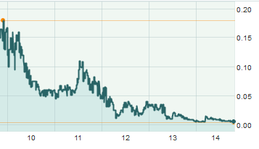
Knowing This, Would You Have Invested in Suspect Detection Systems Inc.?

Slide 13
Independence of events
Events A and B are independent if learning that B has happened does not change our assessed likelihood of A happening.
Equivalent definitions:
  P(A | B) = P(A)
  P(A | not B) = P(A)
  P(B | A) = P(B)
  P(B | not A) = P(B)
  P(A and B) = P(A ∩ B) = P(A) ⋅ P(B)
How Likely Is It That Birth Control Could Let You Down?

