Slide 1
Finance 441 Tutorial 8
TA: Mame Maloney
Email: m-maloney@kellogg.northwestern.edu
March 12, 2014

Slide 2
Question 1: Convertible Bonds
PEPCO issues one million convertible bonds with a maturity of 5 years and an 8 percent coupon. Prior to this, they were an all equity firm and the annual standard deviation of their equity returns was 25%. Each bond has a face value of $1000 and sold for this price. The conversion ratio is five. If PEPCO issues straight debt, it will need a coupon rate of 10 percent to sell for par. Each convertible bond can be exchanged for five shares of PEPCO’s common stock. The current stock price is $108 per share and there are 25 million shares outstanding. Assume the probability of default for the convertible bond is zero and that PEPCO stock does not pay dividends. The equity beta on PEPCO is 1.0, and the average excess return on the market portfolio is 8.4%.

Slide 3
Question 1: Convertible Bonds
A convertible bond is a straight bond plus an option to convert into stock. What is the market value of the straight bond component of PEPCO’s convertible bond?
What is the market value of the option to convert which is embedded in the PEPCO convertible bond?
What is the cost of debt for PEPCO? This is the expected return on their straight debt.
If the embedded option has a beta of 3, what is the expected rate of return on the option?
What is the cost of PEPCO’s convertible bond? This is the expected rate of return that investors require to hold PEPCO’s convertible debt.

Slide 4
Question 1: Convertible Bonds
a) A convertible bond is a straight bond plus an option to convert into stock. What is the market value of the straight bond component of PEPCO’s convertible bond?

Slide 5
Question 1: Convertible Bonds
What is the market value of the option to convert which is embedded in the PEPCO convertible bond?

Slide 6
Question 1: Convertible Bonds
c) What is the cost of debt for PEPCO? This is the expected return on their straight debt.

Slide 7
Question 1: Convertible Bonds
d) If the embedded option has a beta of 3, what is the expected rate of return on the option?

Slide 8
Question 1: Convertible Bonds
e) What is the cost of PEPCO’s convertible bond? This is the expected rate of return that investors require to hold PEPCO’s convertible debt.

Slide 9
Question 2: Convertible Bonds
Hanesbrand, which markets men’s and women’s clothing, saw their sales slow in the second half of 2007. To address softness in their sales, they have decided to launch a new advertising campaign. To fund the advertising campaign, to pay for needed renovation in their manufacturing facilities, and to stockpile capital for future investment in case the economy continues to deteriorate, they have decided to raise $50M in the bond market. The bonds will mature next year and be sold for their face value of $100,000 per bond. The new debt will be junior to Hanesbrand’s current bank loan. The bank loan from JP Morgan matures next year and the total interest and principal payment due at that time is $10M. This is Hanesbrand’s only current debt. The rest of the firm is equity financed and there are currently 16M shares outstanding. Current interest rates on one year debt are presented in following table:
Bond | T-Bill | Aaa | Aa | A | Baa
Rate | 5.0 | 5.5 | 5.6 | 5.8 | 6.1

Slide 10
Question 2: Convertible Bonds
a) Based on Hanesbrand’s current financials and the opinions of Moodys and S&P, Hanesbrand’s new bonds will be rated A. If the Mr. Lee Wyatt, the CFO, knew that the firm should really be an Aaa credit risk, how much would he be willing to pay to convince the market they are truly an Aaa credit risk prior to issuing the bond?

Slide 11
Question 2: Convertible Bonds
Cont’d

Slide 12
Question 2: Convertible Bonds
Cont’d

Slide 13
Question 2: Convertible Bonds
b) Based on Mr. Wyatt’s information, Hanesbrand is actually an A credit risk, just as the market believes. However, he would like to preserve Hanesbrand’s cash over the next year by reducing their interest burden and thus has decided to issue a convertible bond, instead of the standard bond which would yield 5.8%. The convertible bond will require a coupon rate of only 2% to sell at par. Bondholders will have the option of receiving the interest and principal at maturity or 12,000 shares of Hanesbrand stock. If Hanesbrand issues the convertible bond, what can you tell me about the yield on Hanesbrand’s current bank loan?

Slide 14
Question 2: Convertible Bonds
c) Investors pay $100K to purchase each convertible bond. What is the value of the option to convert the bond into 12K shares?

Slide 15
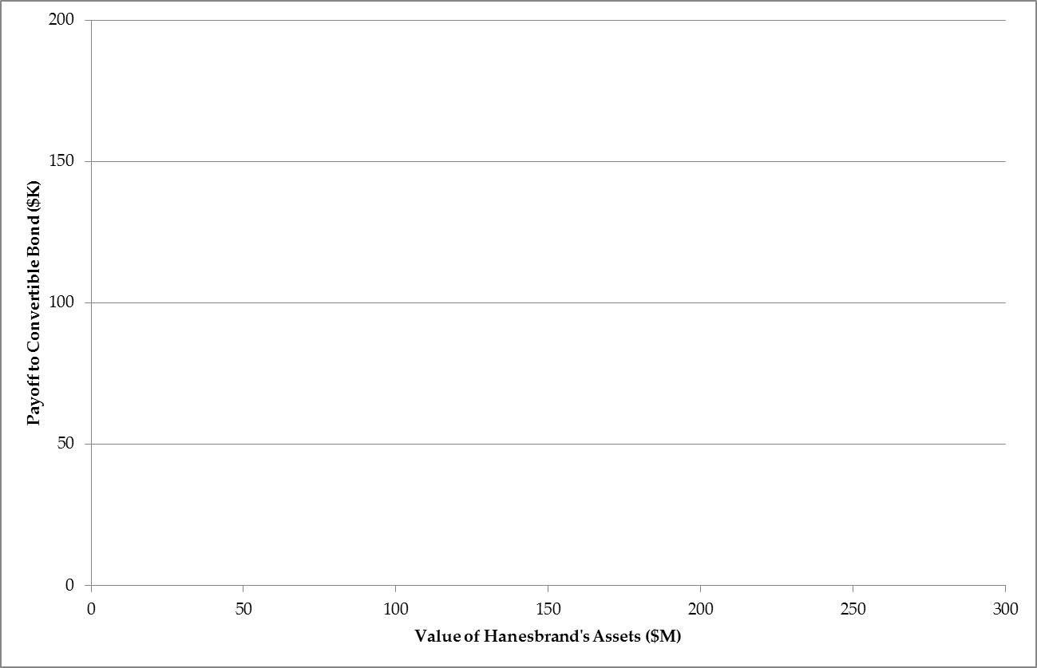
Question 2: Convertible Bonds
d) Draw the payoff diagram to one convertible bond as a function of the assets of the firm one year from today (i.e., the day before the bank loan and bond are due).

Slide 16
Question 2: Convertible Bonds
d) Cont’d

Slide 17
Question 2: Convertible Bonds
d) Cont’d

Slide 18
Question 2: Convertible Bonds
d) Cont’d

Slide 19
Question 2: Convertible Bonds
e) Increasing the leverage of a firm often makes the debt riskier and thus raises the expected return on the debt. When Hanesbrand issued the convertible debt, they increased the leverage of the firm. How did this change the riskiness of the bank loan?

