Slide 1
Finance 441 Tutorial 8
TA: Mame Maloney
Email: m-maloney@kellogg.northwestern.edu
March 12, 2014

Slide 2
Question 1: Convertible Bonds
PEPCO issues one million convertible bonds with a maturity of 5 years and an 8 percent coupon. Prior to this, they were an all equity firm and the annual standard deviation of their equity returns was 25%. Each bond has a face value of $1000 and sold for this price. The conversion ratio is five. If PEPCO issues straight debt, it will need a coupon rate of 10 percent to sell for par. Each convertible bond can be exchanged for five shares of PEPCO’s common stock. The current stock price is $108 per share and there are 25 million shares outstanding. Assume the probability of default for the convertible bond is zero and that PEPCO stock does not pay dividends. The equity beta on PEPCO is 1.0, and the average excess return on the market portfolio is 8.4%.

Slide 3
Question 1: Convertible Bonds
A convertible bond is a straight bond plus an option to convert into stock. What is the market value of the straight bond component of PEPCO’s convertible bond?
What is the market value of the option to convert which is embedded in the PEPCO convertible bond?
What is the cost of debt for PEPCO? This is the expected return on their straight debt.
If the embedded option has a beta of 3, what is the expected rate of return on the option?
What is the cost of PEPCO’s convertible bond? This is the expected rate of return that investors require to hold PEPCO’s convertible debt.

Slide 4
Question 1: Convertible Bonds
a) A convertible bond is a straight bond plus an option to convert into stock. What is the market value of the straight bond component of PEPCO’s convertible bond?
To value the bond, you need to discount the cash flows at the appropriate rate. Since the probability of default is zero, we just discount the promised payment on the debt at the promised rate of return on debt. The value of the straight bond is $924:

Slide 5
Question 1: Convertible Bonds
What is the market value of the option to convert which is embedded in the PEPCO convertible bond?
Since the convertible bond sold for $1000 and the straight bond is worth $924, the imbedded option is worth $76.

Slide 6
Question 1: Convertible Bonds
c) What is the cost of debt for PEPCO? This is the expected return on their straight debt.
The “cost of debt” is the expected rate of return required by investors in the firm’s straight debt. Since the probability of default is zero, the expected rate of return equals the promised rate of return, which is 10%.
Note: 8% is wrong. PEPCO could sell a bond with an 8% coupon, but only if they sold the bond for $924. The promised and expected return on the bond would still be 10%. To sell the bond for face value, the coupon rate must be set at 10%.

Slide 7
Question 1: Convertible Bonds
d) If the embedded option has a beta of 3, what is the expected rate of return on the option?
The expected rate of return on the option is the rate of return demanded by the market to own options on the firm’s equity. Using CAPM:
Notice the expected return on the option is significantly above the expected return on equity. The expected return on PEPCO’s equity is only 18.4%. A call option on equity is even more levered than the underlying equity.

Slide 8
Question 1: Convertible Bonds
e) What is the cost of PEPCO’s convertible bond? This is the expected rate of return that investors require to hold PEPCO’s convertible debt.
A convertible bond is a portfolio of straight debt and an option to convert. The expected return on the portfolio is a weighted average of the expected return on the straight debt and on the option. The weights are the fractions of the portfolio’s value based on the debt and the option, respectively:
Notice the expected return on the convertible bond is higher than the expected return on PEPCO’s straight debt (10 percent) and lower than the expected return on PEPCO’s equity (18.4%).

Slide 9
Question 2: Convertible Bonds
Hanesbrand, which markets men’s and women’s clothing, saw their sales slow in the second half of 2007. To address softness in their sales, they have decided to launch a new advertising campaign. To fund the advertising campaign, to pay for needed renovation in their manufacturing facilities, and to stockpile capital for future investment in case the economy continues to deteriorate, they have decided to raise $50M in the bond market. The bonds will mature next year and be sold for their face value of $100,000 per bond. The new debt will be junior to Hanesbrand’s current bank loan. The bank loan from JP Morgan matures next year and the total interest and principal payment due at that time is $10M. This is Hanesbrand’s only current debt. The rest of the firm is equity financed and there are currently 16M shares outstanding. Current interest rates on one year debt are presented in following table:
Bond | T-Bill | Aaa | Aa | A | Baa
Rate | 5.0 | 5.5 | 5.6 | 5.8 | 6.1

Slide 10
Question 2: Convertible Bonds
a) Based on Hanesbrand’s current financials and the opinions of Moodys and S&P, Hanesbrand’s new bonds will be rated A. If the Mr. Lee Wyatt, the CFO, knew that the firm should really be an Aaa credit risk, how much would he be willing to pay to convince the market they are truly an Aaa credit risk prior to issuing the bond?
To calculate this number, we compare what Hanesbrand will sell the debt for given the market’s perception of Hanesbrand’s credit risk (A) versus the true value of the bond if Hanesbrand was really a Aaa credit risk. The bonds must have a coupon rate of 5.8% for them to sell for face value ($100,000 per bond).
Remember, the price of the bond is determined by the market and thus it is the market’s perception of credit risk that matters.

Slide 11
Question 2: Convertible Bonds
Cont’d
To get the value of the bond we can discount the expected cash flows at the risk-adjusted discount rate or the promised cash flows at the correct promised rate of return. The promised payment is the face value plus the coupon rate of 5.8%. If Hanesbrand was really a Aaa credit risk, the correct promised rate would be 5.5%.

Slide 12
Question 2: Convertible Bonds
Cont’d
Thus Hanesbrand would lose $284 per bond. Since they are selling 500 bonds (i.e., $50M / $100K), Mr. Wyattt would be willing to pay up to $284 * 500 = $142,180 to educate the market as to the true credit quality of Hanesbrand.

Slide 13
Question 2: Convertible Bonds
b) Based on Mr. Wyatt’s information, Hanesbrand is actually an A credit risk, just as the market believes. However, he would like to preserve Hanesbrand’s cash over the next year by reducing their interest burden and thus has decided to issue a convertible bond, instead of the standard bond which would yield 5.8%. The convertible bond will require a coupon rate of only 2% to sell at par. Bondholders will have the option of receiving the interest and principal at maturity or 12,000 shares of Hanesbrand stock. If Hanesbrand issues the convertible bond, what can you tell me about the yield on Hanesbrand’s current bank loan?
The bank loan has a higher priority and thus lower default risk than the convertible bond. Because the bank loan is less likely to default, it will have a lower promised return. The promised return on the bank loan must be less than 5.8% (the yield on the junior debt if it had no conversion option) and greater than 5.0% (the yield on T-bills) since it is unlikely the bank loan has zero default risk.

Slide 14
Question 2: Convertible Bonds
c) Investors pay $100K to purchase each convertible bond. What is the value of the option to convert the bond into 12K shares?
When the bond market pays $100K for the convertible bond, they are purchasing a bond with a 2% coupon rate plus the conversion option. Since the credit risk of the bond implies a promised rate of 5.8% (i.e., if the bond did not have a conversion feature, it would have to have a 5.8% coupon rate to sell at par), we can discount the promised payments of the convertible bond at 5.8% to get the value of the bond part of the convertible.

Slide 15
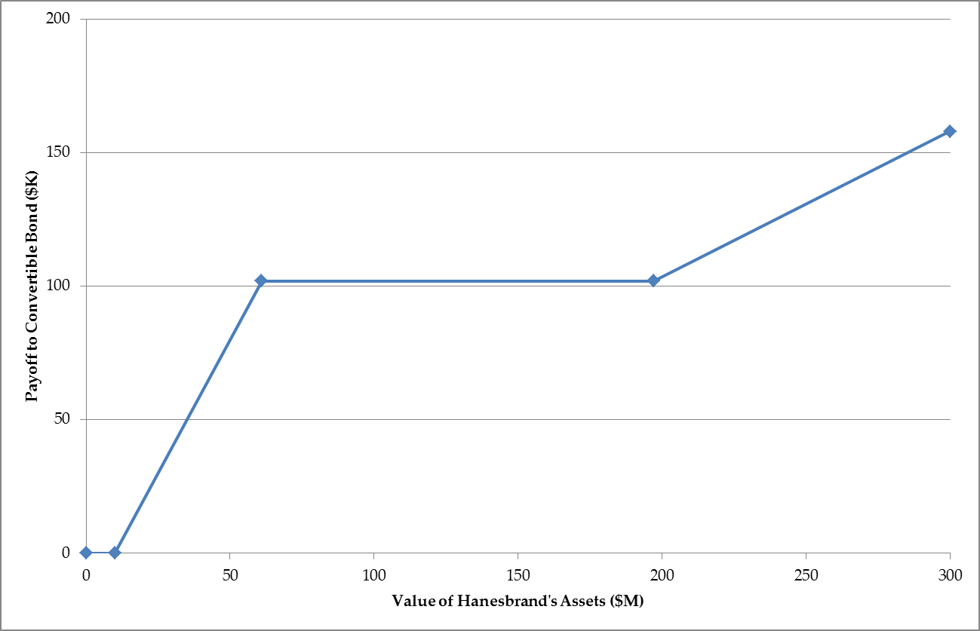
Question 2: Convertible Bonds
d) Draw the payoff diagram to one convertible bond as a function of the assets of the firm one year from today (i.e., the day before the bank loan and bond are due).

Slide 16
Question 2: Convertible Bonds
d) Cont’d
When the assets are less than $10M, the firm defaults and all of the assets are used to pay off the bank loan. The convertible bond holder receives zero.
When the assets are greater than 10M, but less than $61M (10M promised payment to the bank loan plus 51M promised payment to the bondholders), the firm defaults on the convertible bond. The convertible bondholder receives every dollar after the bank loan is fully paid, but they do not receive their full promised payment.
When the assets are equal to $61M, there are just enough assets to pay off the bank loan ($10M) and the convertible bond holder ($50M in principal and $1M in interest). When the assets are worth $61M, the convertible bond holder receives their promised payment of 102K.

Slide 17
Question 2: Convertible Bonds
d) Cont’d
The last kink occurs when the assets, equity value, and stock price is just high enough to make the convertible bond holder indifferent between converting their bond into 12K shares and receiving the interest and principal of $102K. This occurs when the assets are worth $197M. If the convertible bond holders choose stock, they will own 6M shares (500 convertible bonds times 12K shares per bond). This means they will own 6 / 22 of the firm’s equity. This is equal to the promised payment of $51M when the assets are worth $197M.

Slide 18
Question 2: Convertible Bonds
d) Cont’d
Once the assets are greater than $197M, the convertible bond holders will convert. In this case, there will be 22M shares outstanding in this case as well as the $10M in bank debt. Thus the stock price is:
The value of the convertible bond is 12K times the stock price. For example, when the assets are worth $300M, the stock price is 13.18 per share and the payoff to the convertible bond is 158,182. Your diagram should thus be a line from (0,0) to (10M,0) to (61M,102K) to (197M,102K) to (300M, 158K).

Slide 19
Question 2: Convertible Bonds
e) Increasing the leverage of a firm often makes the debt riskier and thus raises the expected return on the debt. When Hanesbrand issued the convertible debt, they increased the leverage of the firm. How did this change the riskiness of the bank loan?
Issuing the convertible bond lowers the risk of the bank loan. The bank loan has higher priority than the convertible bond, i.e., it is paid first. When the convertible bond is issued, $50M of capital flows into Hanesbrand. The bank loan has first claim on this capital. There are now more assets backing up the $10M loan, decreasing the probability
of default on the bank loan and thus the risk.
The greater leverage makes the equity riskier, because the equity stands behind the convertible bond in the priority structure. Thus the probability of Hanesbrand defaulting on any of its debt is greater, but there is a lower probability that the bank loses.

