Slide 1
Finance 441 Tutorial 3
Financial Options
TA: Mame Maloney
Email: m-maloney@kellogg.northwestern.edu
January 22, 2014

Slide 2
Question 1: Cisco Options
Draw the gross payoff for the following portfolio: buy a one year call option on Cisco with the strike price of 20 and sell a one year call option on Cisco with the strike price of 80.
Do you think the above portfolio has a positive price? (Hint: do you think you should pay or be paid to hold the above portfolio?) Why?
Assume that the β on Cisco stock is 1.3 and the risk free interest rate is 2%. What can you say about the expected return you earn from shorting calls on Cisco stock?

Slide 3
Question 1: Cisco Options
a) Draw the gross payoff for the following portfolio: buy a one year call option on Cisco with the strike price of 20 and sell a one year call option on Cisco with the strike price of 80.
 | p_{CSCO} ≤ 20 | 20 < p_{CSCO} ≤ 80 | 80 < p_{CSCO}
Long Call Strike 20
Short Call Strike 80
Total

Slide 4
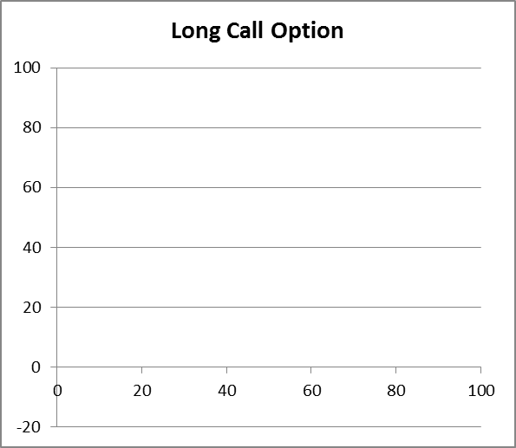
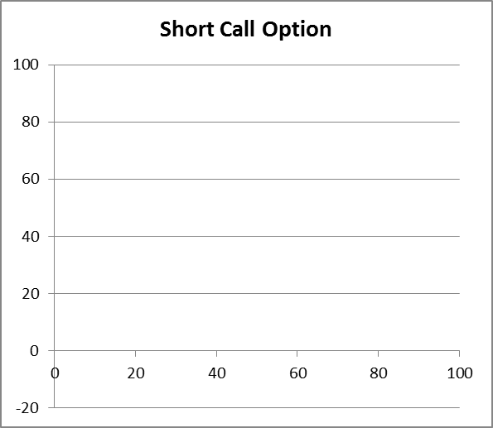
Question 1: Cisco Options
a) Draw the gross payoff for the following portfolio: buy a one year call option on Cisco with the strike price of 20 and sell a one year call option on Cisco with the strike price of 80.

Slide 5
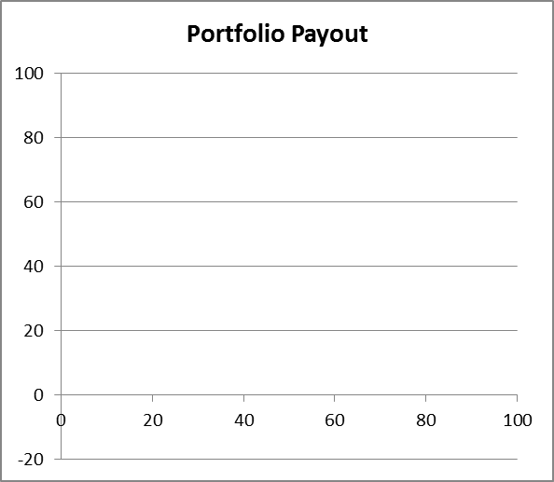
Question 1: Cisco Options
a) Draw the gross payoff for the following portfolio: buy a one year call option on Cisco with the strike price of 20 and sell a one year call option on Cisco with the strike price of 80.

Slide 6
Question 1: Cisco Options
b) Do you think the above portfolio has a positive price? (Hint: do you think you should pay or be paid to hold the above portfolio?) Why?

Slide 7
Question 1: Cisco Options
c) Assume that the β on Cisco stock is 1.3 and the risk free interest rate is 2%. What can you say about the expected return you earn from shorting calls on Cisco stock?

Slide 8
Question 2: Apple Options
Graph the payoff of the following portfolio of options on Apple stock expiring in one month, at the end of May: Sell one million call options with a strike price of $75, buy two million call options with a strike price of $100, and sell one million call options with a strike price of $125. The current price of Apple is $100.
Why might you want to hold this portfolio? Explain completely the beliefs consistent with holding this portfolio, and comment on possible alternative portfolios consistent with these beliefs.

Slide 9
Question 2: Apple Options
a) Graph the payoff of the following portfolio of options on Apple stock expiring in one month, at the end of May: Sell one million call options with a strike price of $75, buy two million call options with a strike price of $100, and sell one million call options with a strike price of $125. The current price of Apple is $100.
 | p_{AAPL} ≤ 75 | 75 <p_{AAPL} ≤ 100 | 100<p_{AAPL}≤ 125 | p_{AAPL} >125
Short 1M Calls Strike 75
Long 2M Calls Strike 100
Short 1M Calls Strike 125
Total

Slide 10
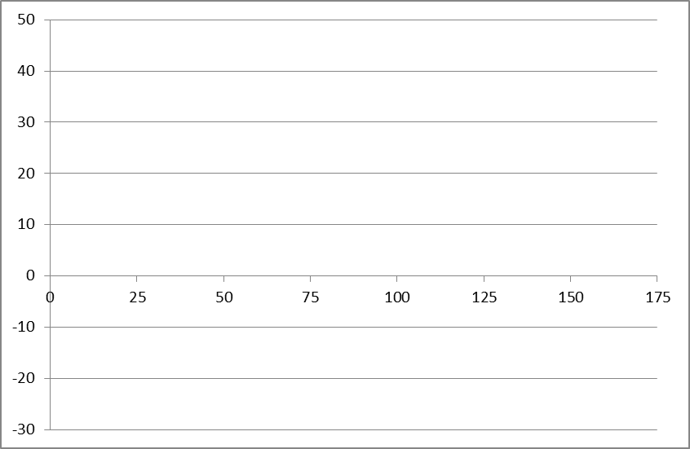
Question 2: Apple Options
a) Graph the payoff of the following portfolio of options on Apple stock expiring in one month, at the end of May: Sell one million call options with a strike price of $75, buy two million call options with a strike price of $100, and sell one million call options with a strike price of $125. The current price of Apple is $100.

Slide 11
Question 2: Apple Options
a) Graph the payoff of the following portfolio of options on Apple stock expiring in one month, at the end of May: Sell one million call options with a strike price of $75, buy two million call options with a strike price of $100, and sell one million call options with a strike price of $125. The current price of Apple is $100.

Slide 12
Question 2: Apple Options
a) Graph the payoff of the following portfolio of options on Apple stock expiring in one month, at the end of May: Sell one million call options with a strike price of $75, buy two million call options with a strike price of $100, and sell one million call options with a strike price of $125. The current price of Apple is $100.

Slide 13
Question 2: Apple Options
a) Graph the payoff of the following portfolio of options on Apple stock expiring in one month, at the end of May: Sell one million call options with a strike price of $75, buy two million call options with a strike price of $100, and sell one million call options with a strike price of $125. The current price of Apple is $100.

Slide 14
Question 2: Apple Options
b) Why might you want to hold this portfolio? Explain completely the beliefs consistent with holding this portfolio, and comment on possible alternative portfolios consistent with these beliefs.

Slide 15
Question 3: Put-Call Parity
Draw the payoff diagram for the following portfolio: Purchase one share of stock in Minnesota Mining and Manufacturing, purchase one put option on MMM stock with one year to expiration and a strike price of 100, and borrow the present value of 100. Draw the payoff for this portfolio as a function of MMM’s stock price next year.
What does the payoff diagram you have drawn in a) look like?
What can you say, if anything, about the price of a call option on the MMM stock with a strike price of 100 and two years to expiration?
What can you say, if anything, about the price of a put option on the MMM stock with a strike price of 120 and one year to expiration?

Slide 16
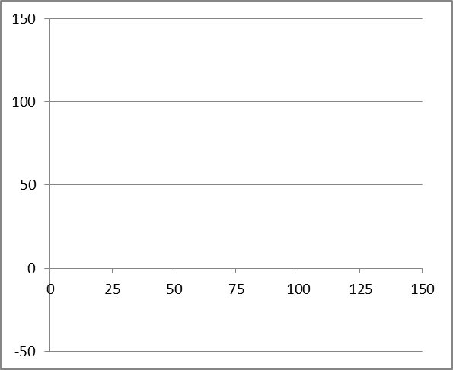
Question 3: Put-Call Parity
a) Draw the payoff diagram for the following portfolio: Purchase one share of stock in Minnesota Mining and Manufacturing, purchase one put option on MMM stock with one year to expiration and a strike price of 100, and borrow the present value of 100. Draw the payoff for this portfolio as a function of MMM’s stock price next year.

Slide 17
Question 3: Put-Call Parity
a) Draw the payoff diagram for the following portfolio: Purchase one share of stock in Minnesota Mining and Manufacturing, purchase one put option on MMM stock with one year to expiration and a strike price of 100, and borrow the present value of 100. Draw the payoff for this portfolio as a function of MMM’s stock price next year.

Slide 18
Question 3: Put-Call Parity
a) Draw the payoff diagram for the following portfolio: Purchase one share of stock in Minnesota Mining and Manufacturing, purchase one put option on MMM stock with one year to expiration and a strike price of 100, and borrow the present value of 100. Draw the payoff for this portfolio as a function of MMM’s stock price next year.

Slide 19
Question 3: Put-Call Parity
a) Draw the payoff diagram for the following portfolio: Purchase one share of stock in Minnesota Mining and Manufacturing, purchase one put option on MMM stock with one year to expiration and a strike price of 100, and borrow the present value of 100. Draw the payoff for this portfolio as a function of MMM’s stock price next year.

Slide 20
Question 3: Put-Call Parity
What does the payoff diagram you have drawn in a) look like?

Slide 21
Question 3: Put-Call Parity
c) What can you say, if anything, about the price of a call option on the MMM stock with a strike price of 100 and two years to expiration?

Slide 22
Question 3: Put-Call Parity
d) What can you say, if anything, about the price of a put option on the MMM stock with a strike price of 120 and one year to expiration?

