Slide 1
Finance 441 Tutorial 3
Financial Options
TA: Mame Maloney
Email: m-maloney@kellogg.northwestern.edu
January 22, 2014

Slide 2
Question 1: Cisco Options
Draw the gross payoff for the following portfolio: buy a one year call option on Cisco with the strike price of 20 and sell a one year call option on Cisco with the strike price of 80.
Do you think the above portfolio has a positive price? (Hint: do you think you should pay or be paid to hold the above portfolio?) Why?
Assume that the β on Cisco stock is 1.3 and the risk free interest rate is 2%. What can you say about the expected return you earn from shorting calls on Cisco stock?

Slide 3
Question 1: Cisco Options
a) Draw the gross payoff for the following portfolio: buy a one year call option on Cisco with the strike price of 20 and sell a one year call option on Cisco with the strike price of 80.
This portfolio contains two options, so your final picture will contain two kinks –one at 20 and the other at 80. Below 20, both options are out of the money. Between 20 and 80 the long position has a payoff equal to the stock price minus 20, the short position has zero payoff. Above 80, the short position becomes relevant. For every dollar the price of Cisco increases above 80 you will gain 1 dollar with the long position and lose one dollar with the short position. This is called a bull spread. Holders of bull spreads benefit from price increases.

Slide 4
Question 1: Cisco Options
a) Draw the gross payoff for the following portfolio: buy a one year call option on Cisco with the strike price of 20 and sell a one year call option on Cisco with the strike price of 80.
 | p_{CSCO} ≤ 20 | 20 < p_{CSCO} ≤ 80 | 80 < p_{CSCO}
Long Call Strike 20 | 0 | p_{CSCO} - 20 | p_{CSCO} - 20
Short Call Strike 80 | 0 | 0 | -(p_{CSCO} – 80)
Total | 0 | p_{CSCO} - 20 | 60

Slide 5
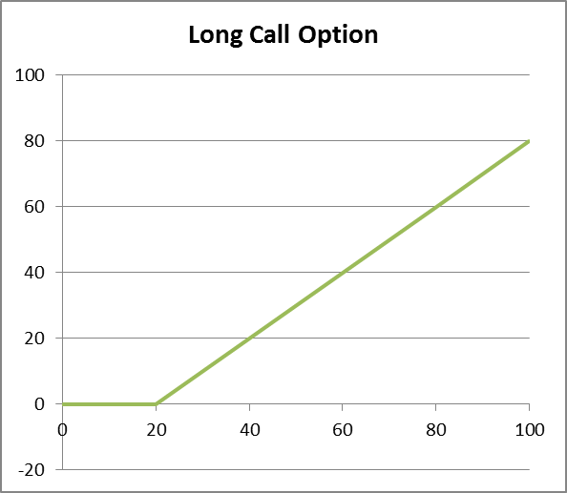
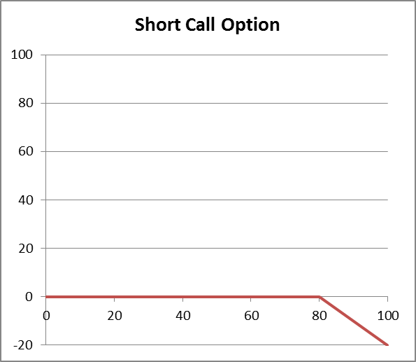
Question 1: Cisco Options
a) Draw the gross payoff for the following portfolio: buy a one year call option on Cisco with the strike price of 20 and sell a one year call option on Cisco with the strike price of 80.
Slope = 1
Slope = -1
Kink at 20
Kink at 80

Slide 6
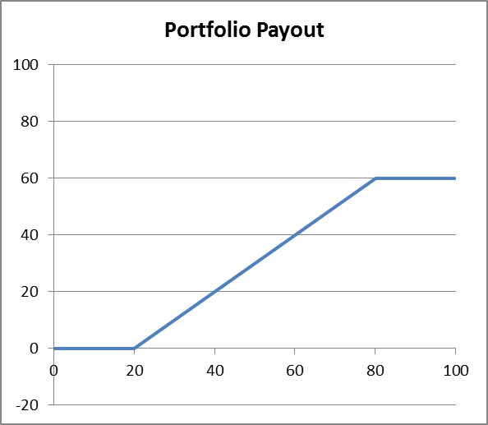
Question 1: Cisco Options
a) Draw the gross payoff for the following portfolio: buy a one year call option on Cisco with the strike price of 20 and sell a one year call option on Cisco with the strike price of 80.
Slope = 1
Kinks at 20 & 80

Slide 7
Question 1: Cisco Options
b) Do you think the above portfolio has a positive price? (Hint: do you think you should pay or be paid to hold the above portfolio?) Why?
The portfolio always has a positive payoff. This portfolio has a positive price, i.e. you should be paying in order to be able to buy the portfolio. If you could get paid to hold this portfolio, you could make a riskless arbitrage trade by doing so (you get money today and the worst that can happen tomorrow is that you make nothing.)

Slide 8
Question 1: Cisco Options
c) Assume that the β on Cisco stock is 1.3 and the risk free interest rate is 2%. What can you say about the expected return you earn from shorting calls on Cisco stock?
The expected return on shorting calls is less than the risk free rate. The beta of Cisco is positive – its stock price rises in booms and falls in recessions. Now look at the payoff of the short position. When Cisco’s stock price rises, the short position loses money (in booms). Thus the beta of shorting a call is negative. Thus, the expected return on shorting calls is less than the risk free rate.

Slide 9
Question 2: Apple Options
Graph the payoff of the following portfolio of options on Apple stock expiring in one month, at the end of May: Sell one million call options with a strike price of $75, buy two million call options with a strike price of $100, and sell one million call options with a strike price of $125. The current price of Apple is $100.
Why might you want to hold this portfolio? Explain completely the beliefs consistent with holding this portfolio, and comment on possible alternative portfolios consistent with these beliefs.

Slide 10
Question 2: Apple Options
a) Graph the payoff of the following portfolio of options on Apple stock expiring in one month, at the end of May: Sell one million call options with a strike price of $75, buy two million call options with a strike price of $100, and sell one million call options with a strike price of $125. The current price of Apple is $100.
 | p_{AAPL} ≤ 75 | 75 <p_{AAPL} ≤ 100 | 100 < p_{AAPL} ≤ 125 | p_{AAPL} > 125
Short 1M Calls Strike 75 | 0 | -1M*(p_{AAPL} - 75) | -1M*(p_{AAPL} - 75) | -1M*(p_{AAPL} - 75)
Long 2M Calls Strike 100 | 0 | 0 | 2M*(p_{AAPL} - 100) | 2M*(p_{AAPL} - 100)
Short 1M Calls Strike 125 | 0 | 0 | 0 | -1M*(p_{AAPL} - 125)
Total | 0 | -1M*(p_{AAPL} - 75) | 1M*(p_{AAPL} - 125) | 0

Slide 11
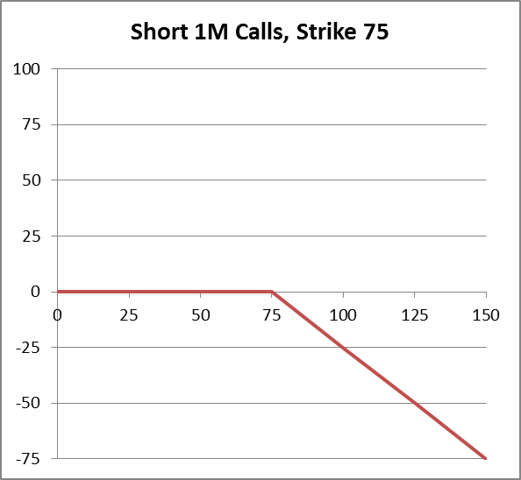
Question 2: Apple Options
a) Graph the payoff of the following portfolio of options on Apple stock expiring in one month, at the end of May: Sell one million call options with a strike price of $75, buy two million call options with a strike price of $100, and sell one million call options with a strike price of $125. The current price of Apple is $100.
Kink at 75
Slope = -1

Slide 12
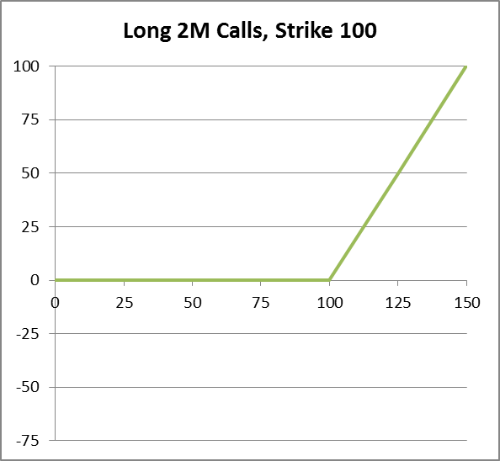
Question 2: Apple Options
a) Graph the payoff of the following portfolio of options on Apple stock expiring in one month, at the end of May: Sell one million call options with a strike price of $75, buy two million call options with a strike price of $100, and sell one million call options with a strike price of $125. The current price of Apple is $100.
Slope = 2
Kink at 100

Slide 13
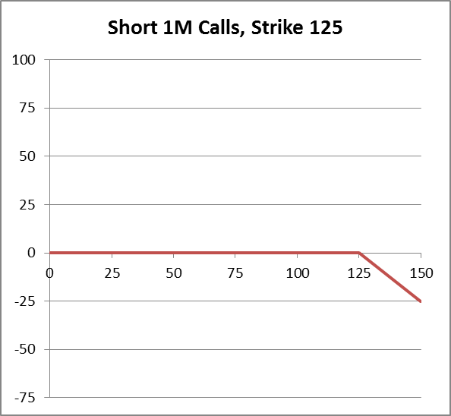
Question 2: Apple Options
a) Graph the payoff of the following portfolio of options on Apple stock expiring in one month, at the end of May: Sell one million call options with a strike price of $75, buy two million call options with a strike price of $100, and sell one million call options with a strike price of $125. The current price of Apple is $100.
Slope = -1
Kink at 125

Slide 14
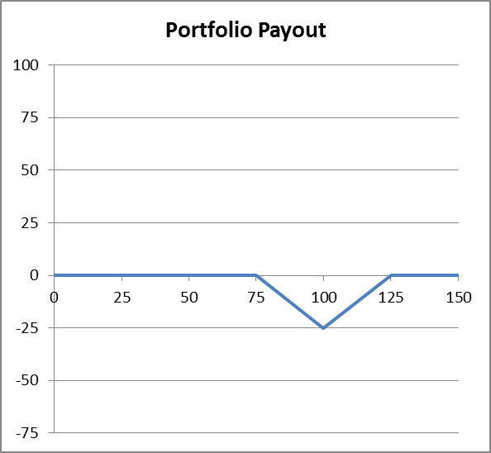
Question 2: Apple Options
a) Graph the payoff of the following portfolio of options on Apple stock expiring in one month, at the end of May: Sell one million call options with a strike price of $75, buy two million call options with a strike price of $100, and sell one million call options with a strike price of $125. The current price of Apple is $100.

Slide 15
Question 2: Apple Options
b) Why might you want to hold this portfolio? Explain completely the beliefs consistent with holding this portfolio, and comment on possible alternative portfolios consistent with these beliefs.
This graph is the opposite of the bet on low volatility. It is a bet on high volatility. If the price is currently $100, this portfolio will have a positive net payoff if Apple’s price experiences large price movements. If your beliefs reflect those of the average market participant, then this portfolio will have a price equal to the expected risk adjusted discounted payoff, i.e. it is fairly priced. Thus, you expect zero risk adjusted profits on this bet. On the other hand, if you believe volatility is higher than the average market participant believes, then all call options are under priced from your perspective. Since you are both buying and selling calls, you are selling some calls which you believe to be under priced. Thus, you may instead want to construct a portfolio with only long options (e.g. a long call and long put with the same strike price) however, this will require more cash up front.

Slide 16
Question 3: Put-Call Parity
Draw the payoff diagram for the following portfolio: Purchase one share of stock in Minnesota Mining and Manufacturing, purchase one put option on MMM stock with one year to expiration and a strike price of 100, and borrow the present value of 100. Draw the payoff for this portfolio as a function of MMM’s stock price next year.
What does the payoff diagram you have drawn in a) look like?
What can you say, if anything, about the price of a call option on the MMM stock with a strike price of 100 and two years to expiration?
What can you say, if anything, about the price of a put option on the MMM stock with a strike price of 120 and one year to expiration?

Slide 17
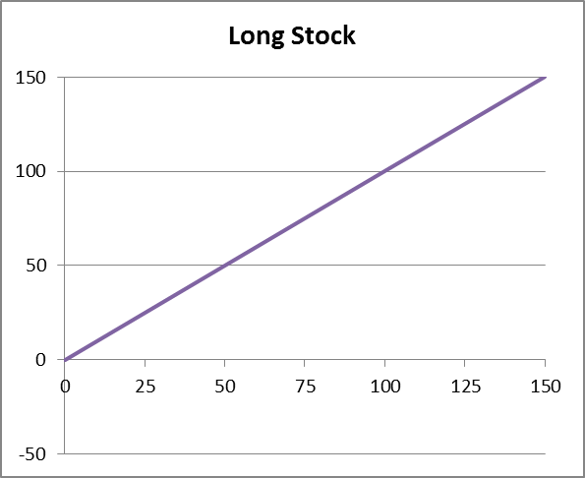
Question 3: Put-Call Parity
a) Draw the payoff diagram for the following portfolio: Purchase one share of stock in Minnesota Mining and Manufacturing, purchase one put option on MMM stock with one year to expiration and a strike price of 100, and borrow the present value of 100. Draw the payoff for this portfolio as a function of MMM’s stock price next year.
Step 1: draw the payoff diagram for one share of MMM stock as a function of the MMM stock price in one year. It is a 45 degree line:

Slide 18
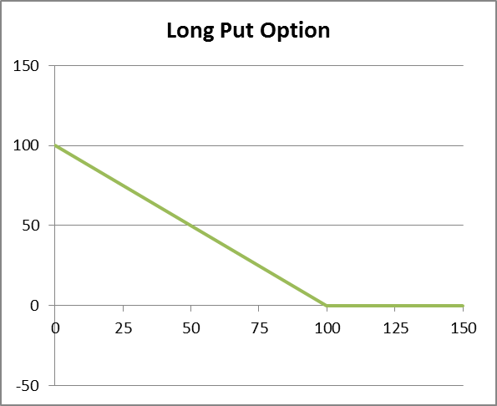
Question 3: Put-Call Parity
a) Draw the payoff diagram for the following portfolio: Purchase one share of stock in Minnesota Mining and Manufacturing, purchase one put option on MMM stock with one year to expiration and a strike price of 100, and borrow the present value of 100. Draw the payoff for this portfolio as a function of MMM’s stock price next year.
Step 2: draw the payoff of the put option as a function of the MMM stock price next year.

Slide 19
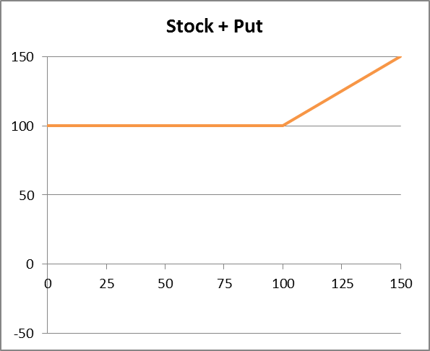
Question 3: Put-Call Parity
a) Draw the payoff diagram for the following portfolio: Purchase one share of stock in Minnesota Mining and Manufacturing, purchase one put option on MMM stock with one year to expiration and a strike price of 100, and borrow the present value of 100. Draw the payoff for this portfolio as a function of MMM’s stock price next year.
Step 3: Add together the stock and the put.

Slide 20
Question 3: Put-Call Parity
a) Draw the payoff diagram for the following portfolio: Purchase one share of stock in Minnesota Mining and Manufacturing, purchase one put option on MMM stock with one year to expiration and a strike price of 100, and borrow the present value of 100. Draw the payoff for this portfolio as a function of MMM’s stock price next year.
Step 4: The final step is to include the borrowing. When I borrow the present value of $100, I promise to pay back $100 in one year. Thus, I need to subtract $100 from the payoff. Notice that the payoff from the stock plus the put is always at least $100. This is why I use the risk-free rate when valuing options. The payoff for the portfolio of long one share of stock plus a put partially financed by borrowing the present value of the strike price ($100) is graphed below:

Slide 21
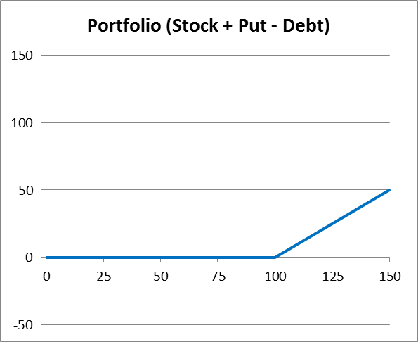
Question 3: Put-Call Parity
a) Draw the payoff diagram for the following portfolio: Purchase one share of stock in Minnesota Mining and Manufacturing, purchase one put option on MMM stock with one year to expiration and a strike price of 100, and borrow the present value of 100. Draw the payoff for this portfolio as a function of MMM’s stock price next year.

Slide 22
Question 3: Put-Call Parity
What does the payoff diagram you have drawn in a) look like?
It is the payoff diagram for a call option on MMM stock with a strike price of $100.

Slide 23
Question 3: Put-Call Parity
c) What can you say, if anything, about the price of a call option on the MMM stock with a strike price of 100 and two years to expiration?
The value of waiting is greater the more you learn. Since you will learn more about the future stock price in two years than in one, the longer the maturity the more valuable the option. Thus the call option on MMM stock with a strike price of 100 and two years to maturity must have a price greater than the call with a strike price of 100 and one year to maturity.

Slide 24
Question 3: Put-Call Parity
d) What can you say, if anything, about the price of a put option on the MMM stock with a strike price of 120 and one year to expiration?
The payoff to a put option rises as the strike price rises. You would rather have the option to sell stock for 120 in one year than for a price of 100. So, this put must have a price greater than the price of the put with a strike price of 100.

