Slide 1
Finance 441 Tutorial 1
Cost of Capital
TA: Mame Maloney
Email: m-maloney@kellogg.northwestern.edu
January 10, 2013

Slide 2
Overview
We are interested in valuing a project or a firm by discounting expected CFs of a project using a discount rate.
What is the correct discount rate to use for assets of a certain riskiness?

Slide 3
Overview
We are interested in valuing a project or a firm by discounting expected CFs of a project using a discount rate.
By investing in the firm’s project, the investor will not be able to invest elsewhere. The correct discount rate to use for assets should reflect the opportunity cost, which is the cost of investing with the firm: firm’s cost of capital.

Slide 4
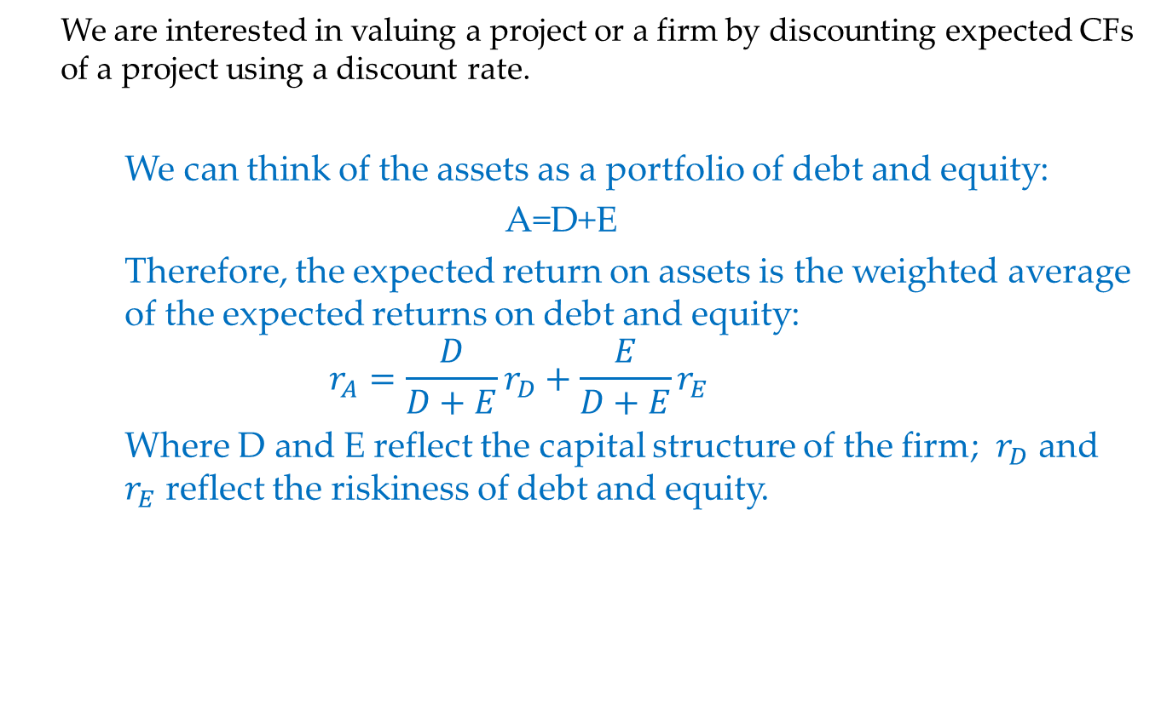
Overview
We are interested in valuing a project or a firm by discounting expected CFs of a project using a discount rate.
We can think of the assets as a portfolio of debt and equity:
A=D+E
Therefore, the expected return on assets is the weighted average of the expected returns on debt and equity:
$${r_{A}=\frac{D}{D+E}r}_{D}+\frac{E}{D+E}r_{E}$$
Where D and E reflect the capital structure of the firm; $r_{D}$ and $r_{E}$ reflect the riskiness of debt and equity.

Slide 5
Question 1: Cost of debt
A company just issued 1-year bond with a face value of $1000. The stated coupon rate is 10% (paid annually). The current price of bond is $998.5.
What is the promised rate or yield of the bond?
Suppose the bond defaults 10% of the time in which case it only returns half of the principal (non interest). What is the expected return of the bond?
If the 1-year risk free rate is 3% and the market risk premium is 8%, what is the beta of this debt?

Slide 6
Question 1: Cost of debt
What is the promised rate or yield of the bond?
First, recall two definitions:
Coupon rate (r_{c}): the interest rate contractually set by the firm; along with the face value, they determine the contractual/promised CFs associated with this bond.
Promised rate (r_{p}): the bond’s yield; it is the discount rate that sets the present value of the contractual/promised CFs equal to the price.
Cash Flow = Face Value + Coupon
= $1000 + $1000*10%
= $1100
Present Value = price = $998.5

Slide 7
Question 1: Cost of debt
Cont’d
So we can calculate the promised rate by:

Slide 8
Question 1: Cost of debt
Cont’d
Why is the promised rate was higher than the coupon rate of 10%, and how should we interpret this?
The present value of $998.5 has to grow by 10.16% to reach the time 1 cash flows of $1100.
The face value of $1000 would only need to grow by 10% (a smaller amount) to reach the time 1 cash flow of $1000.
So we see that this bond has a lower price than it would have if it only needed to grow by 10% to reach its goal. Does that mean the bond is “discounted” or a “good deal”? Not exactly --- as we’ll see in part (b), there is more to the story that we haven’t seen yet.

Slide 9
Question 1: Cost of debt
Suppose the bond defaults 10% of the time in which case it only returns half of the principal (non interest). What is the expected return of the bond?
“Expected return” is the probability-weighted average of returns on debt across all states. There are two “states” here: default, and no default. So, we can build a chart:
State | Probability | Cash Flows | Return
No Default | 90% | $1100 | 10.16%
Default | 10% | $500 | -49.9%

Slide 10
Question 1: Cost of debt
Cont’d
How did we get these numbers?
Probability: These were given in the statement of the problem.
Cash Flows:
  In part (a), we calculated the $1100 cash flow for the no-default state.
  For the default state, the problem tells us we get half of the principal (i.e. half of the face value). The face value is $1000, so this means we get a cash flow of $500 in the default state.
Returns: these are calculated by taking your out-of-pocket cash flow, and dividing by the original amount you paid to get a percentage comparison. The formula is:

Slide 11
Question 1: Cost of debt
Cont’d
In the no-default state, the return is:
In the default state, the return is:

Slide 12
Question 1: Cost of debt
Cont’d
Now we’re ready to calculate the expected return, i.e. weighted average return:

Slide 13
Question 1: Cost of debt
If the 1-year risk free rate is 3% and the market risk premium is 8%, what is the beta of this debt?
We can figure this out using the CAPM formula:
Filling in the pieces of the formula:

Slide 14
Question 2: Cost of Capital
Thomson Industries wants to estimate the cost of capital for the evaluation of expanding its current business. A typical project is financed with 30% debt-to-value ratio (i.e., D/(D+E) = 0.30). The cost of debt for Thomson is 7%
DataServices, a publicly traded firm in the same business as Thomson Industries, is financed with 20% debt-to-value ratio and has an equity beta of 0.8. The cost of debt for DataServices is 6%.
Assume that the risk free rate is 5% and the expected market risk premium is 7%.
a) What is the cost of capital of Thomson Industries?
b) What is the required return on equity for Thomson Industries?

Slide 15
Question 2: Cost of Capital
What is the cost of capital of Thomson Industries?
Before we dive into the calculations, notice that both of the questions we have to answer are about Thomson Industries. But the problem also gives us information about DataServices --- this is a big hint that we need to use the DataServices information in order to figure out something about Thomson.
One “hidden assumption” that is buried in this question is that since DataServices and Thomson are in the same industry and have the same asset beta, we thus assume they have the same overall cost of capital:
We need to find the overall cost of capital of Thomson (i.e. r_{A}). Let’s look at our formula and think about what pieces of the puzzle we already have, and what pieces we need.

Slide 16
Question 2: Cost of Capital
Cont’d
Note: being in the same industry doesn’t automatically mean that two firms have the same cost of capital. His example was Microsoft versus some one-man tech startup; even though both companies are in the technology industry, they will have very different characteristics. This is completely correct, and saying that they are in the same “industry” is just a simplification. Thinking about it more deeply, the start-up probably is riskier than Micrsoft, but much of this additional risk is idiosyncratic. Idiosyncratic risk does not affect the discount rate. It may have a higher or lower beta than Microsoft, we would have to think about what kind of product/service they sell relative to Microsoft. The way firms are compared in real life isn’t to a broad “industry”, but rather to a localized “peer group”: a collection of companies with similar characteristics.

Slide 17
Question 2: Cost of Capital
Cont’d
Our formula is:
We can only apply this formula to one firm at a time. We can’t “mix and match” the various pieces of the formula between the two firms. So, let’s focus on DataServices first. What pieces do we know?

Slide 18
Question 2: Cost of Capital
a) Cont’d
 | DataServices
D/(D+E) | =20%. This was given in the statement of the problem.
E/(D+E) | =80%. Since we know the fraction of the “pie” that is made up of debt, the remaining slice of the pie is equity.
r_{D} | =6%. This was given in the statement of the problem.
r_{E} | =10.6%. See next page for calculation.
r_{A} | = 9.68%. See next page for calculation.

Slide 19
Question 2: Cost of Capital
Cont’d
Return on equity: we don’t know this piece yet. However, the information we get in the problem gives us a big hint. Since we know the equity beta for DataServices, and we know the risk free rate and market risk premium, we can figure this part out.
Using our familiar CAPM formula:
Substituting in the pieces of this formula using the information given in the problem:

Slide 20
Question 2: Cost of Capital
Cont’d
Now we can plug this into the formula for cost of capital for DataServices:

Slide 21
Question 2: Cost of Capital
b) What is the required return on equity for Thomson Industries?
 | Thomson Industries
r_{A} | =9.68%. We figured this out in part (a).
D/(D+E) | =30%. This is given in the statement of the problem.
E/(D+E) | =70%. The remaining slice of the pie.
r_{D} | =7%. This is given in the statement of the problem.
r_{E} | =10.83%. See next page for calculation.

Slide 22
Question 2: Cost of Capital
Cont’d
Plugging everything in to get the return on equity:

Slide 23
Question 3: Cost of Capital and Capital Structure
Consider a project with free cash flows in one year of either $100,000 or $180,000 with each outcome being equally likely. The initial investment required for the project is $100,000 and the project's cost of capital is 20%. The risk-free interest rate is 10%.
a) What is the NPV of this project?
b) Suppose that to raise the funds for the initial investment, the project is sold to investors as an all-equity firm. The equity holders will receive the cash flows of the project in one year. How much money can be raised in this way - that is, what is the initial market value of unlevered equity?
c) Suppose the initial $100,000 is instead raised by borrowing $50,000 at the risk free interest rate and selling the rest of the project to equity investors. What are the cash flows of the levered equity? What is the expected return on equity?
d) Suppose the initial $100,000 is instead raised by issuing $100,000 with a stated coupon rate of 25%. What are the cash flows of the levered equity? What are the expected returns on debt and equity?

Slide 24
Question 3: Cost of Capital and Capital Structure
What is the NPV of this project?
Step “0”: let’s write down the pieces of information that the problem already gives us:
r_{A} = 20%
r_{f} = 10%
CF₀ = -100,000
State | Probability | CF₁
Bad | 0.5 | $100,000
Good | 0.5 | $180,000

Slide 25
Question 3: Cost of Capital and Capital Structure
Cont’d
Step 1: Compute the expected CF at time 1 using CF₁ and the probabilities:
Step 2: Use the project’s cost of capital to discount the expected CF at time one (since CF₁ is risky)
Step 3: Compute the project’s NPV by subtracting away the cost:

Slide 26
Question 3: Cost of Capital and Capital Structure
b) Suppose that to raise the funds for the initial investment, the project is sold to investors as an all-equity firm. The equity holders will receive the cash flows of the project in one year. How much money can be raised in this way - that is, what is the initial market value of unlevered equity?
State | Probability | CF₁ | E₁ | r_{E}
Bad | 0.5 | $100,000 | -100,000 | -14.3%
Good | 0.5 | $180,000 | -180,000 | 54.3%
Expected |  | $140,000 | -140,000 | 20%

Slide 27
Question 3: Cost of Capital and Capital Structure
Cont’d
Note that in this case, assets = equity. The equity investors are willing to raise the amount of money that equals to the present value of CFs at time one:
The equity cost of capital is the same as the return on assets since equity CFs are just as risky as the asset.

Slide 28
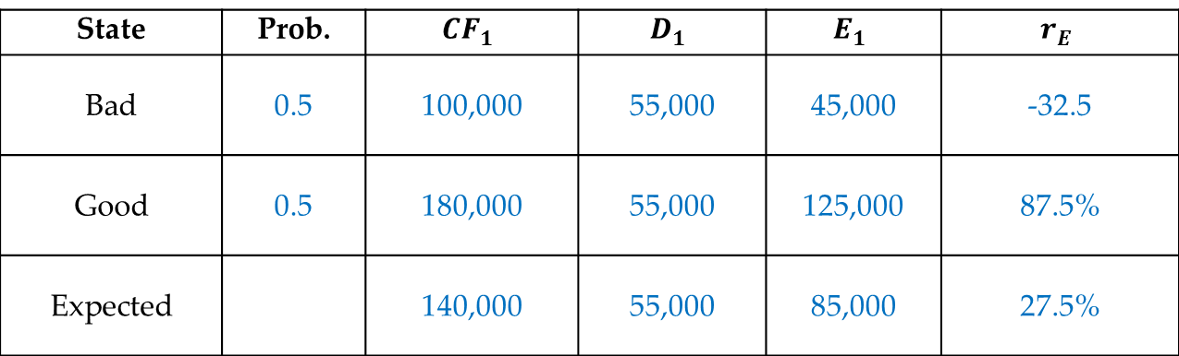
Question 3: Cost of Capital and Capital Structure
Suppose the initial $100,000 is instead raised by borrowing $50,000 at the risk free interest rate and selling the rest of the project to equity investors. What are the cash flows of the levered equity? What is the expected return on equity?
CF₀ = -$100,000
D₀ = $50,000
E₀ = $116,667 - $50,000 = $66,667
State | Prob. | $$CF_{1}$$ | $$D_{1}$$ | $$E_{1}$$ | $$r_{E}$$
Bad | 0.5 | 100,000 | 55,000 | 45,000 | -32.5
Good | 0.5 | 180,000 | 55,000 | 125,000 | 87.5%
Expected |  | 140,000 | 55,000 | 85,000 | 27.5%

Slide 29
Question 3: Cost of Capital and Capital Structure
Cont’d
Step 1: Determine the CFs to debt holders at time one
Promised CF to the debt holders if there is no default: $50,000*(1+10%)=$55,000
Given CF₁>55000 in both states, debt holders will always receive $55,000.
Step 2: Determine the CFs to equity holder as E₁=CF₁ - D₁

Slide 30
Question 3: Cost of Capital and Capital Structure
Cont’d
Step 3: Expected CF to equity holder:
Step 4: Determine the value of equity at time zero:

Slide 31
Question 3: Cost of Capital and Capital Structure
Cont’d
Step 5: Determine the value of equity at time zero:

Slide 32
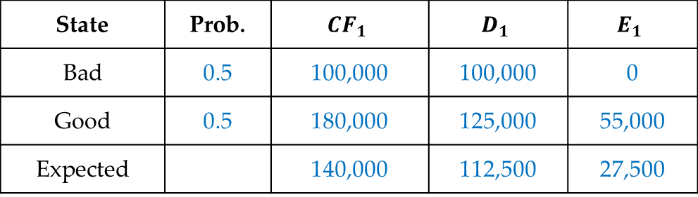
Question 3: Cost of Capital and Capital Structure
Suppose the initial $100,000 is instead raised by issuing $100,000 with a stated coupon rate of 25%. What are the cash flows of the levered equity? What are the expected returns on debt and equity?
State | Prob. | $$CF_{1}$$ | $$D_{1}$$ | $$E_{1}$$
Bad | 0.5 | 100,000 | 100,000 | 0
Good | 0.5 | 180,000 | 125,000 | 55,000
Expected |  | 140,000 | 112,500 | 27,500

Slide 33
Question 3: Cost of Capital and Capital Structure
Cont’d
Step 1: Determine the CFs to debt holders at time one
  • The promised CF to debt holders if there is no default: $100,000*(1+25%)=$125,000
  • In the good state: no default, debt holders will receive $125,000.
  • In the bad state: default since 𝐶𝐹_1 < 𝑝𝑟𝑜𝑚𝑖𝑠𝑒𝑑 𝑝𝑎𝑦𝑚𝑒𝑛𝑡, debt holders will receive 𝐶𝐹_1=100,000
Step 2: Determine the expected CF to debt holders:
  (𝐷1) = 0.5×125,000 + 0.5×100,000 = $112,500
Step 3: Expected return to debt holders
(𝑟𝐷) = E(D1)/D0 – 1 = 112,500/100,000 – 1 = 12.5%

Slide 34
Question 3: Cost of Capital and Capital Structure
Cont’d
Step 4: Determine the CFs to equity holder:
E₁^{Bad} = CF₁^{Bad} - D₁^{Bad} = 100,000 - 100,000 = $0
E₁^{Good} = CF₁^{Good} - D₁^{Good} = 180,000 - 125,000 = $55,000
Step 5: Expected CF to equity holder:
E(E₁ )=0.5×$0+0.5×55,000=27,500
Step 6: Determine the value of equity at time zero:
E₀=PV(CF₁ )-D₀=116,667-100,000=16,667
Step 7: Expected return on equity:

