Slide 1

DC Health Link
Mila Kofman, JD
Executive Director
DC Health Benefit Exchange Authority

Slide 2
Background – DC
2012 legislation
HBX Executive Board appointed (7 private voting members; 4 non-voting government agency directors)
Jan 2013 IT contract with SI signed by city

Slide 3
DC ENROLLMENT AS OF 8/29
October 1, 2013 to August 28, 2014 (includes open enrollment and SEPs), 56,921 people have enrolled through DC Health Link in private health plans or Medicaid:
  14,158 people enrolled in private health plans through the DC Health Link individual and family marketplace;
  28,568 people determined eligible for Medicaid coverage through DC Health Link; and
  14,195 people enrolled through the DC Health Link small business marketplace (includes Congressional enrollment)

Slide 4
2014:
267 Small Group Plans and 34 Individual (3 catastrophic)
2015:
161 Small Group Plans and 31 Individual (3 catastrophic) filed for approval
Insurers: Aetna; Carefirst BlueCross BlueShield; Kaiser Permanente; United HealthCare (group only)

Slide 5
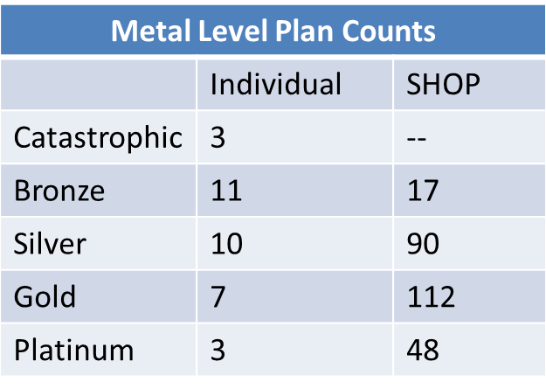
2014 Products for Individuals/Small Business
Prices & Medal Levels
Carrier Plan Counts
 | Individual | SHOP
Aetna | 9 | 14
CareFirst | 15 | 54
Kaiser | 10 | 22
United | -- | 177

Slide 6
Proposed for 2015 Metal Level Plan Counts
 | Individual (31) | SHOP (161)
Catastrophic | 3 | n/a
Bronze | 9 | 16
Silver | 9 | 50
Gold | 7 | 57
Platinum | 3 | 38
Notes:
SHOP: By carrier for 2015: 8 Aetna, 57 CareFirst, 24 Kaiser, 72 United
Individual: By carrier for 2015: 6 Aetna, 15 CareFirst, 10 Kaiser

Slide 7
Individual Covered Lives - METAL LEVEL 8/17 data

Slide 8
SHOP COVERED LIVES - METAL LEVEL
(not including Congress) 8/17 data

Slide 9
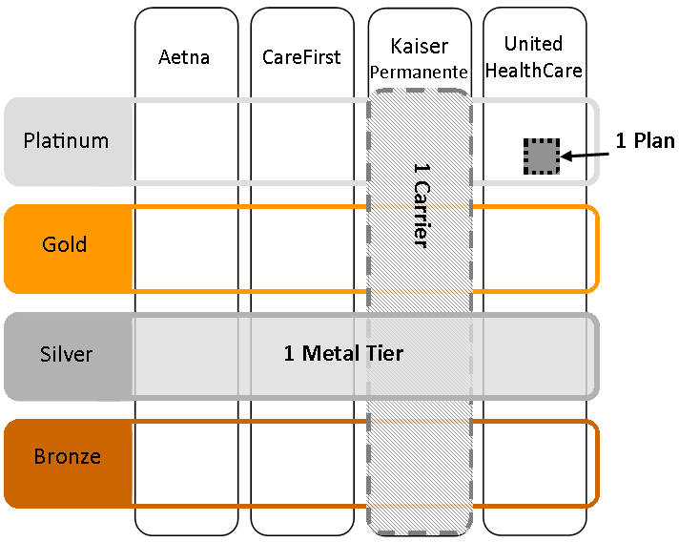
Employer’s Options
Employer chooses how many plans to offer to employees:
All Plans - 1 Metal Level
All Plans from 1 Carrier
1 Plan from 1 Carrier

Slide 10
Employer’s Choice (first 243 employers)
1 Plan 1 Carrier | 72
All Plans 1 Carrier | 97
1 Metal Level all Carriers | 74

Slide 11
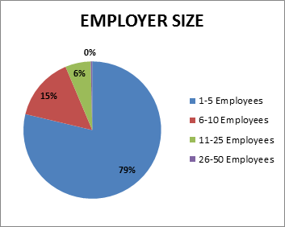
EMPLOYER SIZE | COUNT
1-5 Employees | 211
6-10 Employees | 40
11-25 Employees | 16
26-50 Employees | 1
TOTAL | 268
* Does Not Include Congressional Employers

Slide 12
Nationwide networks – most QHPs
  Regional products reflect pre-marketplace networks (including in-network providers in DC, MD, VA, and parts of DE, WV, and PA)
EHB – no benefit substitution (stakeholder working group consensus)
Standardization working group: 2016 QHPs cost sharing, e.g. deductibles, etc.(one standard plan at metal levels, others non-standard)

Slide 13
Thank you!
To learn more:
Visit us at www.dchealthlink.com
Like us on Facebook:DC Health Benefit Exchange
Follow us on twitter @dchbx

