Slide 1
Symposium on State-Based Exchanges: Takeaways
Professor Leemore Dafny
September 4, 2014

Slide 2
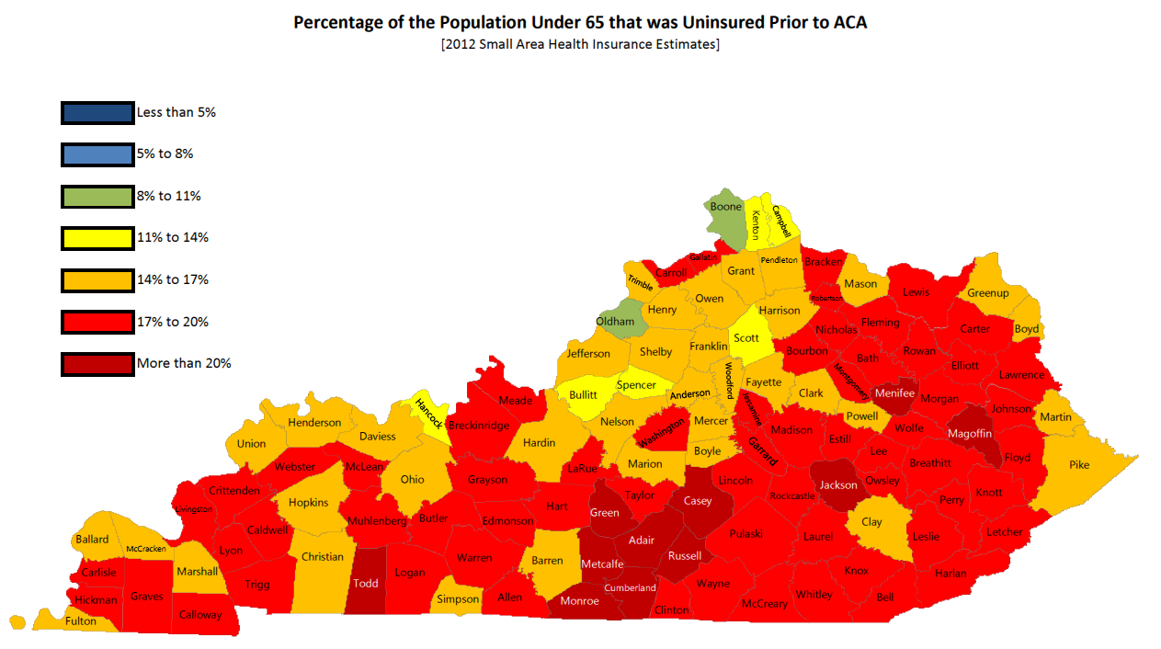
Key slides

Slide 3
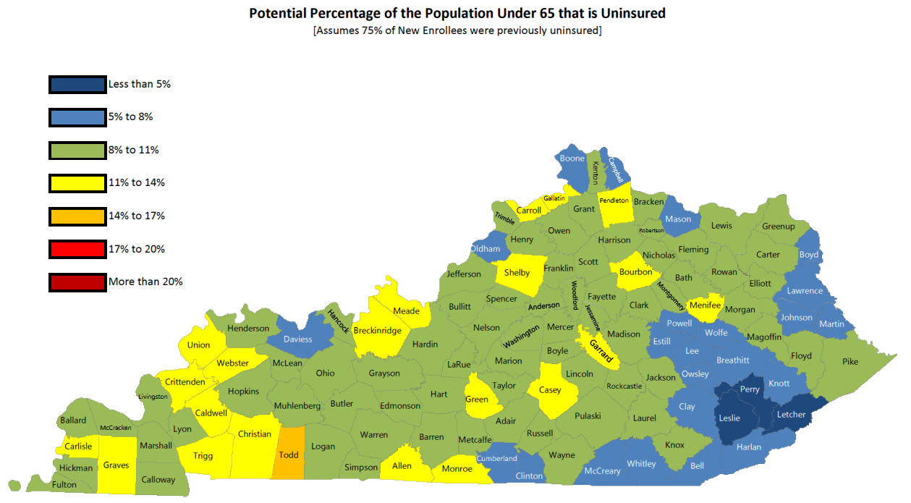
Key slides
INSERT BEFORE AND AFTER KY SLIDES HERE

Slide 4
Selected Quotes
“The exchange is more than a website.” (MD)
“Whatever you do, do it quickly.” (WA)
“[Don’t underestimate] the importance of a single wringable neck.” (MN)
“We dreamt big….those dreams kept shrinking…ended up with a few pieces of key functionality.” (CO)
“You have the advantage of being a second round adopter.” (Howard)
“I wish I could go back to that simple stakeholder environment.” (CT)

Slide 5
Overview
Consensus Benefits of Running a State Exchange
Consensus Challenges of Running a State Exchange
Consensus Challenges (any exchange)
Different approaches taken
  Governance
  Technology
  Plan design
Ingredients for Success

Slide 6
Consensus Benefits
Sustain policy flexibility
  Your deadlines, your regulations
Address local and regional consumer needs
  Obtain, use, and share real-time data
Integrated, seamless Medicaid enrollment
Collaborate with stakeholders
Choose governance structure (and pick your team)
Avoid dual regulation

Slide 7
Consensus Challenges
Time constraints
Identify and attract leaders and champions
Establish points of accountability
Operationalize transparency
  Manage tension between transparent decision making and flexibility and speed
Coordinate with multiple state agencies (and they don’t all play nicely)
Manage public – private conflicts
Notes:
Time frame: The limited time frame proved to be challenging in multiple regards. It was difficult to develop the IT, select leadership, and establish roles, responsibilities, and accountability quickly. Many states struggled with identifying the chain of command initially.
Governance structure: States identified the governing structure as one of the critical aspects of establishing a successful exchange. It is important for exchanges to select and implement a governance structure that aligns with the exchange’s goals.
Several speakers highlighted the importance of working with a team made up of dedicated and informed people. In particular, it is important to select people with expertise in areas that are relevant to the exchange’s goals while accounting for conflicts of interest.
Year 2 outreach and education v. Year 1 – Targeting subpopulations, harder to reach uninsured, and the insured for renewal
States discussed the business side of running the exchange – many cited lessons of establishing clear chain of command
Several states underestimated consumer needs for customer support. Kentucky described issues with high traffic on their website, Maryland required more in person navigators
States underscored the value of transparency despite its difficulties, MN published various enrollment metrics, WA and others published meeting minutes
Many state agencies are involved, each with different (potentially redundant ) tasks
i.e. Navigator / Broker issue in many states

Slide 8
Consensus Challenges (any exchange)
Outreach and education
  Mass attendance events work
Provide and predict adequate customer service
Give agents necessary tools (to work with individuals and small businesses)
Resolve navigator/broker tensions

Slide 9
Different approaches
Governance
  If established and operating under executive order: state agency
  Nonprofit or “quasi-governmental” requires legislation
  Stakeholder representation vs. conflicts of interest on managing board
Technology
  Utilizing one integrated eligibility system for Medicaid and QHPs
  Filtering tools
Plan design
  Clearinghouse versus more active purchasing
    “Floor” or “ceiling” approach (or both)
Notes:
RI still operating under exec order
TECHNOLOGY
-Kentucky and Rhode Island utilized an integrated eligibility system when they launched last year. While other states have adopted it, others like Colorado do not.
- States such as Kentucky and Colorado allow consumers to search for plans by provider or hospital

Slide 10
Ingredients for Success
Create a “culture of coverage”
Plan early
Have contingency plans
Integrate eligibility system for Medicaid and QHP
User-friendly site, e.g. re-screen eligibility
Manage politicization of exchanges
Make provider network information accessible
Tailor board of directors to state needs, use advisory boards to address conflicts of interest

