Slide 1

The State of Exchanges:
Where We Are and What the Law Allows

Slide 2
Exchanges are a vital part of the ACA
The success of the ACA ultimately depends on well functioning exchanges
This goes beyond simply the operation of a website
Exchanges must establish the previously elusive stable individual insurance market

Slide 3
Who should run exchanges?
The intention was that states would establish marketplaces (née exchanges)
  “Each State shall, not later than January 1, 2014, establish an American Health Benefit Exchange (referred to in this title as an ‘Exchange’) for the State…”
Federally run exchanges were meant to serve as a backstop for a small number of states that didn’t establish exchanges

Slide 4
“It is one of the happy incidents of the federal system that a single courageous State may, if its citizens choose, serve as a laboratory; and try novel social and economic experiments without risk to the rest of the country…”
- Justice Louis Brandeis

Slide 5
Depending on population size, exchanges can be expensive
State | Enrollees | Total Expenditures | Expenditures per Enrollee
Hawaii | 5,744 | $205,342,270 | $35,749.00
DC | 6,516 | $133,573,927 | $20,499.37
Vermont | 24,326 | $168,124,081 | $6,911.29
Massachusetts | 26,356 | $180,067,775 | $6,832.14
Oregon | 50,137 | $303,011,587 | $6,043.67
Rhode Island | 19,690 | $105,305,029 | $5,348.15
Kentucky | 65,964 | $253,167,439 | $3,837.96
Maryland | 44,836 | $171,063,110 | $3,815.31
Minnesota | 41,273 | $155,020,465 | $3,755.98
Nevada | 35,000 | $90,773,768 | $2,593.54
Connecticut | 64,450 | $164,466,460 | $2,551.85
Colorado | 100,112 | $178,931,022 | $1,787.31
Washington | 191,677 | $266,026,060 | $1,387.89
New York | 342,895 | $429,065,407 | $1,251.30
California | 1,018,315 | $1,065,212,950 | $1,046.05
 |  | Average cost per enrollee | $1,899.16

Slide 6
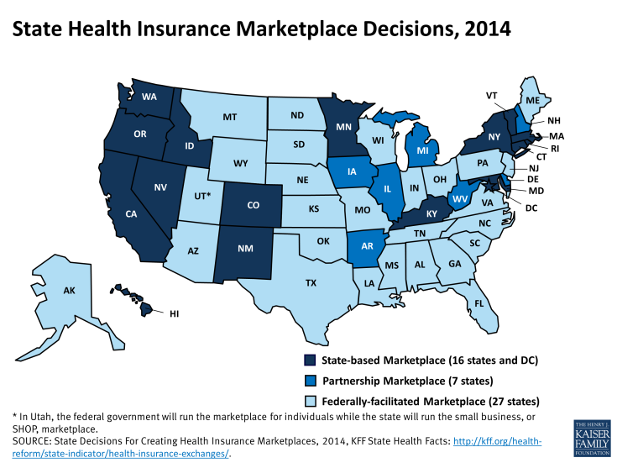

Slide 7
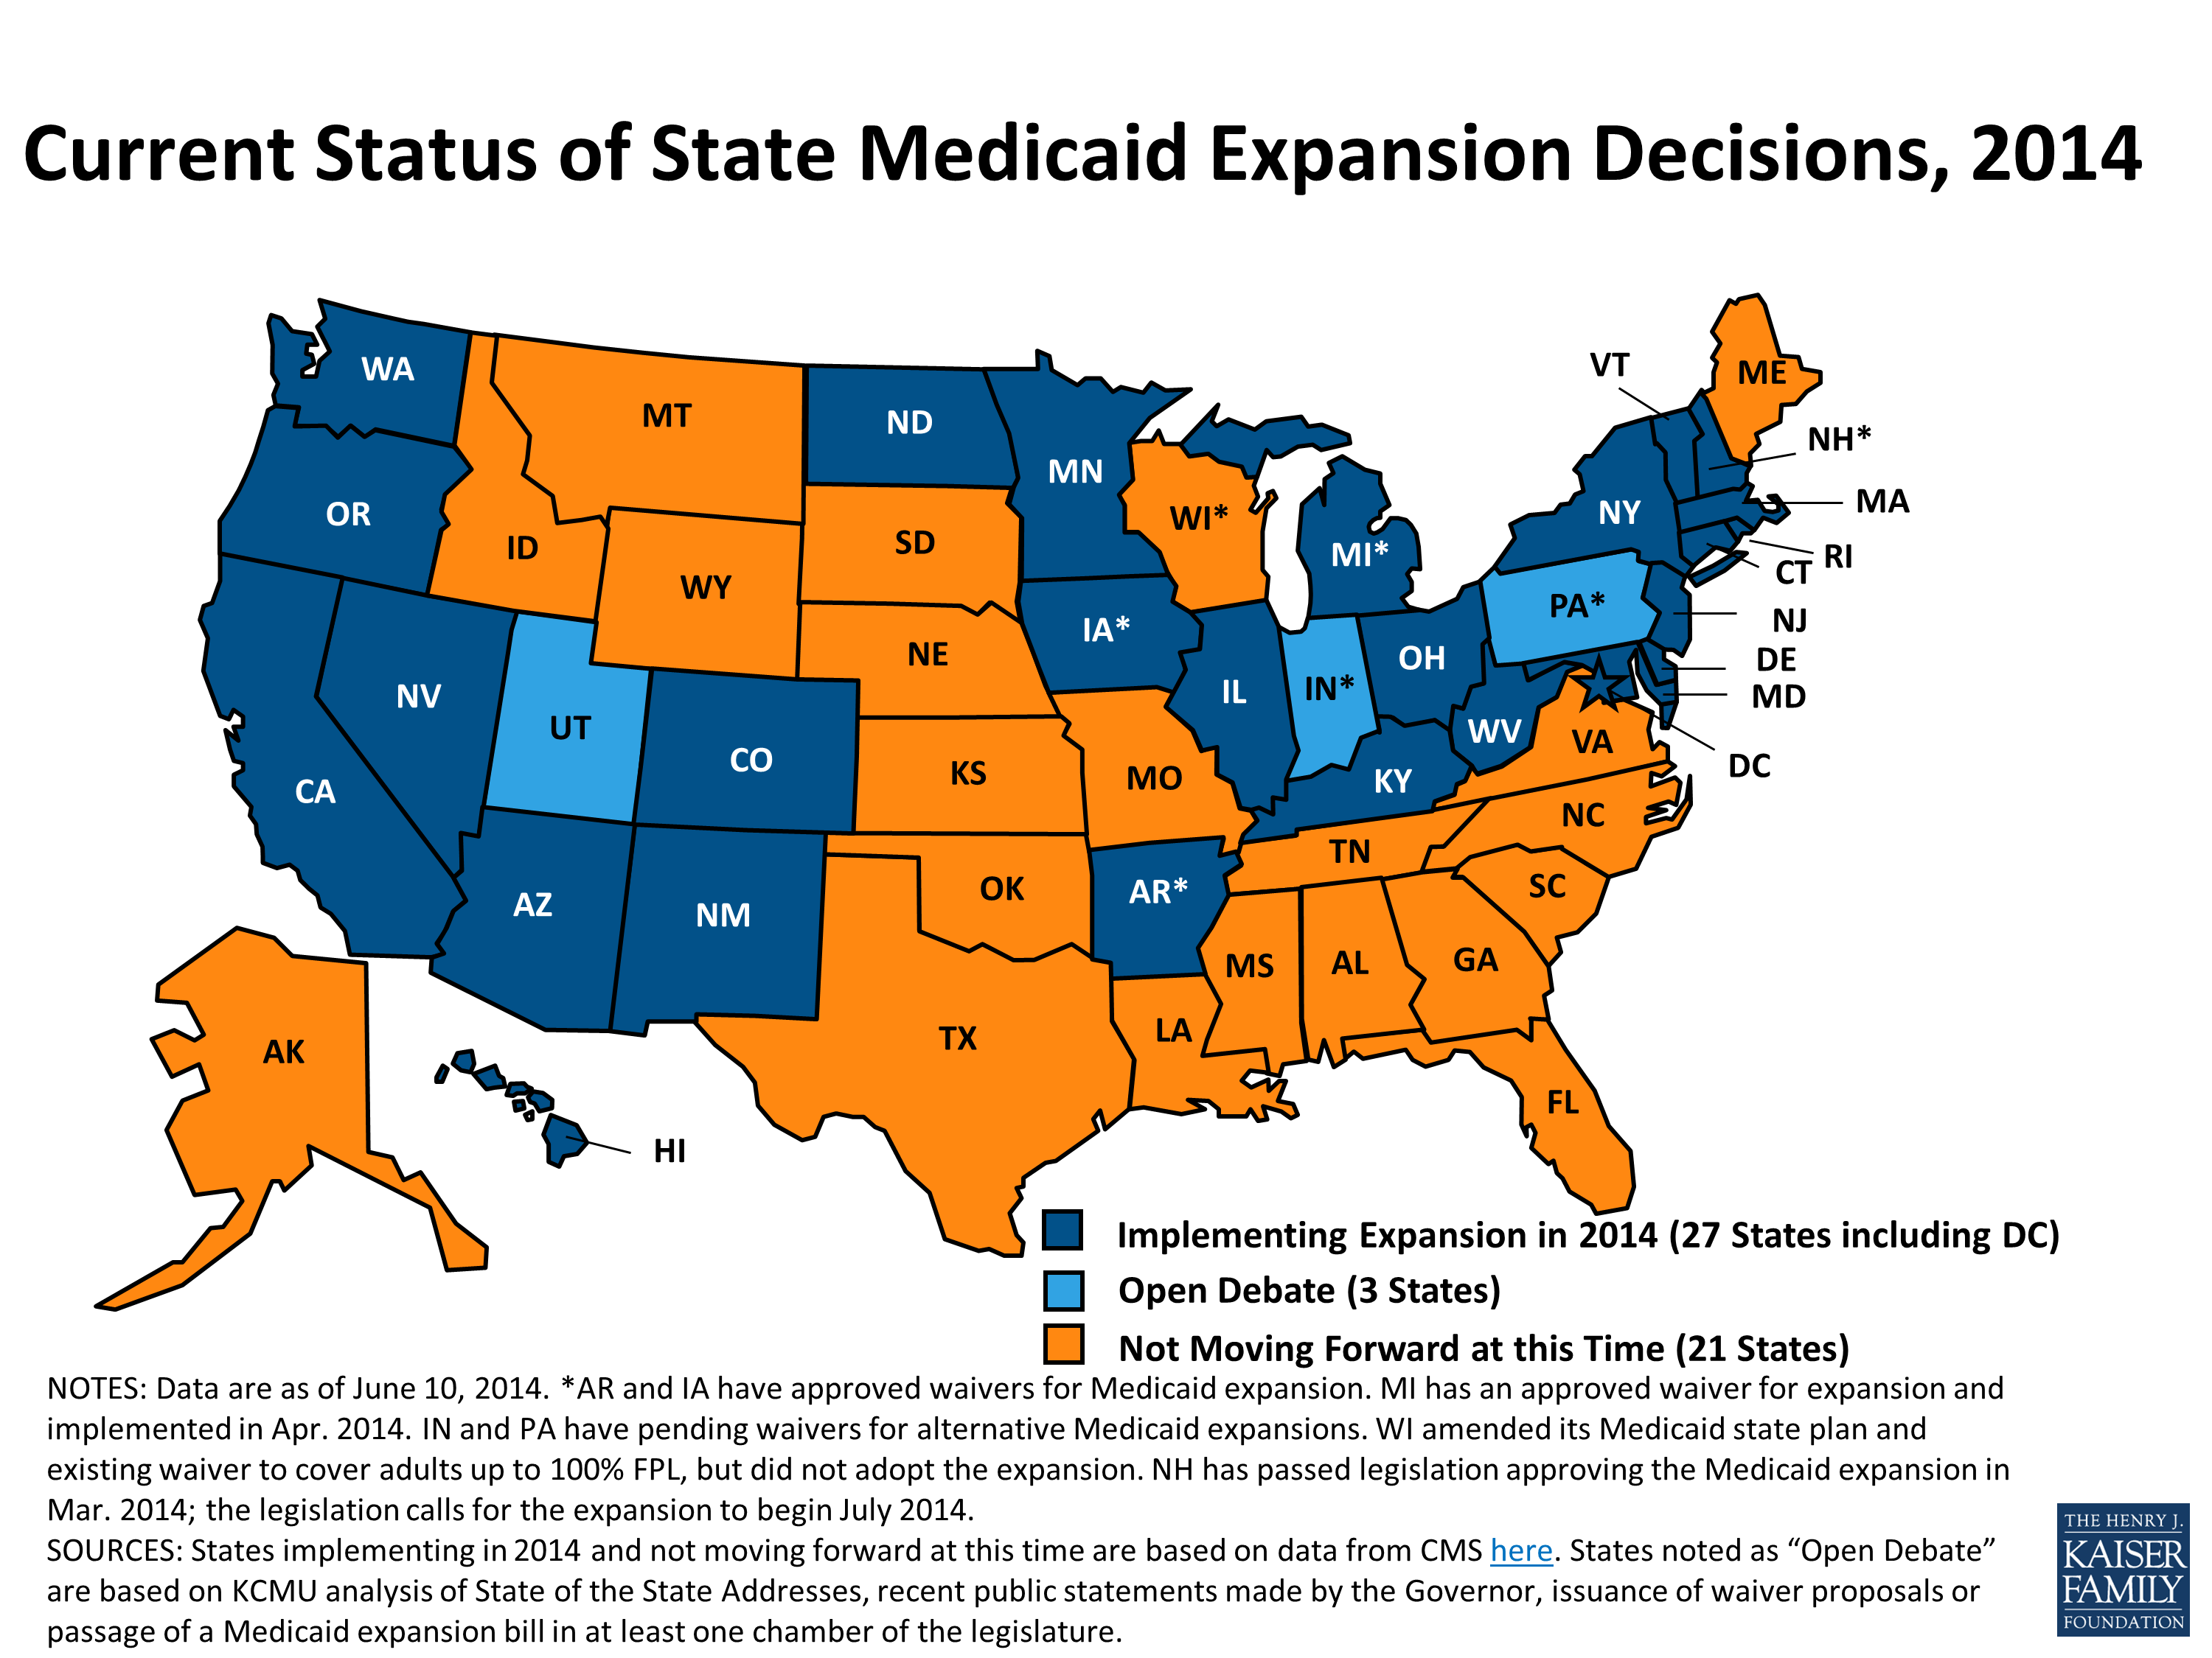

Slide 8
Why does this matter:
59%: Almost six-in-ten uninsured Americans live in states that haven’t set up their own health-insurance exchanges under the Affordable Care Act.

Slide 9
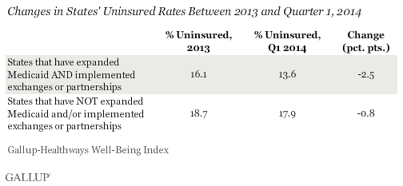
Why does this matter?

Slide 10
What are the benefits of establishing an exchange?
Smaller and more nimble, can respond to problems better.

Slide 11
“Individual state operations are more adaptable … That does not mean that states get everything right. But they can respond more quickly to solve problems as they arise.”
Alan R. Weil
Executive Director
National Academy for State Health Policy

Slide 12
What are the benefits of establishing an exchange?
Smaller and more nimble, can respond to problems better.
Different decisions on website operations
  e.g. some states allowed individuals to shop without creating accounts
Coordination
  Exchange – Medicaid intersection
  Exchange – Private insurance market intersection
Control of exchange insurance markets

Slide 13
What type of exchange does each state run?
Two fundamental models of insurance competition in market
  Actually they represent two ends of a continuum
“Clearinghouse”
  Any plan that meets basic qualifications can offer plans on the exchange
  9 states
“Active purchaser”
  The state serves as the negotiator for premiums and benefits
  6 states

Slide 14
Why active purchasing?
Fears of market failure
  Asymmetric information
Use an agent to negotiate on behalf of a large number of potential subscribers
Hope that this agent can represent the preferences of the subscribers

Slide 15
“Managed competition must involve intelligent, active collective purchasing agents contracting with health care plans on behalf of a large group of subscribers and continuously structuring and adjusting the market to overcome attempts to avoid price competition”
- Alain Enthoven

Slide 16
Why a clearinghouse?
Allow competition to operate unfettered
Trust that a well-designed website will provide the necessary information for informed purchase decisions
May lead of a greater amount of innovation in benefit design

Slide 17
A final reason to run a state exchange
Potential ambiguity in the law about whether enrollees on the federal exchange qualify for subsidies
Recent rulings in Halbig v. Burwell and King v. Burwell offer conflicting decisions.
  Many think that the DC Circuit en banc panel will overturn the three judge panel’s ruling
What if en banc also relies on chevron deference?

Slide 18
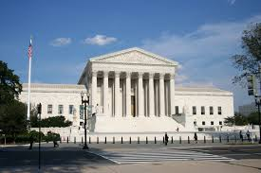

Slide 19
