Slide 1
v
One week program:
Doing Business in Mexico 2013
(Emerging Markets development)
FULL TIME MBA
IPADE Business School International Office Beatriz Guzmán, Director bguzman@ipade.mx
Rosa Garcidueñas, Manager rgarciduenas@ipade.mx

Slide 2
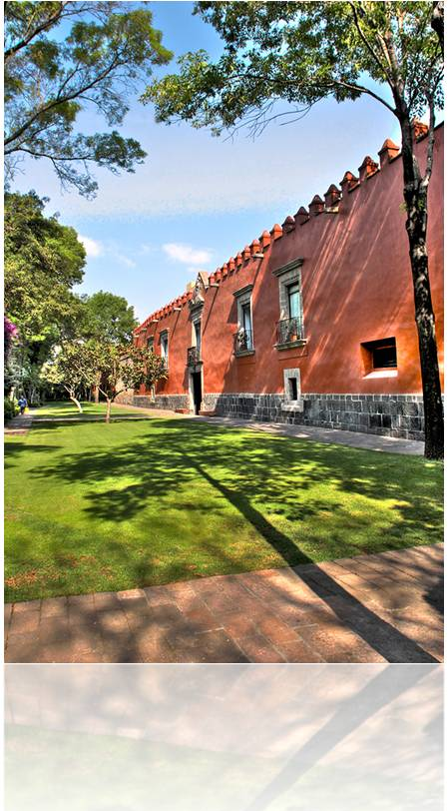
IPADE’s Foundational Principles
IPADE was founded in 1967 by a group of prominent Mexican businessmen with the strategic guidance from Harvard Business School (HBS) and IESE Business School – life long associates through an Advisory Committee –
To bring top management practices to a professional level.
To encourage self improvement, and help top managers carry out their ethical and social responsibilities.
To offer an international business perspective.
P R O G R A M
FULL TIME MBA, INTERNATIONAL EXPERIENCE

Slide 3
An integral perspective in practical learning
IPADE is the only business school founded from the enterprise, for the enterprise. It is the only business school world wide with this model.
Case Method Study: integrating individual study, teamwork and plenary sessions.
Faculty Expertise that combines a full time dedication at IPADE and a strong interaction with the business place.
Strong Selection of the Students, allows to achieve a very high academic standard. The lowest admissions rate in all Latin-America.
P R O G R A M
FULL TIME MBA, INTERNATIONAL EXPERIENCE

Slide 4
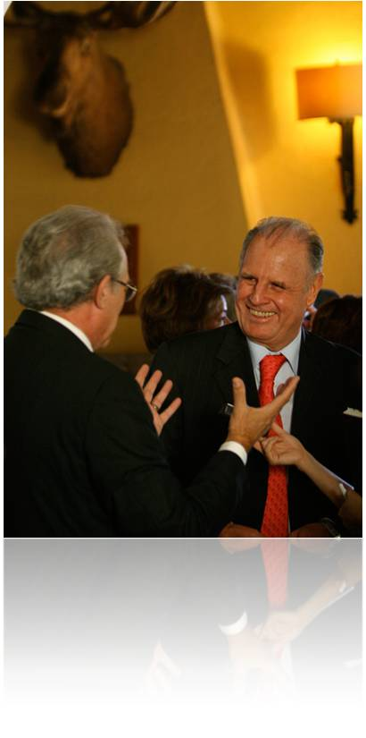
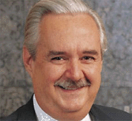
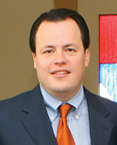
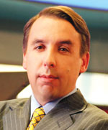
Continuing Education and Alumni network
Alumni continuing Education Program; giving the alumni the opportunity to be up dated. 10 Topics in 2 sessions per month throughout the year.
Biggest alumni network and top business connections in Mexico and Latin America, gives our alumni the benefits of an IPADE community in workplace and business opportunities.
Lorenzo Zambrano
CEO
CEMEX
Luis Berrondo
CEO
MABE
Emilio Azcarraga
CEO
Grupo Televisa
Marcos Martínez
CEO
Banco Santander México
Ramón Zapata
Financial Operations Worldwide
Novartis
P R O G R A M
FULL TIME MBA, INTERNATIONAL EXPERIENCE

Slide 5
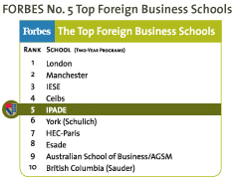
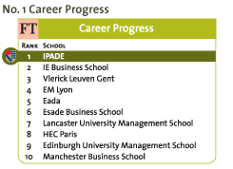
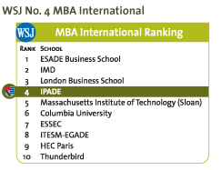
IPADE´s Full-Time MBA Program World Rankings, Accreditations and Associations
American Association of State Counseling Boards
European Quality Improvement System*
European Foundation for Management Development
Graduate Management Admission Council
Public Education Ministry (Mexican government)
P R O G R A M
FULL TIME MBA, INTERNATIONAL EXPERIENCE

Slide 6
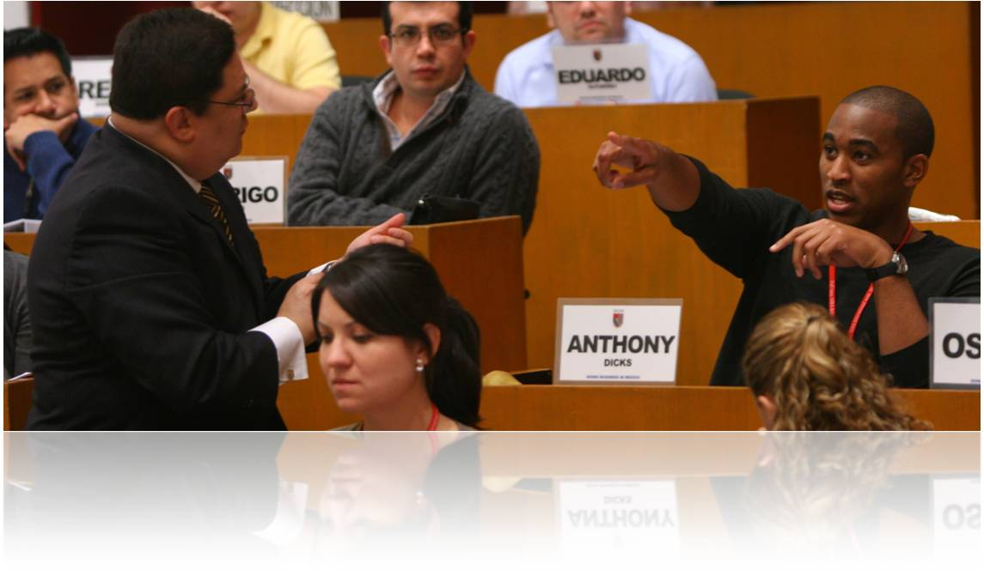
One Week Program
Doing Business in Mexico 2013
(Emerging Markets development)
Video links
IPADE. http://www.ipade.mx/Pages/visualizadorvideos.aspx?category=Videos%20MBA|MBA%20Videos&videoID=63
YouTube. http://www.youtube.com/watch?v=l8FrgfECwT4
P R O G R A M
FULL TIME MBA, INTERNATIONAL EXPERIENCE

Slide 7
Objective:
(Emerging Markets development)
Questions behind the Program:
How to do business in Mexico in different sectors?
How to identify and develop entrepreneurial opportunities?
How to use your talent as MBAs to create entrepreneurial opportunities in Mexico?
How do emerging markets behave and develop.
To give MBA International Students the opportunity to live the Mexican Business Culture in a short period of time, plus the possibility of an enriching interaction with other international and Mexican MBA Students. To explore issues that affect Mexico and the relationship with other countries in the world.
P R O G R A M
FULL TIME MBA, INTERNATIONAL EXPERIENCE

Slide 8
Why a week about Doing Business in Mexico? Because…
Mexico is a leader in development of emerging markets in Latin America with at least 35 multilateral commerce trades.
Mexico has 12 Free Trade Agreements (FTA) with over 40 countries including Guatemala, Honduras, El Salvador, the European Free Trade Area and Japan.
Mexico, according to experts, will have a foreign investment for 2009 of 2,500 million dollars, with the creation of 7,480 new jobs in the short and medium term.
Mexico is a hob for Latin America having one of the largest GDP growth in the last 6 years.
Mexico exports more than 90% of its goods under the FTA.
It offers the opportunity to live in Mexico City and its surroundings; experience the contrast between the pre-Hispanic, Colonial and Modern culture.
P R O G R A M
FULL TIME MBA, INTERNATIONAL EXPERIENCE

Slide 9
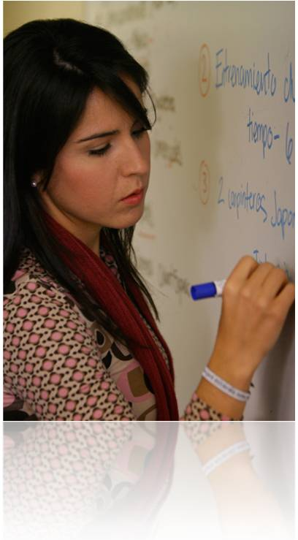
Preliminary academic content
Mexican Politic and Economic Environment. Analysis of today’s politic and economic environment.
Scotiabank Case. The merge of two cultures into one organization, Mexican and Canadian (Human Resources).
Gas Metropolitano Case. A company fighting a corrupted sector and the controlling to avoid it (Control).
Mexican Businessmen psychology. Styles of management and human profile and the impact of doing business together (Organizational Behavior).
Interlingua Case. Management and profile of Mexican franchises (Management Control).
Volaris Case. Operations in a low budget Airline (Operations Management).
P R O G R A M
FULL TIME MBA, INTERNATIONAL EXPERIENCE

Slide 10
Week costs per student (prices in US dollars)
 | Hotel Marquis Reforma (red carpet hotel) www.marquisreforma.com |  | Wyndham Hotel Polanco (four star hotel) www.wyndhampolanco.com.mx
 | Double room | Single room | Double room
Hotel (6 nights) | $565 | $1000 | $400
All transportation (Buses) | $ 60 | $ 60 | $ 60
Cultural Activities | $ 45 | $ 45 | $ 45
Translation/material fees | $ 50 | $ 50 | $ 50
Total cost per student | $720 | $1,155 | $555
March, 11th To 15th, 2013
Registration deadline January 15th, 2013
Breakfast and lunch included
School’s Library, Computer lab and printers no extra charge
Student’s responsibility expenses: dinner, travel to Mexico, airport-hotel-airport transportation
P R O G R A M
FULL TIME MBA, INTERNATIONAL EXPERIENCE

Slide 11
One Week Program’s Structure
Five Business – Academic sessions: | IPADE professors will give three introductory conferences about Mexican Tourism and its consequences in the economic, political and social environments. To complement these knowledgeable sessions professors will deliver two live case studies of leading tourism enterprises in Mexico.
Five conferences by guest Businessmen: | Invited businessmen from the Tourism sector will come and share their experiences.
Three visits to leading companies in Mexico: | Our program includes visits to successful companies in the Tourism sector, allowing students to familiarize themselves with the “day-to-day” operations and key factors of these enterprises in Mexico.
Assigned team projects: | IPADE offers students the invaluable opportunity to interact with colleagues from Mexico and abroad. Engaging the students in two assigned projects (a visit to a company and a real life team presentation), which will enable them to establish a more meaningful relationship with our country and culture.
Intercultural and social activities: | Students will have the opportunity to interact socially and culturally through three organized events:
 | Doing Business in Mexico Mexican food tasting. Guided tour of the Anthropology Museum. A Mexican farewell lunch.
P R O G R A M
FULL TIME MBA, INTERNATIONAL EXPERIENCE

Slide 12
Working load (credits and contact hours)
3.7 US credits / ECTS 6 | Sessions | Contact hours | Independent hours
Business Academic Sessions | 5 | 7 | 6.7
Conference Sessions | 5 | 7 | 6.7
Company Sessions | 3 | 4
Company Visits | 3 |  | 10
Intercultural activities | 2 | 3
Assigned Projects | 2 |  | 15
Teamwork | 5 |  | 15
Total | 25 | 21 | 53.4
Requirements to receive credits:
100% attendance
Active participation in sessions and conferences
Teamwork assignments (two)
P R O G R A M
FULL TIME MBA, INTERNATIONAL EXPERIENCE

Slide 13
Team projects (IPADE and visiting students mixture)
To generate a SWOT (Strengths, Weaknesses, Opportunities and Threats) analysis of a Mexican business and develop a strategic plan to duplicate the Business Model in the global market.
To give a live presentation with the conclusions and take aways of the week.
P R O G R A M
FULL TIME MBA, INTERNATIONAL EXPERIENCE

Slide 14
School Participating
Cranfield School of Management UK
Darden Graduate School of Business Administration USA
Endicott College USA
ENPC School of International Management France
Essec France
IESE Business School Spain
Instituto COPPEAD de Administracao Brazil
IPADE Business School Mexico
Kellogg School of Management USA
La Trobe International Australia
Marshall School of Business USA
Owen Graduate School, Vanderbilt University USA
PAD, Escuela de Dirección Peru
Politecnico di Milano MIP-School of Management Italy
Pontificia Universidad Católica de Chile Chile
Queen’s University Canada
Rice University, Jones School MBA USA
Rotman School of Management Canada
School of Business, Hong Kong Baptist University Hong Kong
Simon Graduate School of Business, University of Rochester USA
SMU COX School of Business USA
The George Washington University School of Business USA
UNC’s Kenan-Flagler Business School USA
Universidad de Chile Chile
Universitá Commerciale Luigi Bocconi Italy
University of Illinois at Urbana-Champaign USA
Warwick Business School UK
Yonsei University School of Business South Korea
We expect 170-180 students
P R O G R A M
FULL TIME MBA, INTERNATIONAL EXPERIENCE

Slide 15
Why is Mexico the Choice
P R O G R A M
FULL TIME MBA, INTERNATIONAL EXPERIENCE

Slide 16
Mexico is open for trade
North American Free Trade Agreement (NAFTA) (1994): Canada and USA.
Colombia and Venezuela, also called G-3 Free-Trade Agreement (1995).
Costa Rica Free-Trade Agreement (1995).
Bolivia Free-Trade Agreement (1995).
Nicaragua Free-Trade Agreement (1998).
Chile Free-Trade Agreement (1999).
EU (European Union) Free-Trade Agreement (2000).
Israel Free-Trade Agreement (2000).
Mexico, Guatemala, El Salvador and Honduras, also called TN Free Trade Agreement (2001).
Iceland, Norway, Liechtenstein, also called AELC (Asociación Europea de Libre Comercio) Free-Trade Agreement (2001).
Uruguay Free-Trade Agreement (2004).
Japan Free-Trade Agreement (2005).
Mexico has a North American Free Trade Agreement (NAFTA) that gives business and entrepreneurial opportunities for American and Canadian MBA’s
Mexico is currently the country with most free-trade agreements in the world.
P R O G R A M
FULL TIME MBA, INTERNATIONAL EXPERIENCE

Slide 17
Mexico, gateway to…
North America
Low rates, benefits when manufacturing in Mexico.
$146 billion US currently exported to the region.
Business relationships already established.
Mexico’s land transportation network is one of the most extensive in Latin America.
Mexico’s ports have experienced an investment and traffic boom following a 1993 law that privatized the port system.
Latin America
Trade Agreements Network.
Business leadership, strongest economy in Latin America.
Strategic geographic location.
Language.
P R O G R A M
FULL TIME MBA, INTERNATIONAL EXPERIENCE

Slide 18
Top Mexican Global Firms
América Móvil Telecommunications Services
CEMEX Construction
Carso Global Telecom Telecommunications Services
FEMSA Food, Drink & Tobacco
Grupo México Materials
Grupo Carso Conglomerates
Grupo Modelo Food, Drink & Tobacco
GFNorte Banking
Grupo Televisa Media
Inbursa Financiero Banking
ALFA Conglomerates
Grupo Elektra Retailing
Grupo Bimbo Food, Drink & Tobacco
Industrias Peñoles Materials
Liverpool Retailing
Soriana Retailing
P R O G R A M
FULL TIME MBA, INTERNATIONAL EXPERIENCE

Slide 19
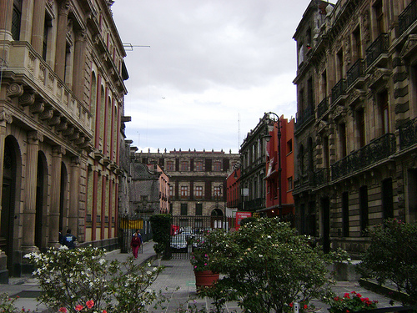
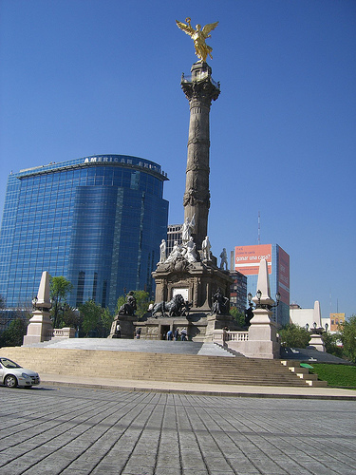
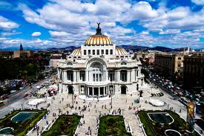
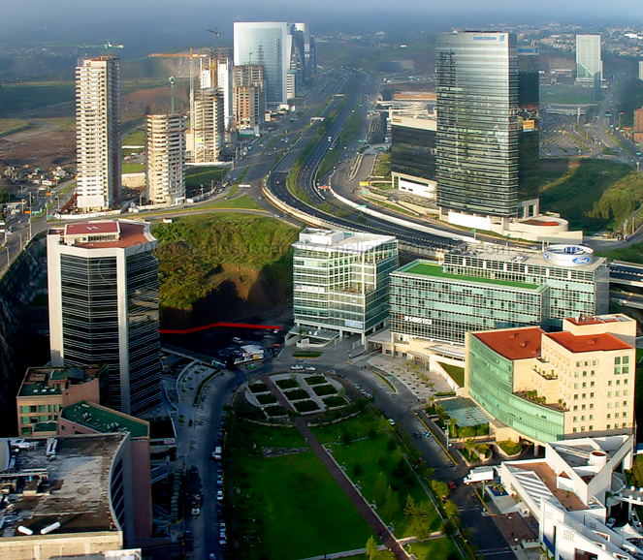
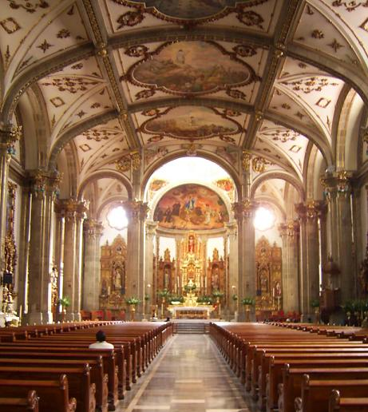
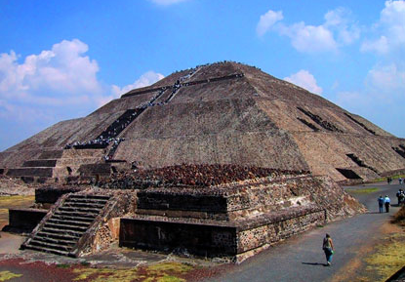
An opportunity to enjoy the city
P R O G R A M
FULL TIME MBA, INTERNATIONAL EXPERIENCE

