Slide 1

Carrie Banahan
Executive Director
September 4, 2014

Slide 2

Over 640,000 uninsured Kentuckians
Increase Access and Affordability to Coverage
Medicaid Expansion
KY Health Report Card - opportunity for improvement
47 – High Blood Pressure
48 – Diabetes
50 – Smoking/Lung Caner
State Based Exchange
45 - Outcomes Rank

Slide 3

Kentucky’s uninsured
640,000 are currently uninsured:
300,000 may qualify for Medicaid under the new eligibility rules
290,000 may qualify for premium assistance through the Exchange
Estimates as of 2012
640,000 are uninsured (15.5%)
593,800 <65 are uninsured (16.2%)
Estimated that 308,000 may qualify for Medicaid under the new eligibility rules
Estimated that 290,000 may qualify for premium assistance through the Exchange
Estimated that 50,000 may purchase insurance on the Exchange without subsidy

Slide 4
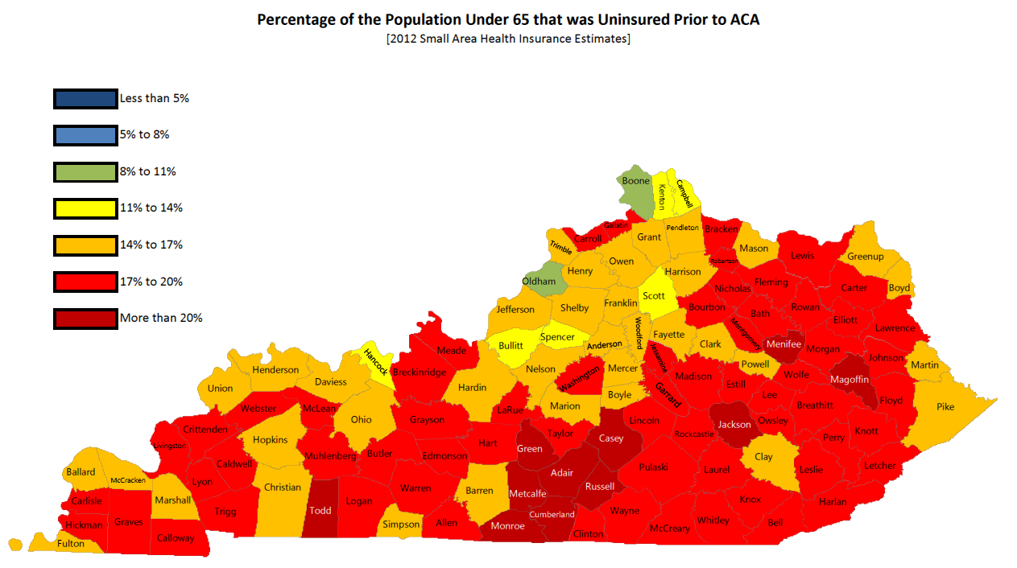

Slide 5

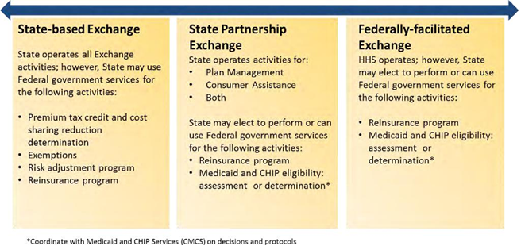
Exchange Options for States

Slide 6

Why Kentucky pursued a
State Based Exchange instead of a Federal Exchange?
Support from interested stakeholders
Prevent dual regulation of the health insurance market
Determine benefits and services provided in Kentucky’s Exchange
Allows Kentucky to have flexibility, including determinations of Medicaid eligibility
Consider Kentucky’s unique regional and economics needs

Slide 7

Creation of Kentucky Health Benefit
Exchange (kynect)
Executive Order signed by Governor Beshear July 17, 2012 created the Exchange and the administrative structure
State Agency housed in the Cabinet for Health and Family Services
Establishment of an Advisory Board
Ability of Advisory Board to create sub-committees

Slide 8
Kentucky Health Benefit Exchange Advisory Board
19 Member Board
Six subcommittees formed:
  - Behavioral Health
  - Dental and Vision
  - Education and Outreach
  - Navigator/Agent
  - Qualified Health Plans
  - Small Employer Health Options Program (SHOP)
Meetings open to the public, schedules and materials posted on the website (healthbenefitexchange.ky.gov).

Slide 9

Factors Resulting in kynect’ s Success
Early Planning
kynect Culture
System Design and Management
Outreach and Education

Slide 10
kynect Early Planning
Received planning grant from HHS in September 2010.
Weekly meetings with Medicaid agency, Community Bases Services, Insurance Department, and IT staff.
Completed system gap analysis.
Held JAD sessions to develop and design system.

Slide 11
kynect Culture
Governor Beshear supportive and committed in the cause to insure Kentuckians
kynect staff are dedicated to the project and are united in the cause to insure Kentuckians
Partnership between executive, business, and technology teams is critical
Technology team embraced as equal partner in this endeavor

Slide 12
kynect System Design and Management
Simplistic, balanced design with multiple application paths
Recognized broad, diverse customer base and high-volume
Launched multiple, complex, systems within a compressed timeframe
Completed extensive system testing
Selection of a capable IT system vendor
Oversight and management of IT system vendor

Slide 13
kynect Outreach and Education
Unique kynect Branding
Comprehensive Advertising Campaign
Multiple Entry Channels
State-wide Mobile Tour
Proactive kynectors and Insurance Agents
Robust Media Coverage

Slide 14
What is kynect ?
An organized marketplace for individuals and employees of small businesses to shop for health insurance offered by insurers (insurance companies, CO-OPs and OPM plans), and compare those plans based on price and quality. Individuals may also apply for Medicaid or the Kentucky Children’s Health Insurance Program (KCHIP) coverage through the Exchange.
The Affordable Care Act requires states to create their own exchanges or default to a federal exchange. Kentucky opted to create its own.

Slide 15
kynect Health Insurer Participation
Individual Plans
  Anthem
  Kentucky Health Cooperative
  HUMANA
Individual | Catastrophic | Bronze | Silver | Gold | Platinum | Total
Anthem | 1 | 5 | 4 | 1 | 0 | 11
Co-Op | 1 | 1 | 1 | 1 | 1 | 5
HUMANA | 4 | 4 | 4 | 4 | 4 | 20
Anthem OPM |  |  | 1 | 1 |  | 2
Total | 6 | 10 | 11 | 7 | 5 | 38

Slide 16
kynect Dental Insurer Participation
Individual Plans
  Anthem
  Best
  Dental Concern
Individual | Low | High | Total
Anthem | 2 | 2 | 4
Best | 3 | 3 | 6
Dental Concern | 1 | 1 | 2
Total | 6 | 6 | 12

Slide 17
kynect Health Insurer Participation
Small Group Plans
  Bluegrass Family Health
  Kentucky Health Cooperative
  Anthem
  United HealthCare
Small Group | Bronze | Silver | Gold | Platinum | Total
Anthem | 2 | 2 | 2 |  | 6
Co-Op | 1 | 1 | 1 |  | 3
Bluegrass | 2 | 4 | 4 | 2 | 12
United | 1 | 1 | 1 |  | 3
Total | 6 | 8 | 8 | 2 | 24

Slide 18
kynect Dental Insurer Participation
Small Group Plans
  Anthem
  Best
  Guardian Life
Small Group | Low | High | Total
Anthem | 2 | 2 | 4
Best | 3 | 3 | 6
Guardian | 2 | 2 | 4
Total | 7 | 7 | 14

Slide 19
kynect MCO Participation
  Passport
  HUMANA
  WellCare
  Coventry
  Anthem

Slide 20
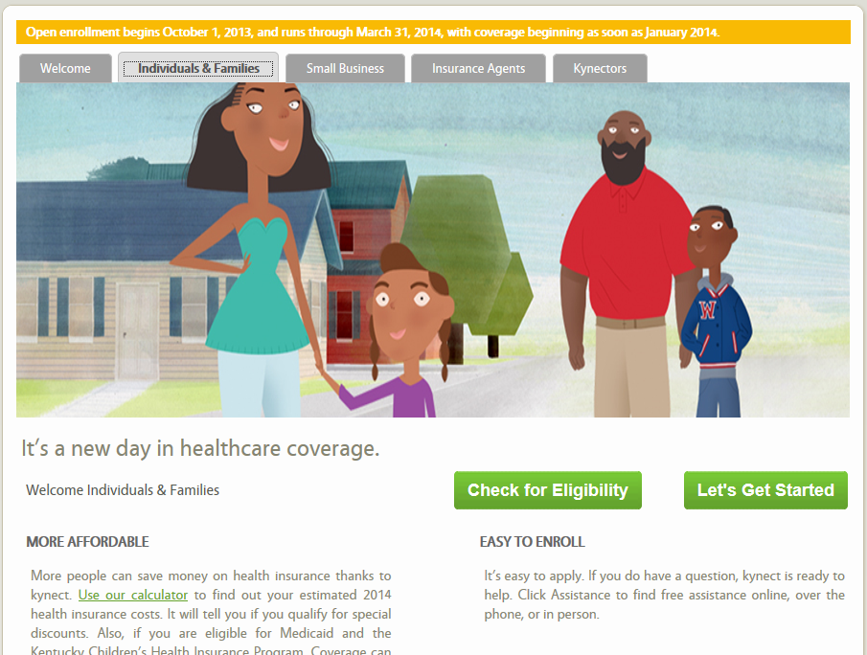
Consumer Welcome Page

Slide 21
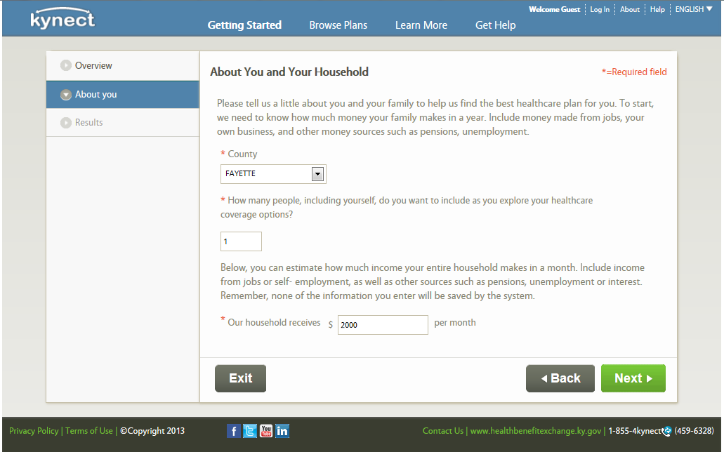
About You and Your Household

Slide 22
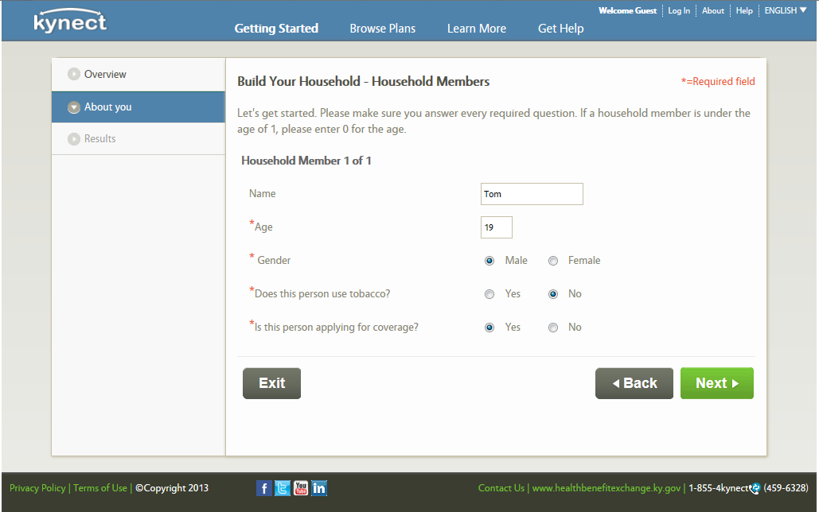
Build Your Household – Household Members

Slide 23
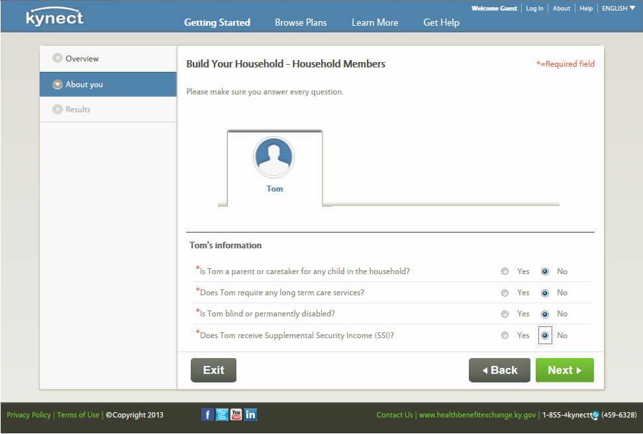
Build Your Household – Household Members

Slide 24
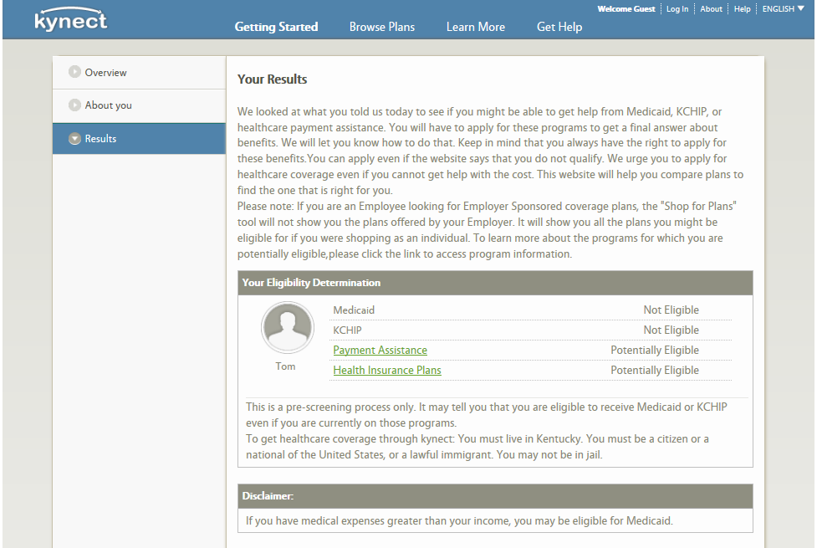
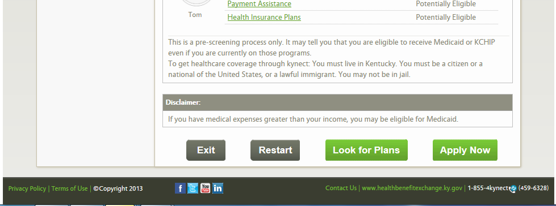
Your Results

Slide 25
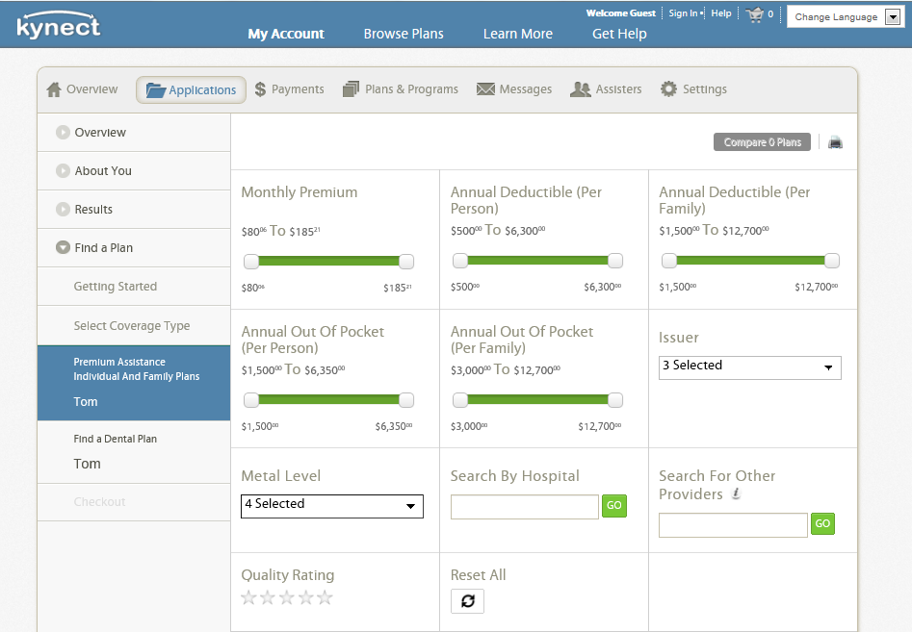
Shopping – Screen 1

Slide 26
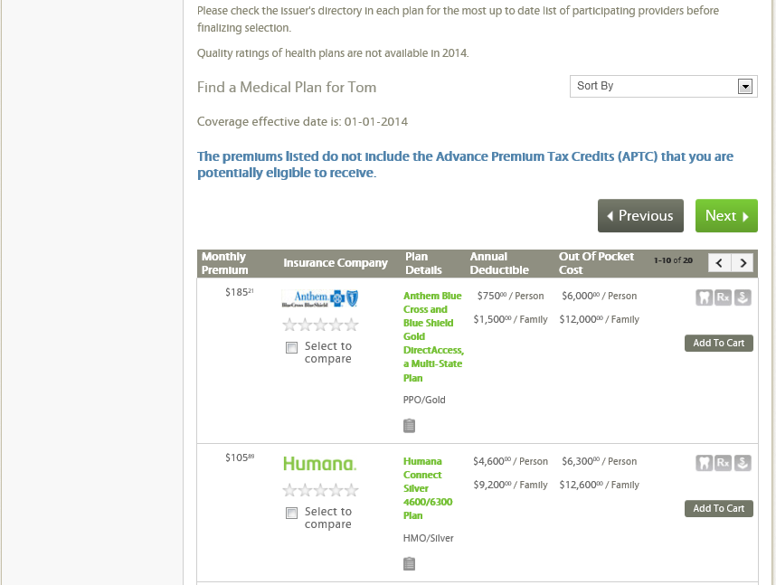
Shopping – Screen 2

Slide 27
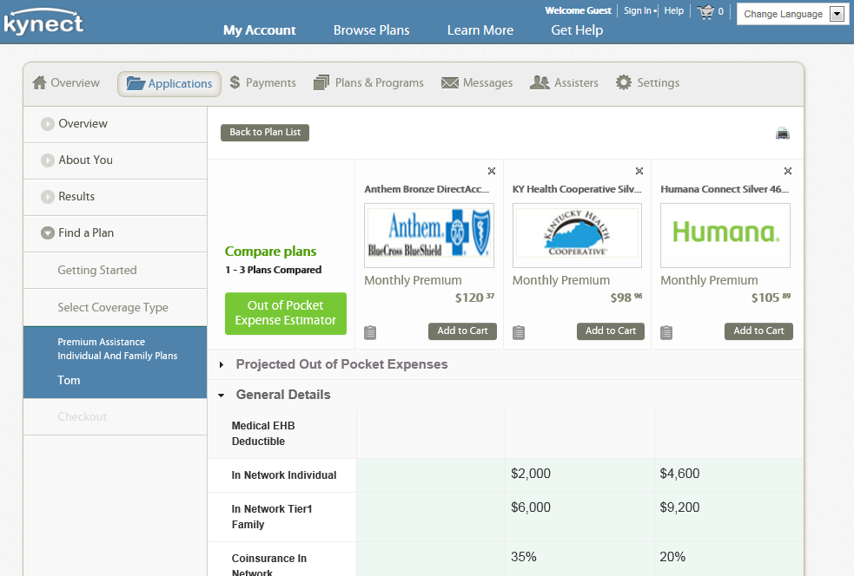
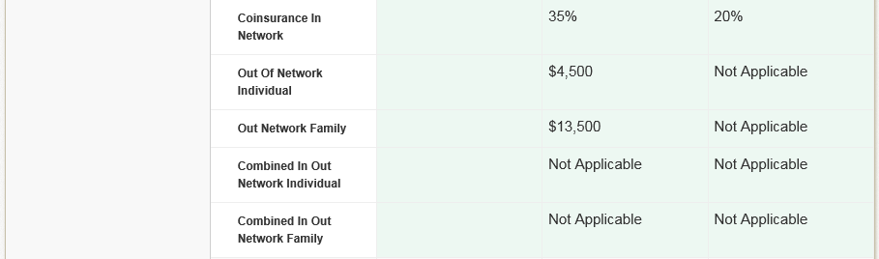
Compare Insurance Plans – Option 1

Slide 28
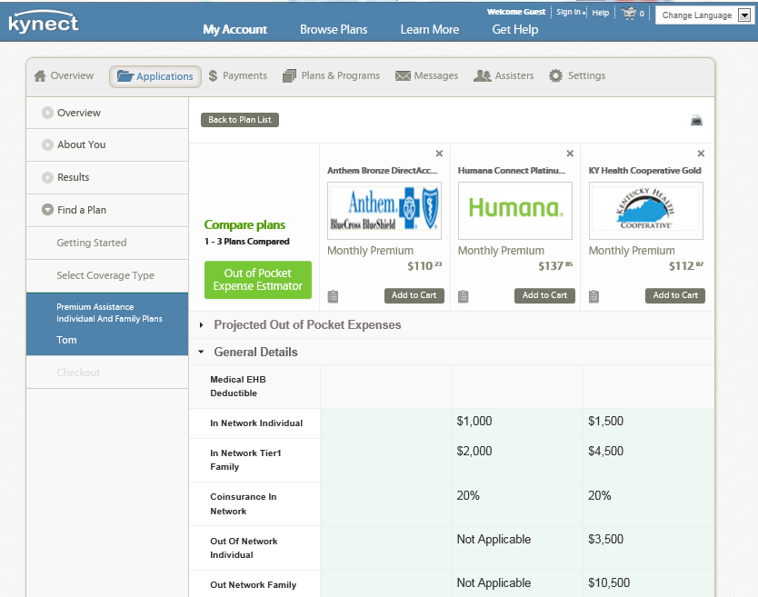
Compare Insurance Plans – Option 2

Slide 29
Kentucky’s uninsured
640,000 are currently uninsured:
300,000 may qualify for Medicaid under the new eligibility rules
290,000 may qualify for premium assistance through the Exchange
Business Metrics After Open Enrollment Over 413,000 enrolled in healthcare coverage through kynect (about 10% of Kentucky’s population)
  Approximately 330,600 Medicaid
  Approximately 83,000 enrolled in a QHP (72% received a subsidy)
52% are under the age of 35
Insurance plans – percent of QHP enrollments
  Kentucky Health Cooperative – 75%
  Anthem – 12.5%
  Humana – 12.5%

Slide 31
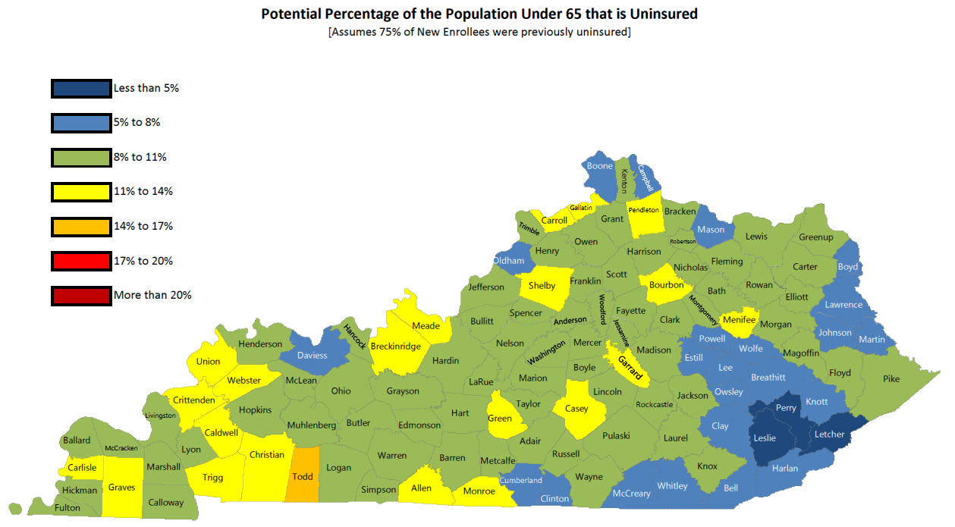

Slide 32


